Slide 1


ACS 567: Software Project Management
Spring 2009
Instructor: Dr. John Tanik

Slide 2
Assumptions and Constraints
Project is completed on an academic level
Only best estimate (not accurate) of the schedule and cost required
No coding is required
Project will not be implemented into the production phase
Project supposed to follow guidelines specified by the instructor
All the deliverables are supposed to be completed before the semester end date.

Slide 3
Contents
A statement of what our project is
The project organization.
The project management, estimation and control procedures.
The activities, schedule, and budget.
The risk management plan.
The test plan and web security plan.
The Quality assurance and verification and validation plan.

Slide 4
Project Organization
Kal Govindu | Deep Rauniyar | Tyson Maxwell
Project Manager - Programmer / Backend Engineer - Art Director/ Visual Designer | Assistant Project Manager Quality Assurance Lead Usability Lead | - Production Lead / Production Designer - Content Manager - Information Designer
**Responsibilities details are outlined in our PMP

Slide 5
Project Estimation
Effort Estimation
  Based on initial architecture, requirements, constraints and scope of the web project
  Outlined in Work Breakdown Structure
Cost Estimation
  Research into similar project of same size and complexity
  Major Cost Drivers: Employee salary, Services Utilized, Materials and Administrative Expenses

Slide 6
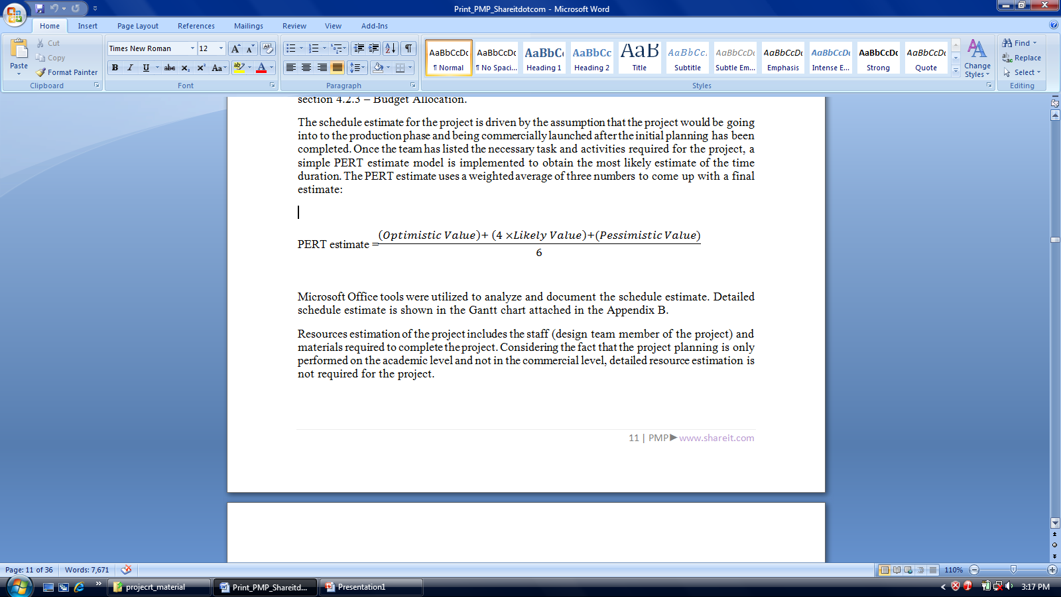
Project Estimation (Continued …)
Schedule Estimation
  Based on research into similar project
  Assumes the project will be taken into production phase and will be commercially launched.
  PERT estimation technique(Microsoft Office Tools)
Resource Estimation
  Staff members and Materials

Slide 7
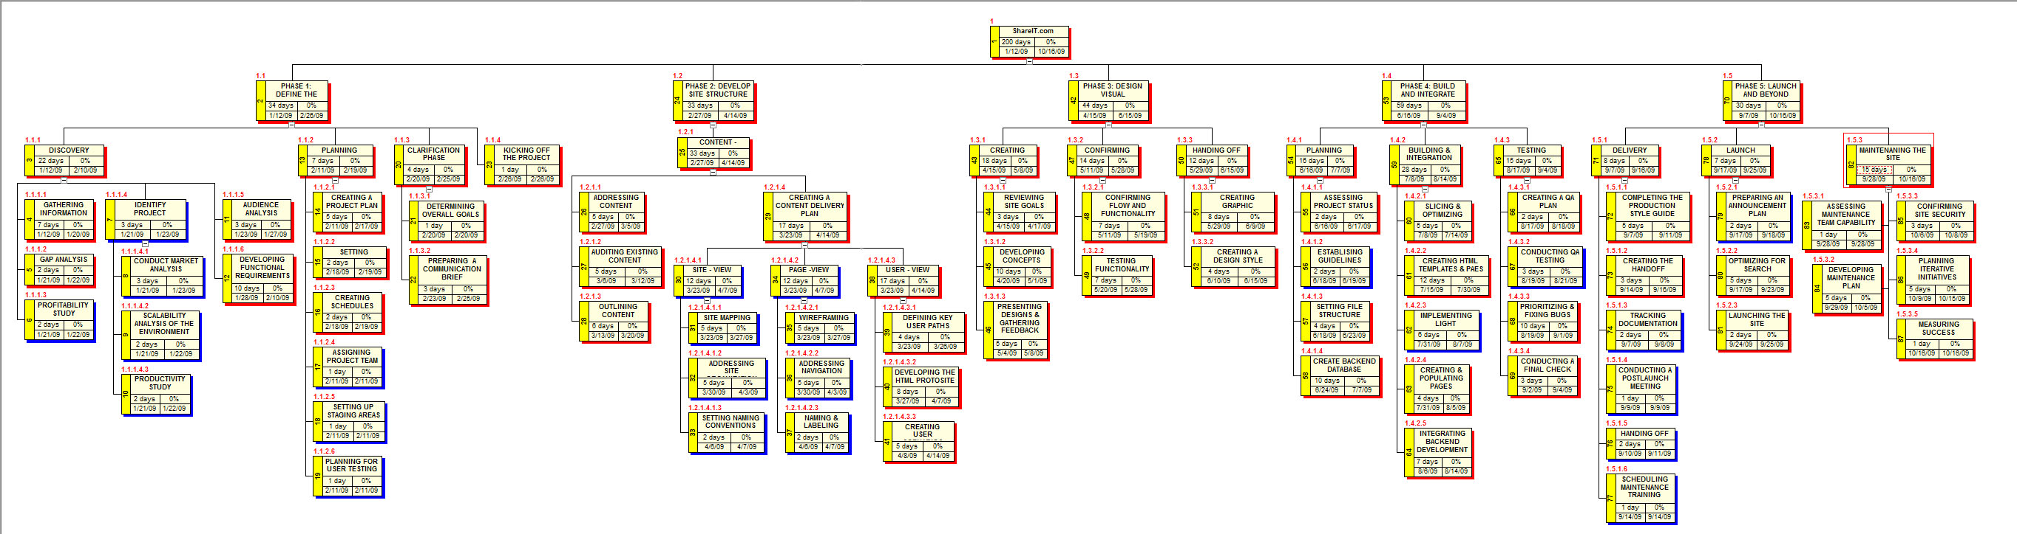
Work Plan - WBS
WBS – Defines the Scope of work
Next Step : WBS Dictionary and RAM ( Responsibility Assignment Matrix)

Slide 8
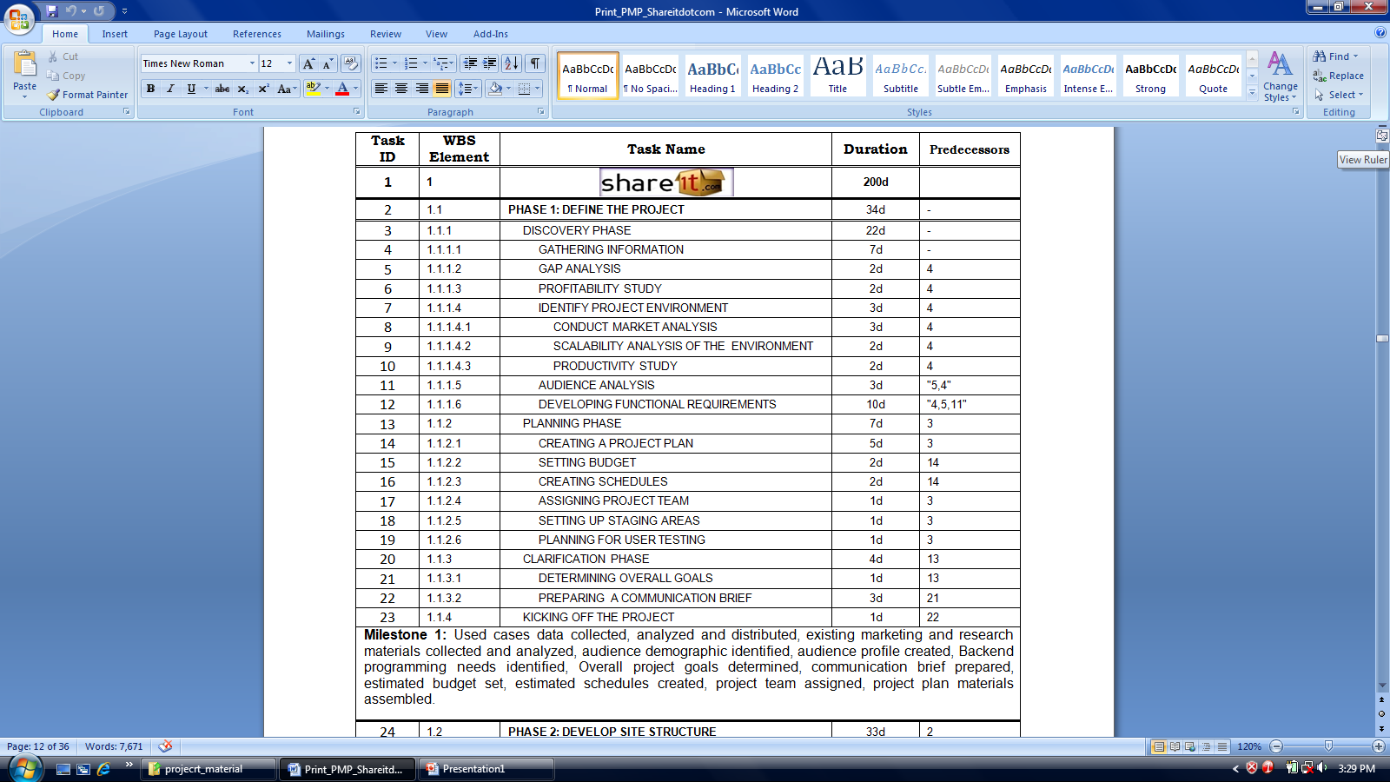
Work Plan – Schedule Dependencies
Detailed Schedule Dependencies is included in our PMP or Refer to our Project Web Site

Slide 9
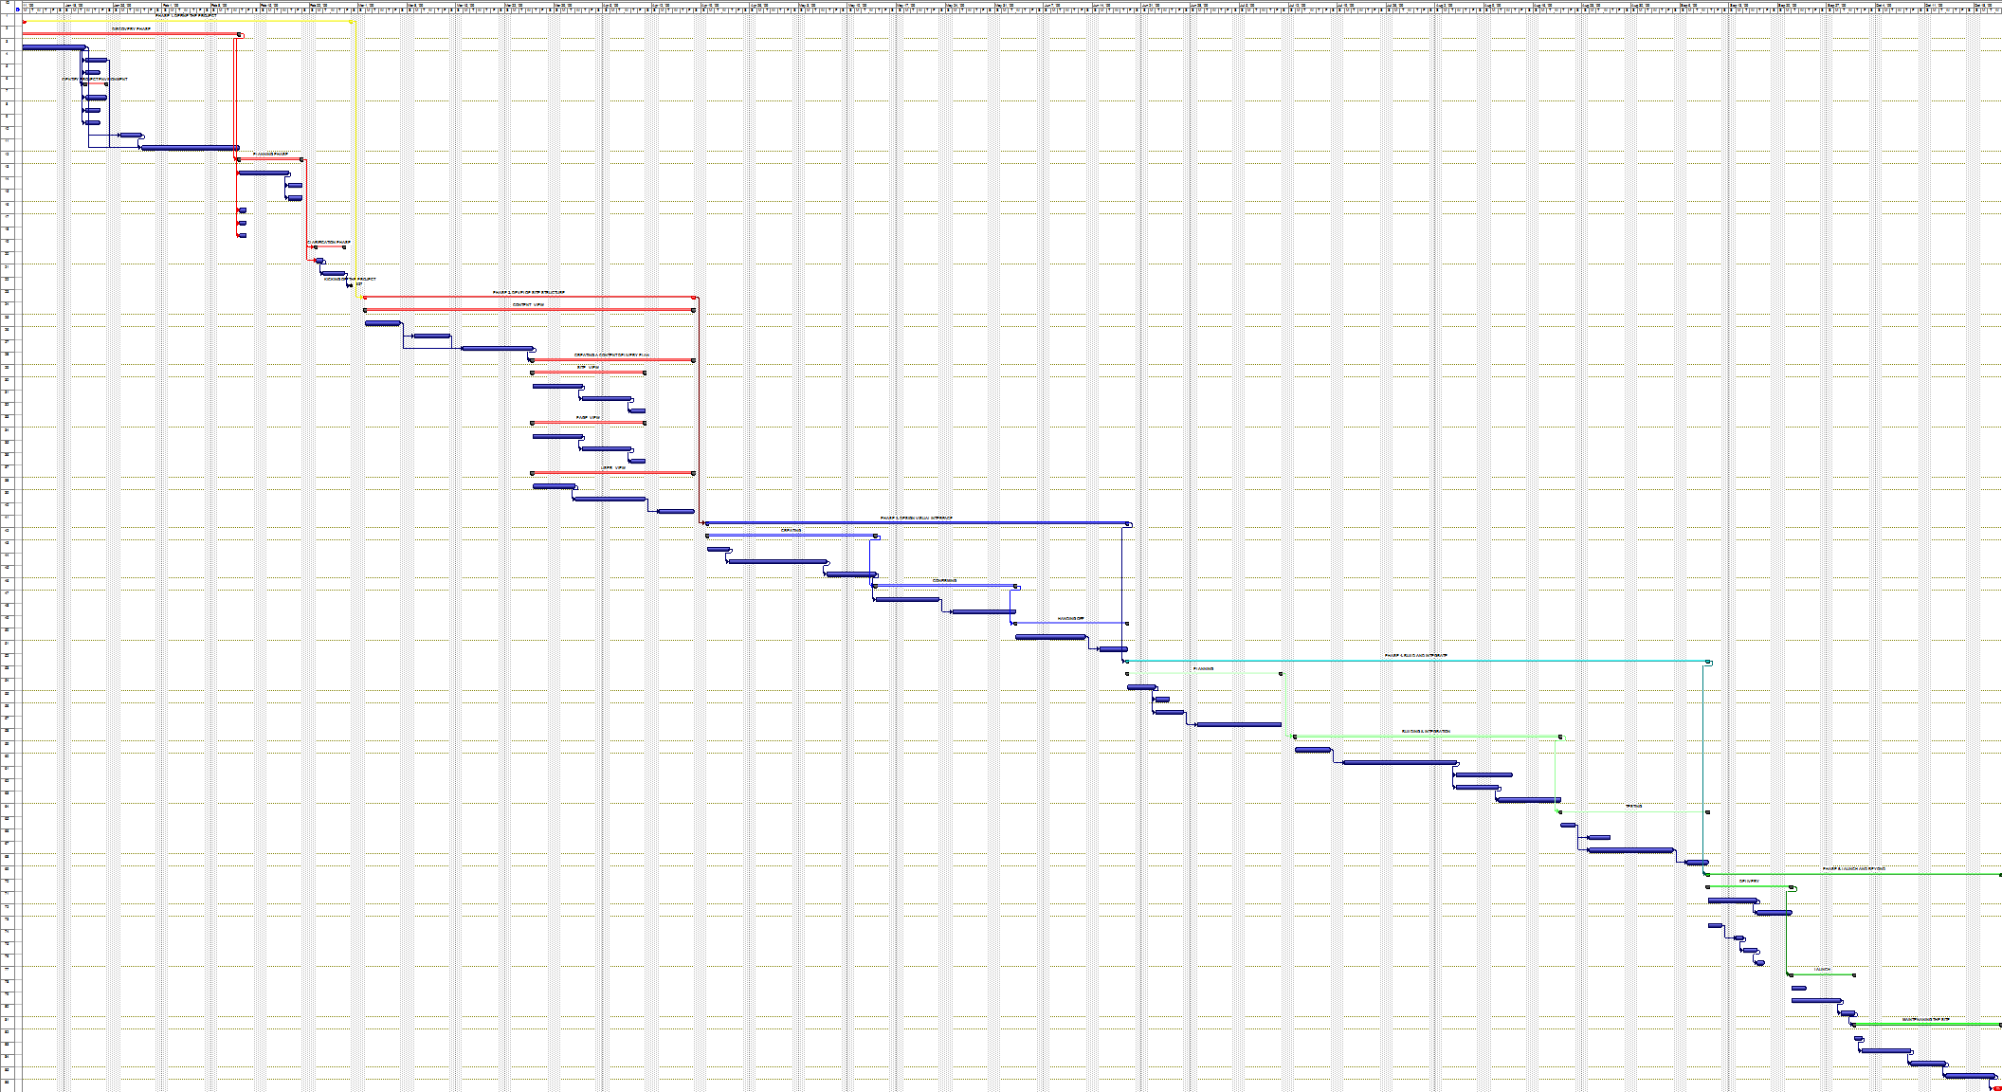
Work Plan – Gantt Chart
*For detail view & the Microsoft Office file refer to our Project Web Site

Slide 10
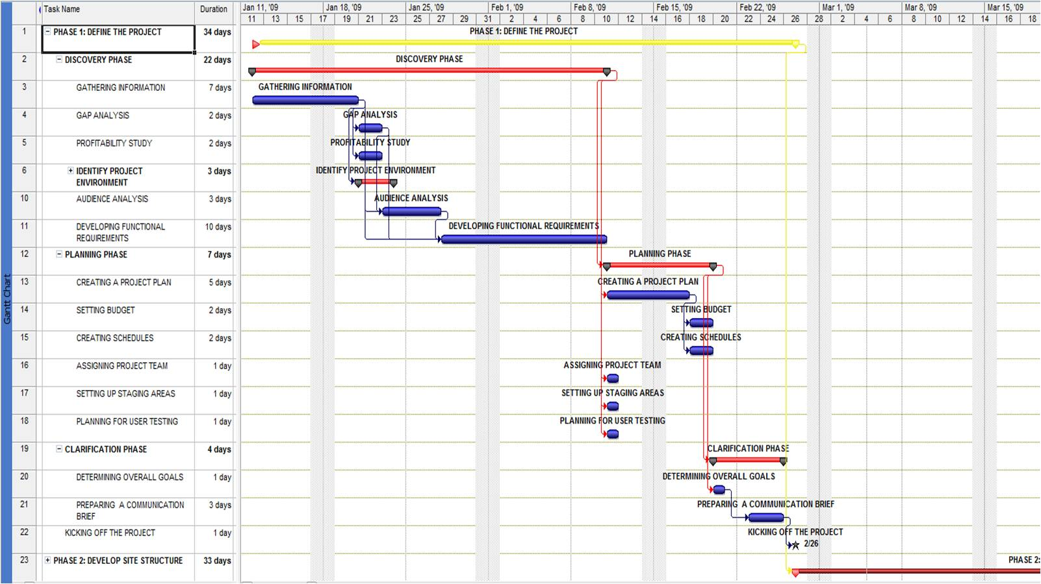
Work Plan – Gantt Chart ( Phase I - Zoomed)

Slide 11
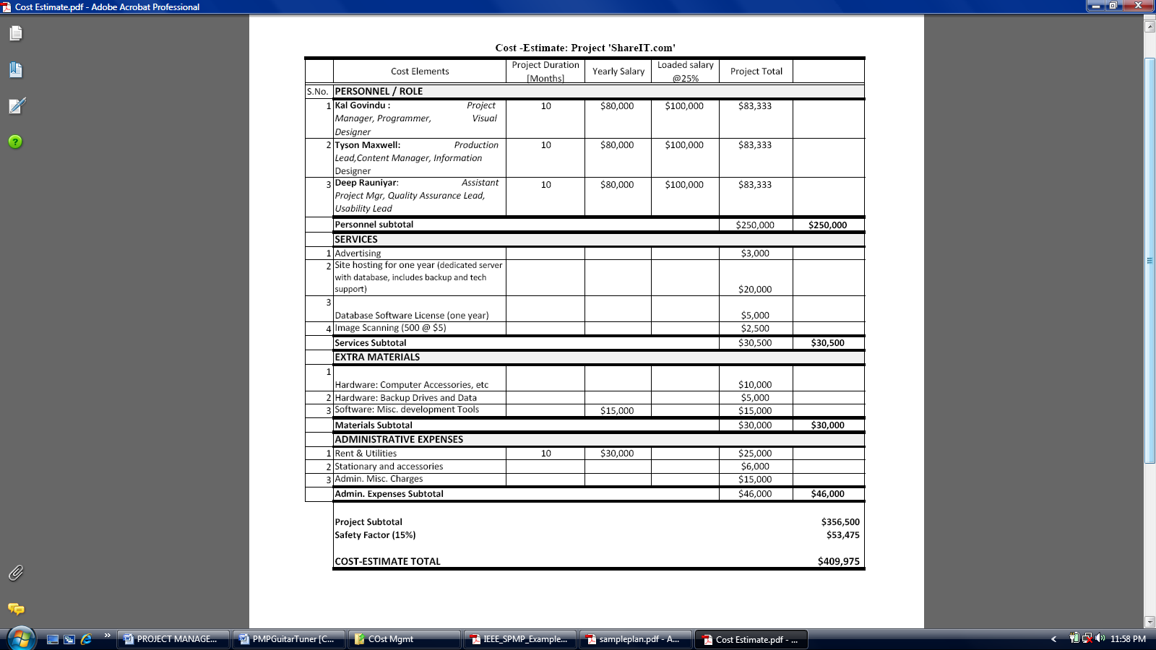
Work Plan – Budget Allocation

Slide 12
Project Control Plan - Requirements
Control plan to manage the requirements process and procedures
  Identification of Requirements
    Identify structure, functionality and performance issue of the project.
  Recording
    Requirements tracking matrix
  Modification of Requirements
    Requires consent and approval of the design team under the authority of the project manager.

Slide 13
Project Control Plan - Schedule
Earned Value Management System (EVMS)
  Schedule Variance (SV), SPI
  Microsoft Project Tools
Critical Path Method
  Control activities most crucial to completion of the project.
Milestones
  Major milestone at the end of each phase.
Weekly examination against the baseline project schedule

Slide 14
Project Control Plan - Budget
Set aside 15% of development cost as reserve.
Considering the size and complexity of the project extensive budget plan not required.
Earned Value Management System (EVMS)
  Cost Variance (CV), CPI
  Microsoft Project Tools

Slide 15
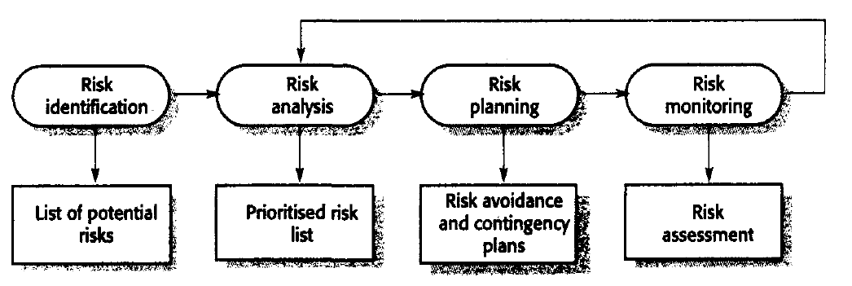
Risk Management Plan
Risk Management Process for ‘ShareIT.com’

Slide 16
Risk Management Plan – Risk Register Elements
Risk ID Number (24 Project risks identified)
Risk Description and Consequences
  Project Risk, Product Risk, Business Risk & External Risk
Risk probability and severity (Scale 1-5)
Risk Response
  Mitigate, Transfer, Avoid and Accept
Risk Trigger
Residual Risk probability and severity
Secondary Risk

Slide 17
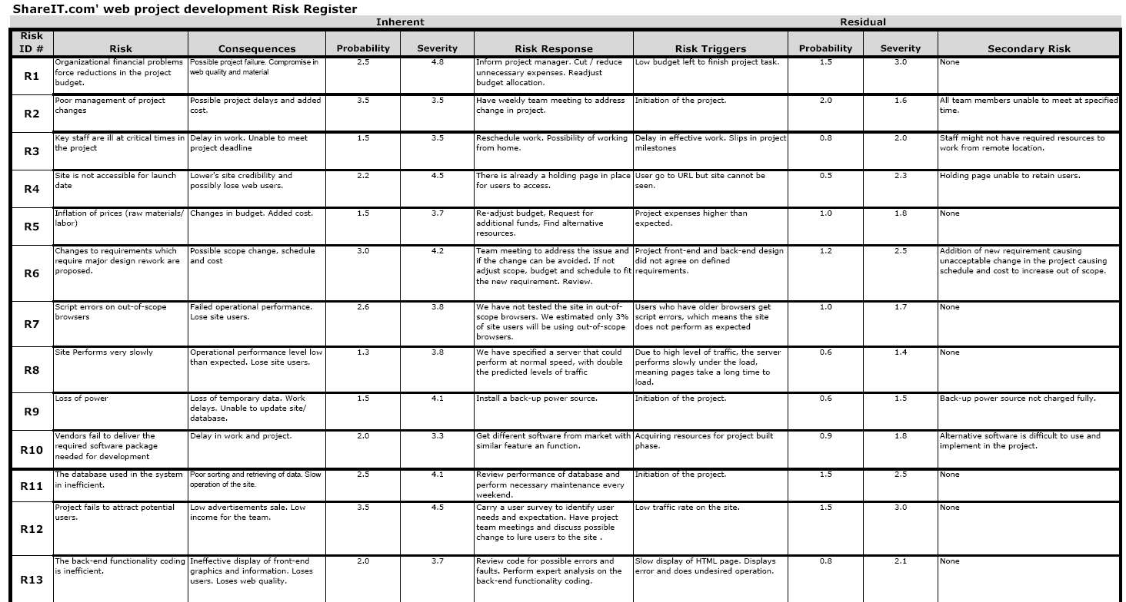
Risk Register – Shareit.com
*For complete table of risk register refer to our Project Web Site

Slide 18
Technical Process – Project Test Plan
Test Plan major elements:
  List of all faults and failures modes
  Test selection criteria
  Testing effectiveness and objectives
  Theoretical and practical limitations
Use of standardized method
Testing will be conducted on multiple stages
Alpha and Beta testing

Slide 19


Technical Process – Web Security Plan
Site security features:
Security questions – 3 security questions
CAPTCHA
Expiring passwords
User Categories – user controls the items they want to share
SSL encryption – encrypted user sessions

Slide 20
Technical Process -
Verification and Validation
Formal verification and validation will be performed on following work products:
  Web design requirements
  Web design architecture
  Web design interface design
  Database design
  Implemented web site interface
Verification and Validation activities includes:
  Inspections
  Review by the design team

Slide 21
Technical Process – Quality Assurance
Quality assurance model based on ISO 9000
Major quality focus area:
  Usability
  Browser and OS compatibility
  Functionality
  Internal Standards
  Performance / Load handling
  Content and Security
  Bug free site
QA activities performed throughout the lifecycle of the project

Slide 22
References
Educational References
Web Redesign: 2.0 Workflow that Works, 1st Edition, Kelly Goto and Emily Cotler. Berkeley, CA: Peachpit Press, 2004.
Real Web Project Management: Case Studies and Best Practices, 1st Edition, Thomas Shelford and Gregory Remillard. Boston: Addison Wesley Professional, 2002.
Software Engineering, 8th Edition, Ian Sommerville. Boston: Addison Wesley Professional, 2006.
A Guide to the Project Management Body of Knowledge. 3rd Edition, ANSI/PMI 99-001-2004. Newton Square, PA: Project Management Institute, 2004.
Guide to the Software Engineering Body of Knowledge. 2004 Version. IEEE Computer Society. Los Alamitos, CA. 2004.
Advisor Reference
Dr. John Tanik

