Slide 1
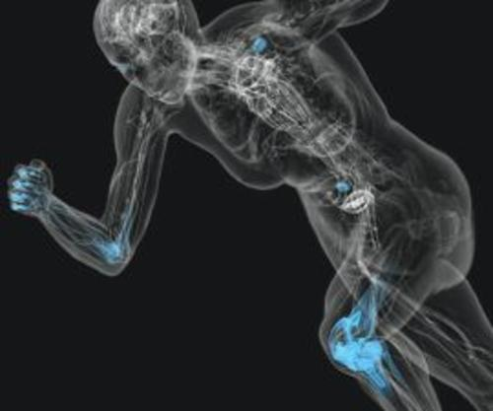
BODY SYSTEMS IN HUMAN ANATOMY
DIGITAL BOOK
BY:
CLAUDIA CABALLERO

Slide 2
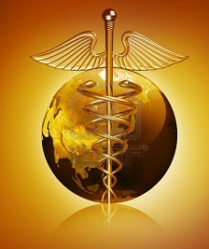
TABLE OF CONTENTS
1.
6.
7.
5.
2.
3.
4.
The Respiratory System
The Skeletal System
The Muscular System
The Nervous System
The Cardiovascular System
The Lymphatic System
The Endocrine System
8.
The Digestive System
9.
The Urinary System
10
The Reproductive System
11.
Reference Page

Slide 3
Skeletal System
2
3
4

Slide 4
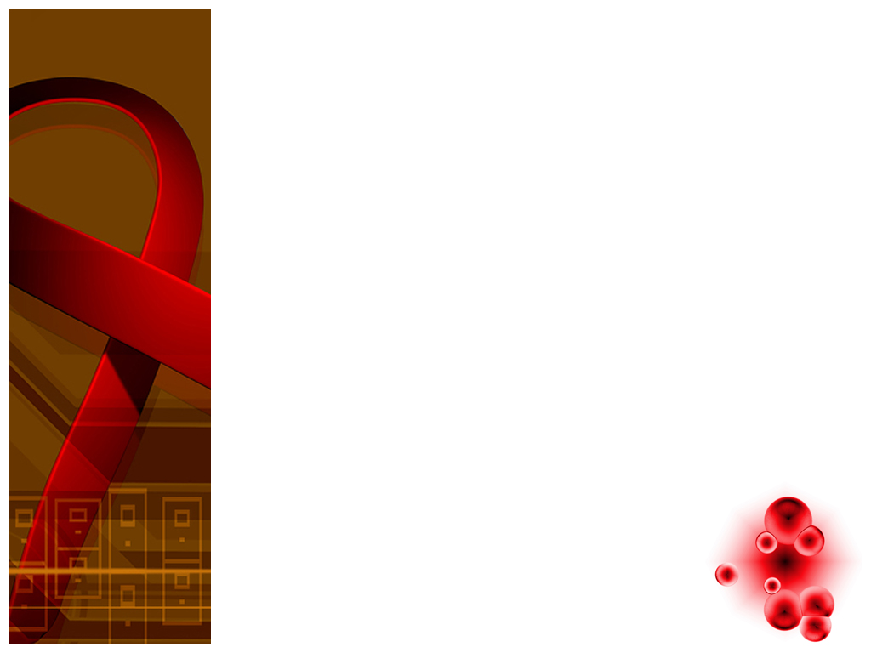
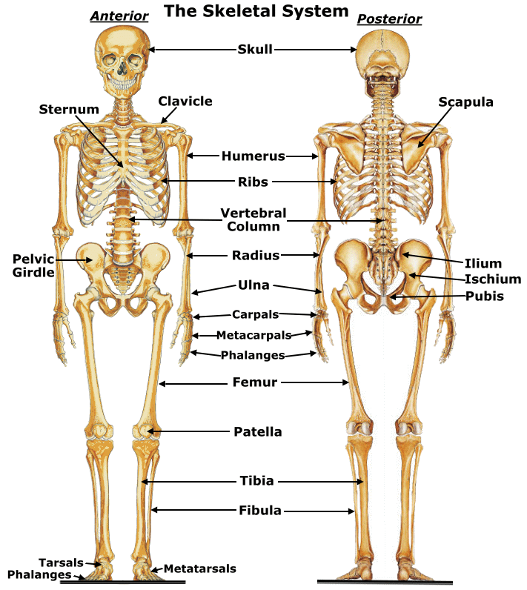
ORGANS OR STRUCTURES FOUND WITHIN THE SYSTEM
1

Slide 5
Functions of the Skeletal System
Protection
Support
Assisting in Movements
Storage of Minerals
Production of Blood Cells
Storage of Chemical Energy
1

Slide 6
RELATIONSHIP TO OTHER SYSTEMS
Muscles attach to the various parts of the skeleton
Allows channels and tunnels for the circulatory vessels and nervous tissue to pass.
Bone tissue supplies blood cells for the circulation and aids the immune system
1

Slide 7
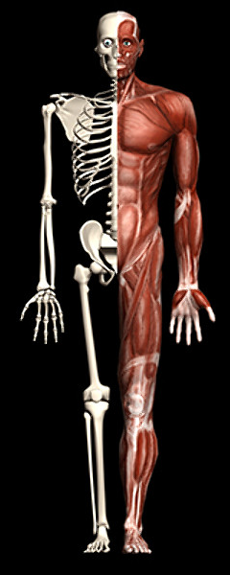
MUSCULAR SYSTEM

Slide 8
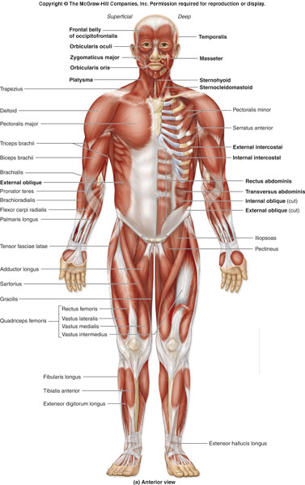
ORGANS OR STRUCTURES FOUND WITHIN THE MUSCULAR SYSTEM

Slide 9
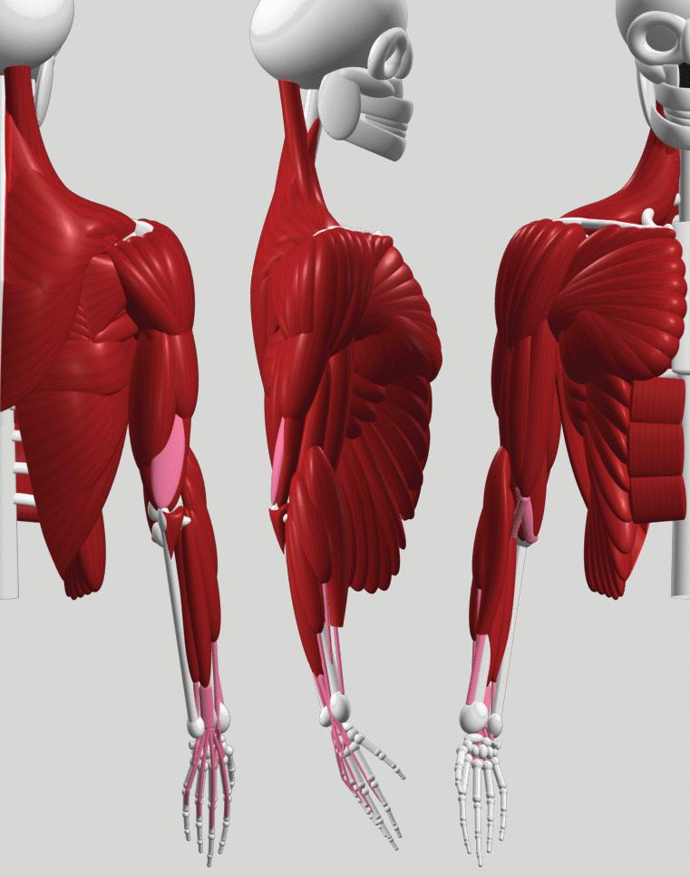
Functions of the Muscular System
Locomotion
Strength
Heat production
Shock absorption
Shaping the body
Posture
Respiration

Slide 10
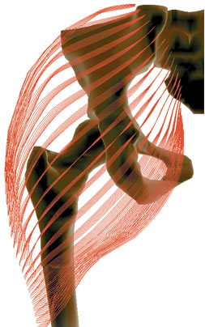
RELATIONSHIP TO OTHER SYSTEMS
  Provides skeletal movement.
  Control entrances and exits of digestive tract
  It works with:
    The endocrine system to produce heat
    The nervous system to sense things
    The respiratory system to allow the diaphragm to expand
    The cardiovascular system to provide circulation

Slide 11
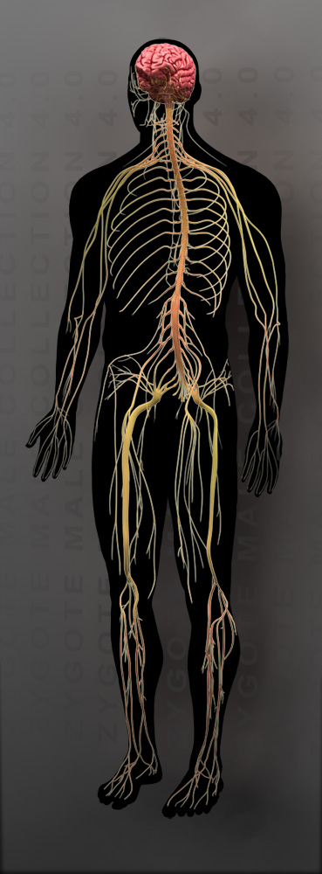
Nervous System

Slide 12
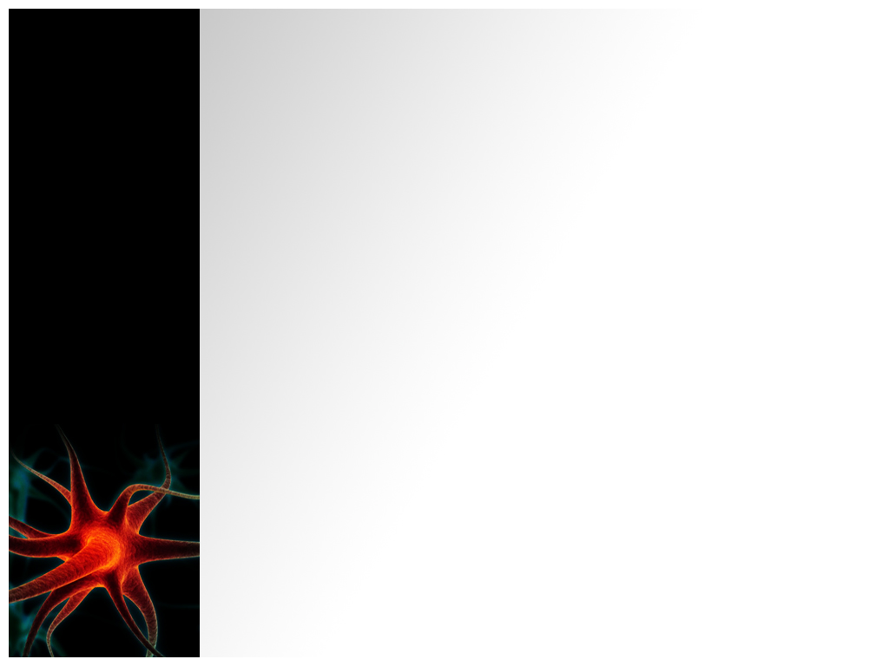
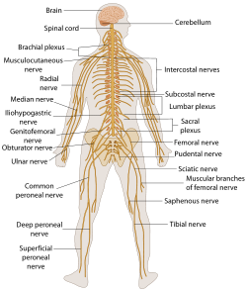
ORGANS OR STRUCTURES FOUND WITHIN THE NERVOUS SYSTEM

Slide 13
Functions of the Nervous System
Control
Regulate
Communicate
Center of mental activity:
  Learning
  memory.
Homeostasis.

Slide 14
RELATIONSHIP TO OTHER SYSTEMS
Bones provide calcium
The skull protects the brain
The vertebrae protect the spinal cord
Endothelial cells maintain the blood-brain barrier.
Hormones provide feedback to the brain to affect neural processing.
The brain monitors respiratory volume and blood gas levels.
Digestive processes provide the building blocks for some neurotransmitters.

Slide 15
RESPIRATORY SYSTEM

Slide 16
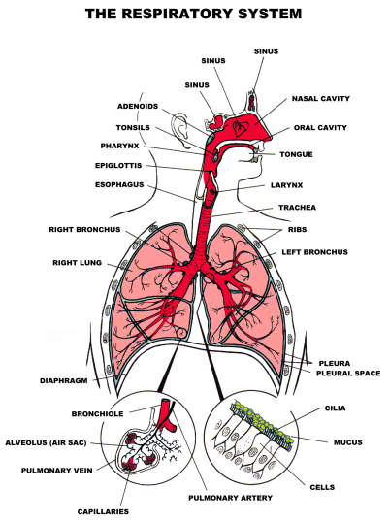
ORGANS OR STRUCTURES FOUND WITHIN THE SYSTEM

Slide 17
FUNCTION(S) OF THE SYSTEM
Ventilate the lungs.
  Extract oxygen from the air and transfer it to the bloodstream.
    Excrete carbon dioxide and water vapour.
          Maintain the acid base of the blood.

Slide 18
RELATIONSHIP TO OTHER SYSTEMS
Work with cardiovascular systems to :
  Supply oxygen to the cells
  Remove Carbon Dioxide
  Regulate the pH of the body fluids.

Slide 19
Cardiovascular System

Slide 20
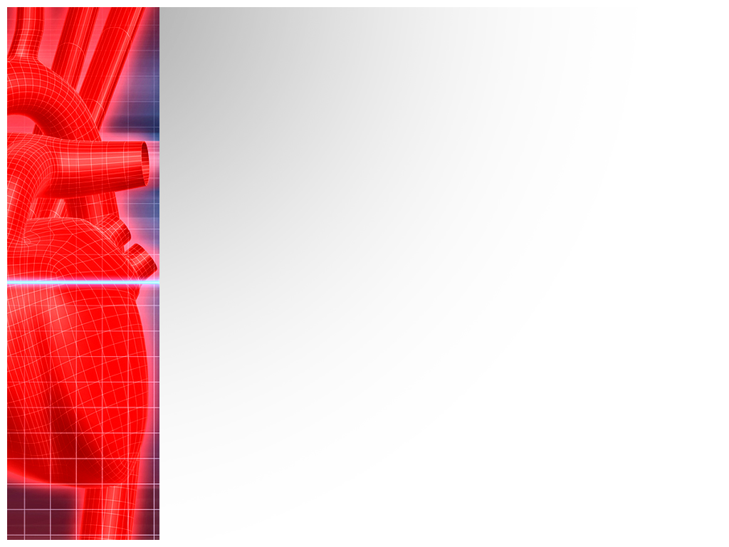
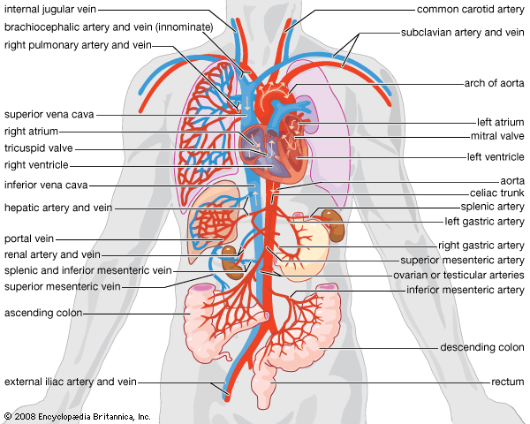
ORGANS OR STRUCTURES FOUND WITHIN THE CARDIOVASCULAR SYSTEM

Slide 21
Functions of the
Cardiovascular
System
Transport:
Oxygen from the lungs to the various cells of the body.
Protection:
The body and its organs from infection and diseases.
Regulation:
Temperature, pH, concentration.

Slide 22
RELATIONSHIP TO OTHER SYSTEMS
Endothelial cells maintain the blood-brain barrier.
Baroreceptors send information to the brain about blood pressure.
Cerebrospinal fluid drains into the venous blood supply.
The brain regulates heart rate and blood pressure.

Slide 23
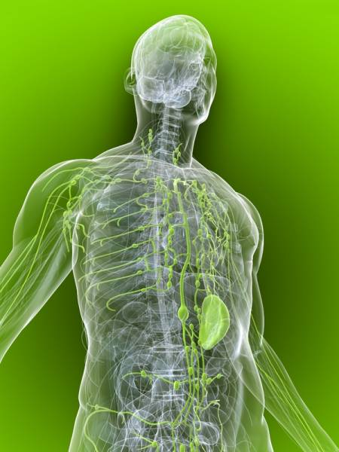
Lymphatic
System

Slide 24
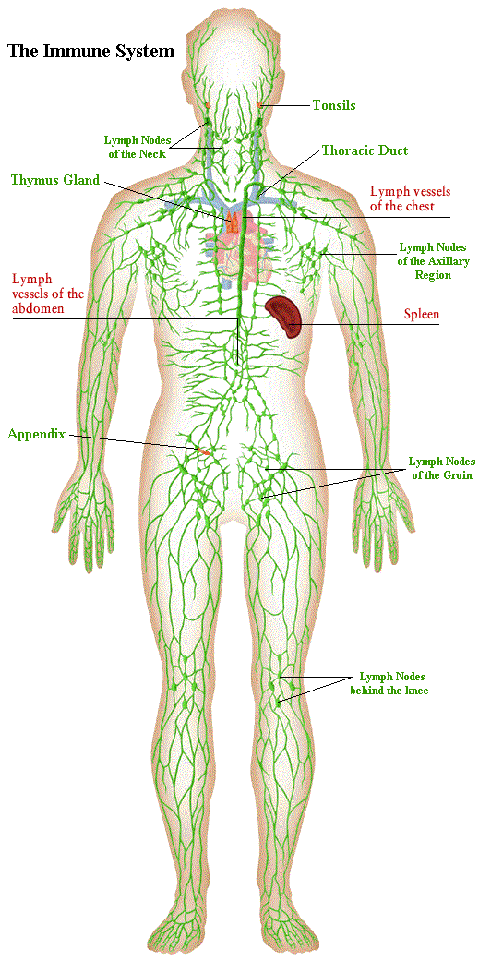
STRUCTURES FOUND WITHIN THE SYSTEM

Slide 25
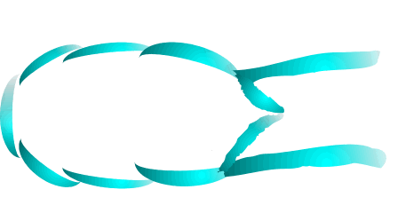
FUNCTION(S) OF THE Lymphatic SYSTEM
Remove :
Fluid
Debris
Dead blood cells
Pathogens
Cancer cells
Toxins

Slide 26
Relationship to other systems
The lymph system collects and transports.
Collection of fluids begins at the capillaries of the circulatory system
The lymph fluid moves through the vessels as you move the voluntary muscles in your body.
The fluid directed through a series of vessels that become the thoracic duct.

Slide 27
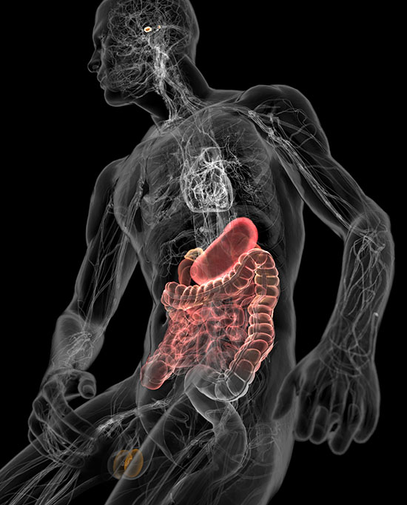
ENDOCRINE SYSTEM

Slide 28
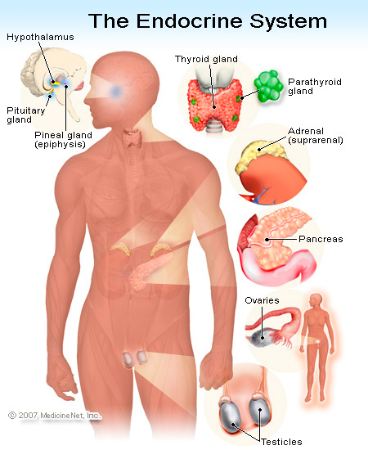
ORGANS OR STRUCTURES FOUND WITHIN THE SYSTEM

Slide 29
FUNCTIONS OF THE SYSTEM
Secrete different
Secret chemical
Maintain a stable environment
Promoting changes of the body.
Regulate:
  Mood
  Growth and development
  Tissue function
  Metabolism
  Sexual function
  Reproductive processes.

Slide 30
RELATIONSHIP TO OTHER SYSTEMS
Works with the nervous system by:
  Sending hormones to cells
  Having a reaction
Works with the digestive system with the pancreas:
  Producing insulin.
The urinary system because it works with:
  Water absorption in the kidneys

Slide 31
Digestive System
Parts
Function
Interconnections

Slide 32
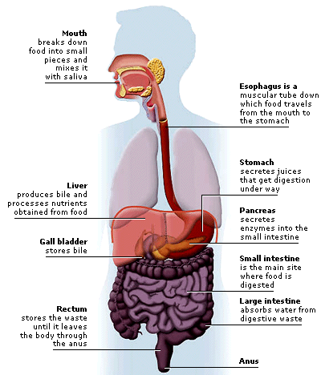
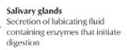
STRUCTURES FOUND WITHIN THE SYSTEM
Menu

Slide 33
FUNCTIONS OF THE DIGESTIVE SYSTEM
Menu
Converts food so it can be used by cells
Break down the food we eat into smaller parts
Provide energy
Stores and digests foods
Transfers nutrients to the body
Eliminates waste water
Absorbs water

Slide 34
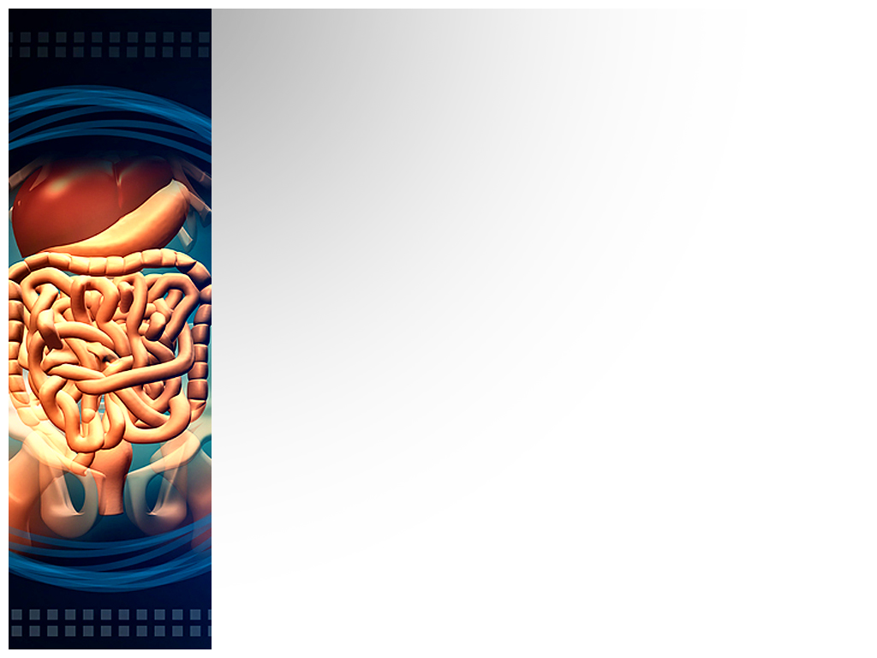
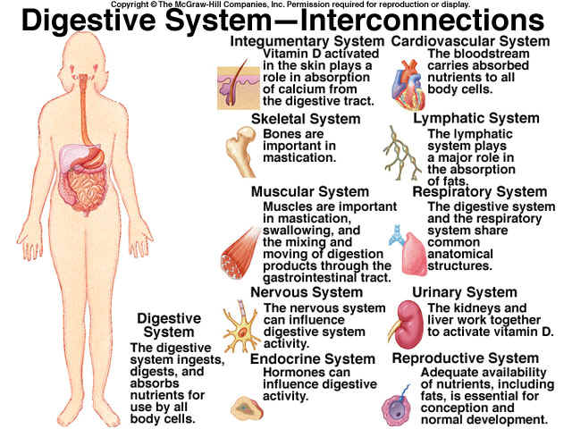
Menu

Slide 35

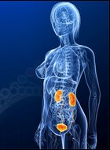
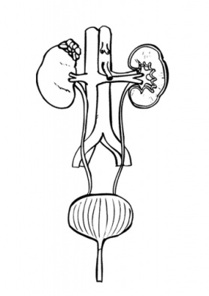

URINARY
SYSTEM

Slide 36
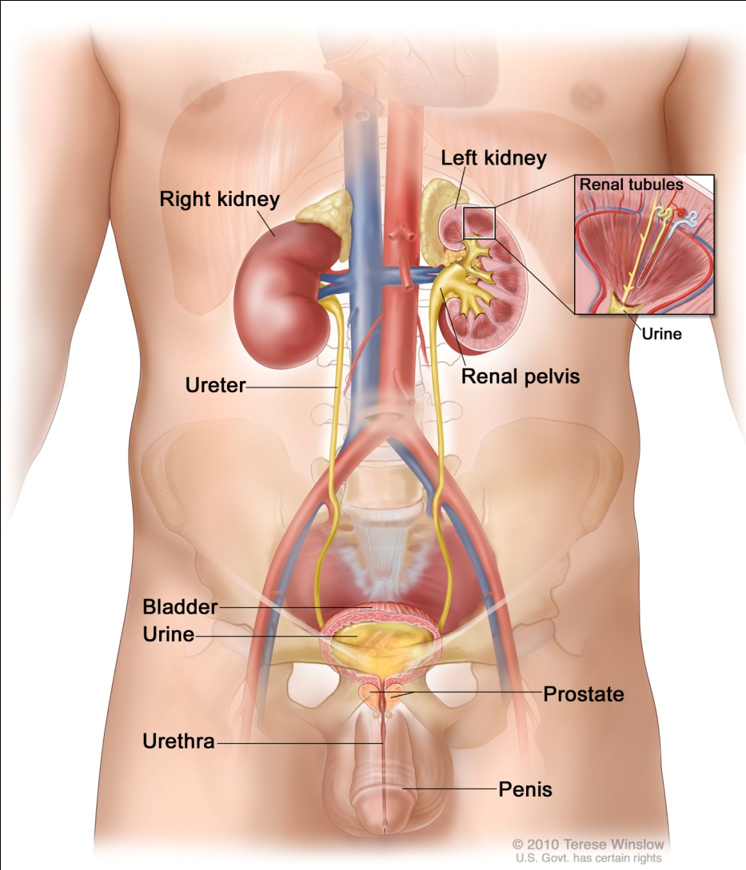
ORGANS OR STRUCTURES FOUND WITHIN THE SYSTEM

Slide 37
FUNCTION(S) OF THE SYSTEM
eliminates waste products
water balance
chemical balance
Homeostatic organ
Acts as blood filter

Slide 38
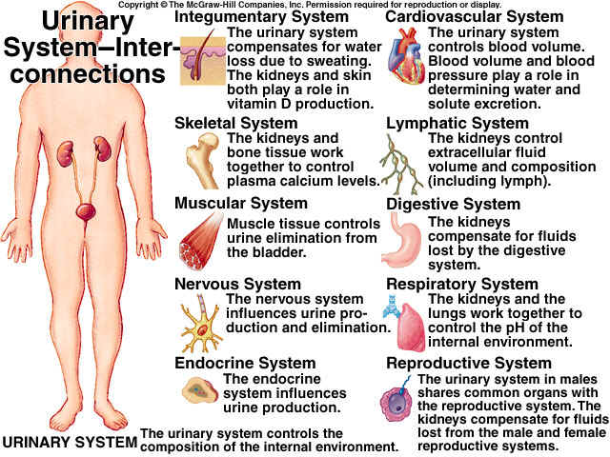
RELATIONSHIP TO OTHER SYSTEMS

Slide 39
Reproductive System: Male and Female

Slide 40
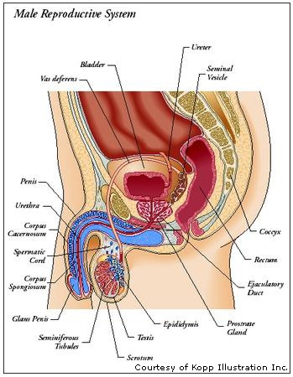
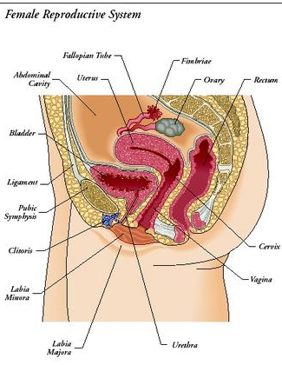
ORGANS OR STRUCTURES FOUND WITHIN THE REPRODUCTIVE SYSTEM

Slide 41

Functions of the Reproductive System
Produce hormones.
Produce and sustain the ova.
Transport the eggs to the Fallopian tube for fertilization with the sperm.
Female:
Male:
Produce sperm
Maintain seminal fluid
Transport sperm

Slide 42
RELATIONSHIP TO OTHER SYSTEMS
The endocrine system sends hormonal messages
The circulatory system sends blood.
The nervous system produces stimulus.
The skeletal system sends nutrients such as calcium and magnesium to the fetus

Slide 43
Reference Pages
http://www.ivy-rose.co.uk/HumanBody/Skeletal/Skeletal_System.php
http://faculty.washington.edu/chudler/organ.html
http://answers.yahoo.com/question/index?qid=20080506143736AAz59i8
http://wiki.answers.com/Q/What_is_the_main_function_of_the_muscular_system
http://www.buzzle.com/articles/endocrine-system-function.html
http://kidshealth.org/teen/your_body/body_basics/endocrine.html
http://www.buzzle.com/articles/cardiovascular-system-function.html
http://www.lymphnotes.com/article.php/id/151/

Slide 44
Reference Pages
http://www.livestrong.com/article/37137-reproductive-system-functions/
http://www.ambulancetechnicianstudy.co.uk/respsystem.html
http://digestive-system.emedtv.com/digestive-system/function-of-the-digestive-system.html
http://faculty.southwest.tn.edu/rburkett/interactions_of_the_digestive_system.htm
http://answers.yahoo.com/question/index?qid=20070516172159AAYu0mW
http://reproductive-system-sakina-lea.blogspot.com/2010/11/relationships-between-reproductive.html
http://wiki.answers.com/Q/The_relationship_between_the_Respiratory_system_and_the_cardiovascular_system_during_the_delivery_of_oxygen_to_other_body_systems
http://wiki.answers.com/Q/Describe_the_relationship_between_the_lymphatic_system_and_the_cardiovascular

