Slide 2
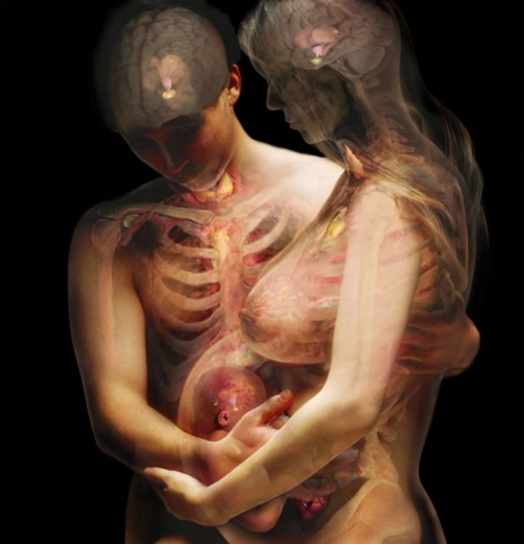
Endocrine System
Group Members
Kevin Almengor
Pilar Araúz
Vicente Montero
Giovani Tejeira
Aida Uribe

Slide 3
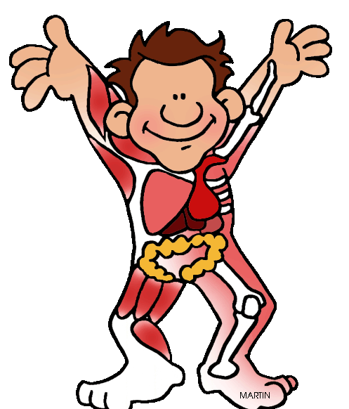
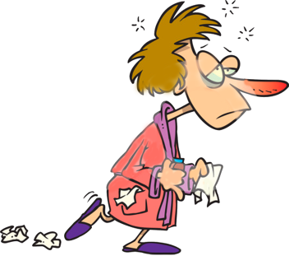
Endocrine System
Endocrine System
Definition
Main Function
Glands
Definition
Hormones
Principal Glands
Diseases

Slide 4
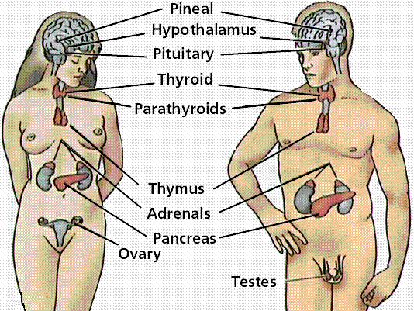
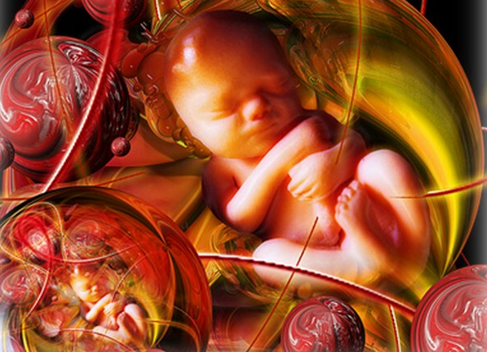
Endocrine System Definition
Hormone’s Secretion
Makes contrast with exocrine system
Makes slow body processes
Works as information signal system
System of glands

Slide 5
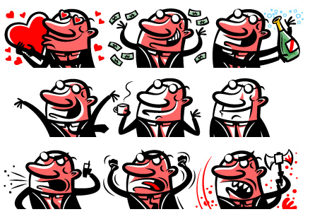
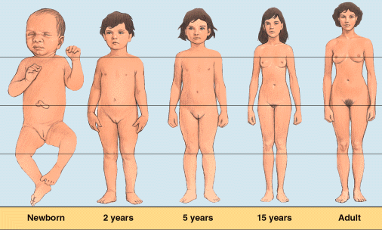
Endocrine System Main Functions
Mood regulation
Growth and development
Tissue function
Metabolism
Sexual and reproductive processes

Slide 6
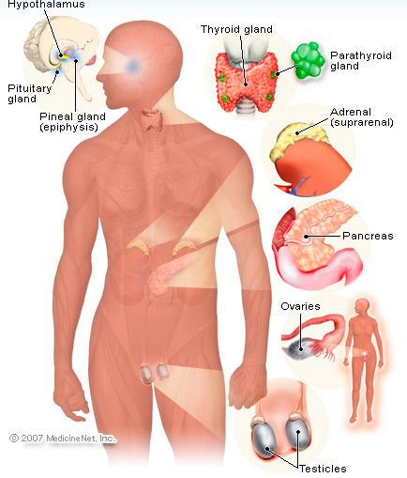
Endocrine System Glands: Definition
Group of cells producing or secreting chemicals (HORMONES)
Someone release the secretion in specific areas
Release more than 20 hormones in the bloodstream

Slide 7
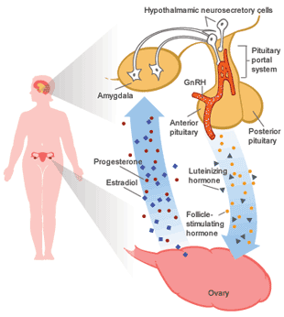
Endocrine System Hormones
Body’s chemical messengers
Transfer information and instructions to one set of cell to another
In the bloodstream, affecting genetically programmed cells
Programmed cells recieved and respond to hormones the message

Slide 8
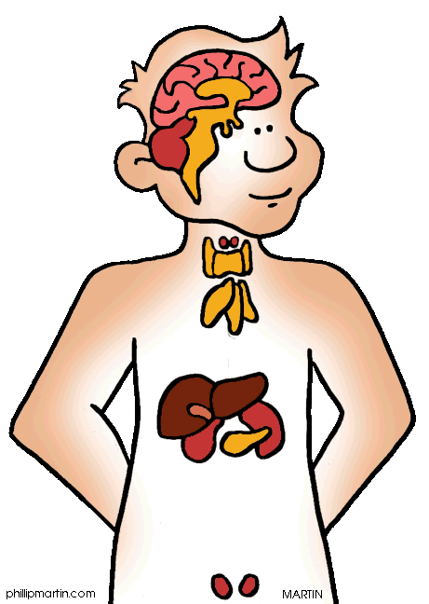
Endocrine System Glands
Hypothalamus
Pituitary Gland
Thyroid
Parathyroid
Adrenal glands
Pineal Body
Reproductive glands (testes and ovaries)
Pancreas

Slide 9
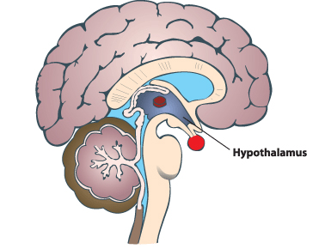
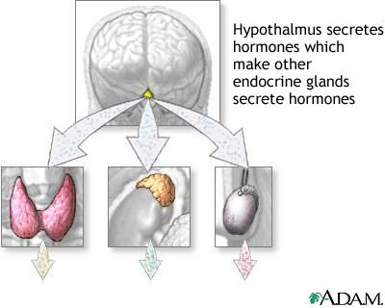
Endocrine System Hypotalamus
Specialized cells in the lower central part of the brain
Link between endocrine system and nervous system
Pituitary gland control

Slide 10
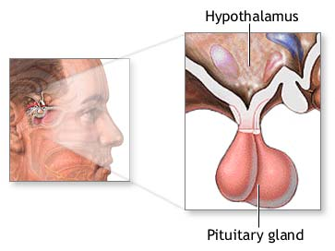
Endocrine System Pituitary Gland
Anterior Lobe
Regulates
Thyroid, Adrenals,
Reproductive glands
Produces:
Growth hormone, prolactin, thyrotropin, corticotropin
Posterior Lobe
Releases Antidiuretic Hormones
Oxytocin
Master Gland (most important)
It hormones control other glands
Influence by factors such emotions
Secretes Endorphins
Signals to make sex hormones
Ovulation control and menstrual cycle

Slide 11
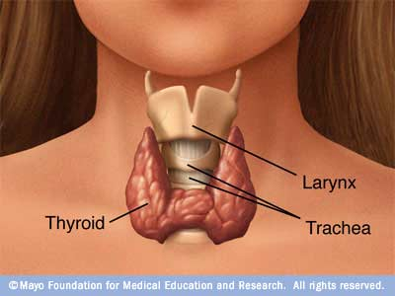
Endocrine System Thyroid
Shaped like a bow tie to the lower necked
Controls the rate which cells produce energy
Key role in bone growth, development and nervous system
Hormones
Thyroid hormones
Thyroxine
triiodothyronine

Slide 12
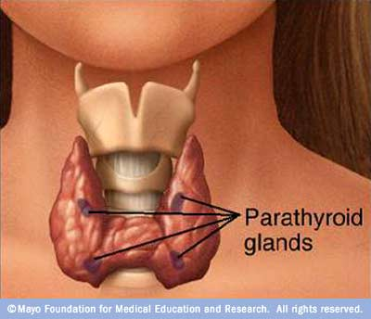
Endocrine System Parathyroid
Attached to the thyroid
4 tiny glands function together
Release parathyroid hormone
Regulates the level of calcium in the blood
Help Calcitonin (produced by thyroid)

Slide 13
Endocrine System Adrenal Glands
2 triangular adrenal glands (top of the kidneys)
2 Parts
Outer part (adrenal Cortex)
Produces corticosteroids (salt and water balance)
Body responses to stress, metabolism, immune system
Inner Part (adrenal medulla)
Produces catecholamines (such epinephrine)
Controlls blood pressure and heart rate (in stress)

Slide 14
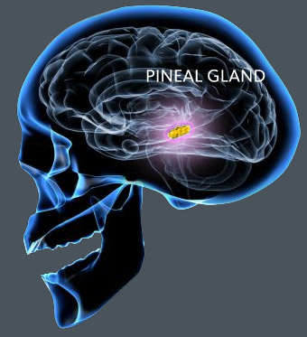
Endocrine System Pineal Body
Pineal body
Located in the middle of the brain
Secretes melatonin
Regulates the wake-sleepy cycle

Slide 15
Endocrine System Reproductive Glands
Male: Testes
Secrete androgens
Principally Testosterone
Regulates body changes (sexual development)
Enlargement of the penis, growth, changes in the voice, facial and pubic hair.
Works with the pituitary gland
Female
In conjunction produce sperm

Slide 16
Endocrine System Reproductive Glands
Female: Ovaries
Produce eggs
Secretes estrogen and progesterone
And
Estrogen
Development of female sexual features
Breast growth
Accumulation of body fat
Growth spurt during puberty
Estrogen + Progesterone
Pregnancy and menstrual cycle

Slide 17
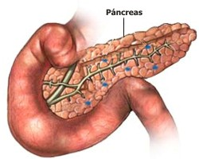
Endocrine System Pancreas
Hormones
Insuline
Glucagon
Steady level of glucose

Slide 18
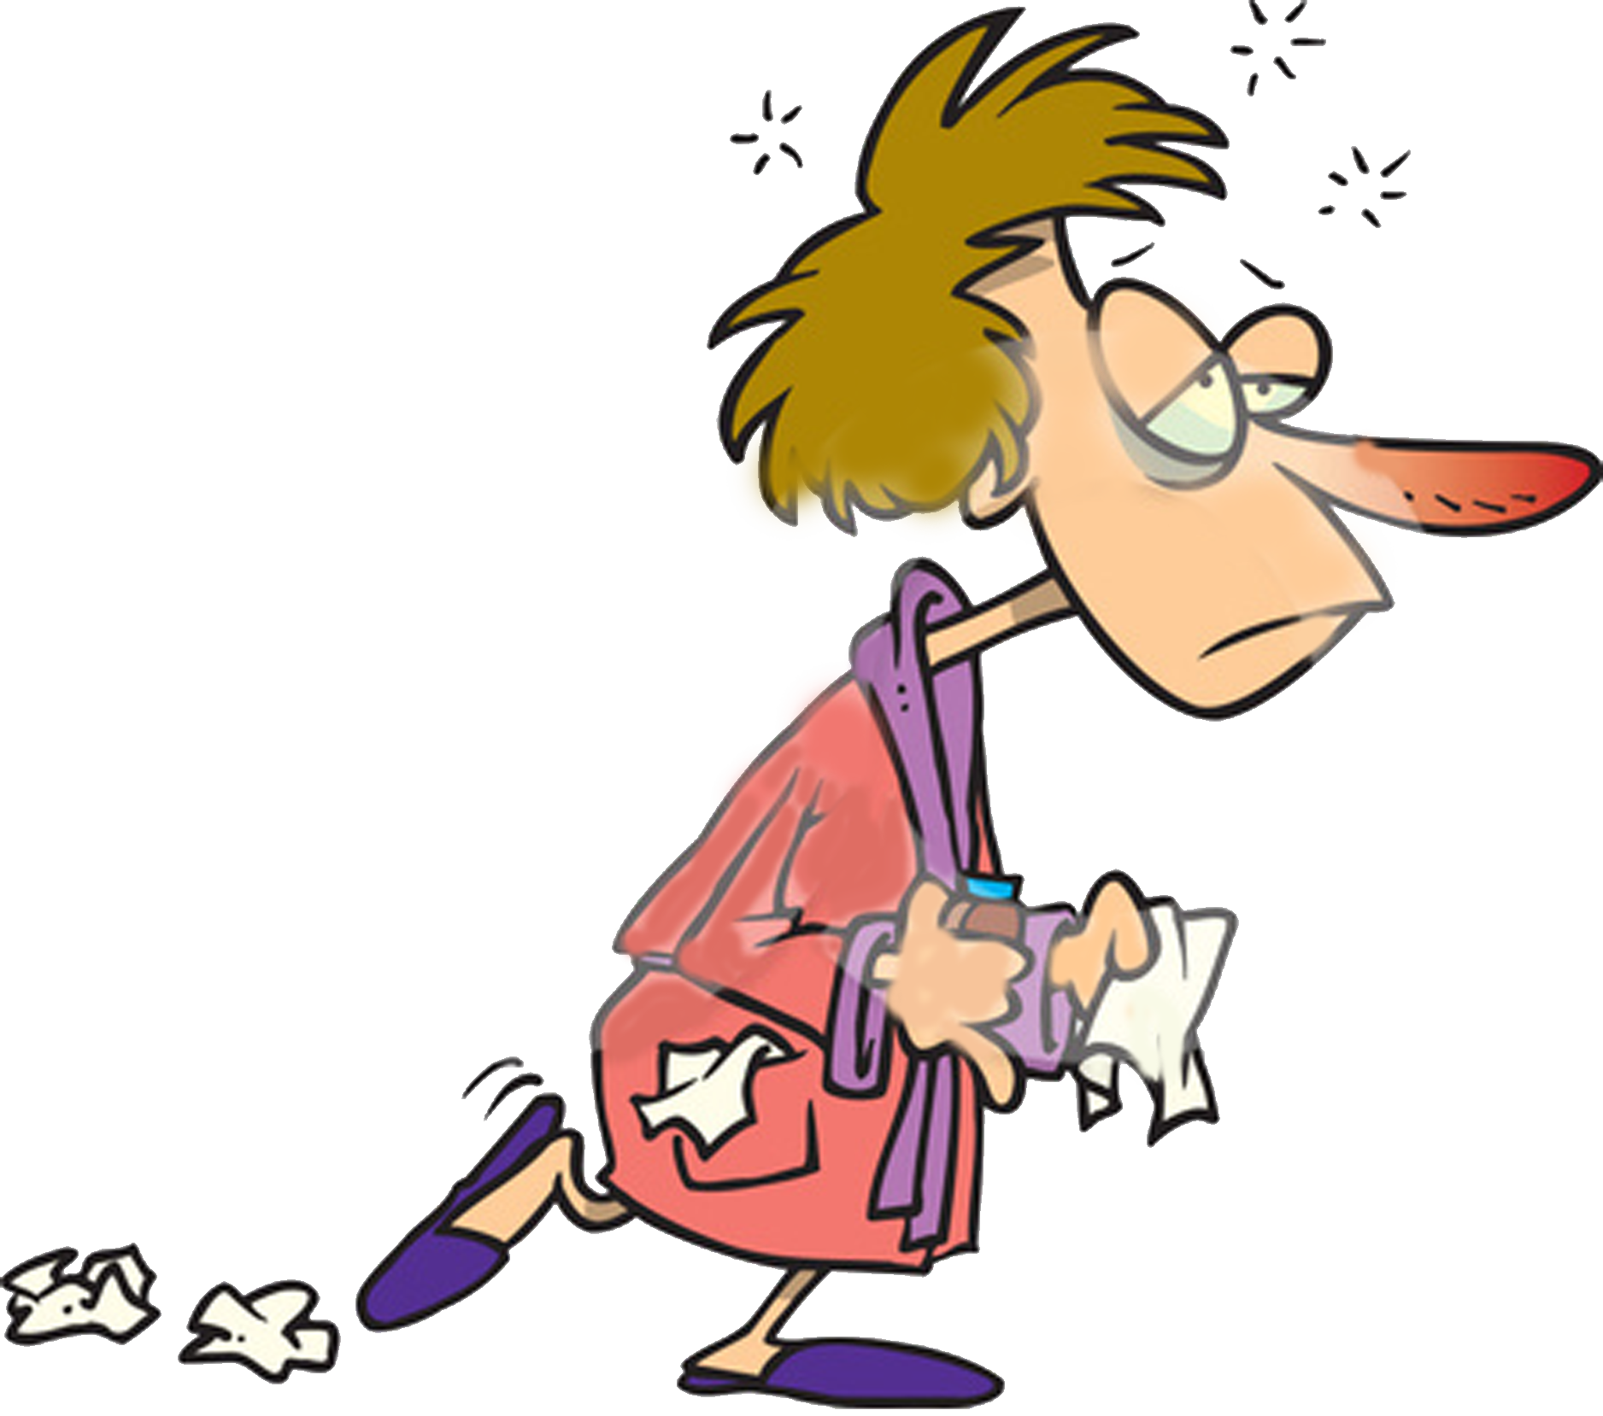
Endocrine System Diseases
Adrenal insufficiency
Type 1 Diabetes
Type 2 Diabetes
Growth hormone problems
Hyperthyroidism
Hypothyroidism
Precocious puberty

Slide 19
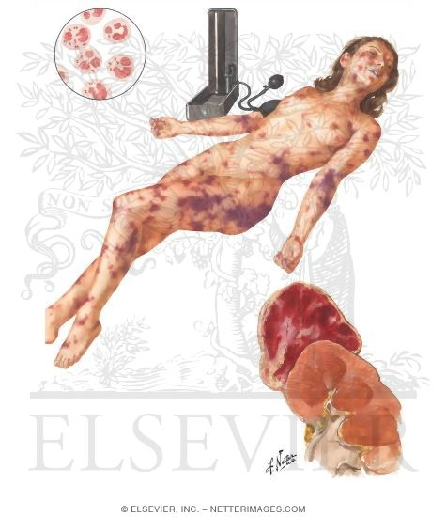
Endocrine System Diseases: Adrenal Insufficiency
Decreased function of the adrenal cortex and underproduction of corticosteroid
Weakness
Fatigue
Abdominal pain
Nausea
Treatment
Replacement of the hormone

Slide 20
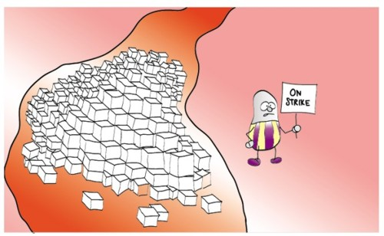
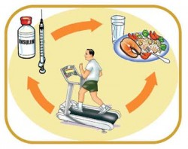
Endocrine System Diseases: Type 1 Diabetes
Pancreas does not produce enough insulin
Excessive thirst
Hunger
Urination
Weight lost
Treatment
Regular insulin injection

Slide 21
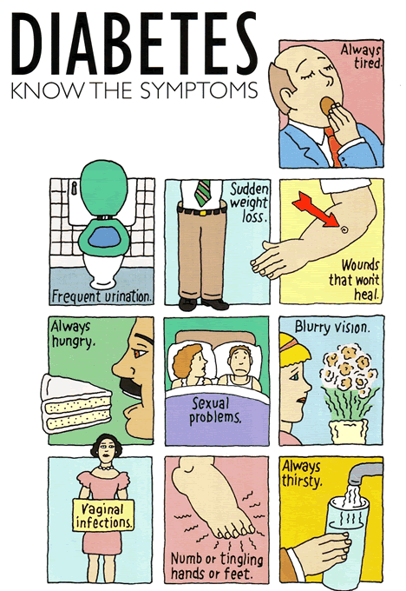
Endocrine System Diseases: Type 2 Diabetes
The body does not response to insulin
Overweight principally
Urination
Excessive thirst
Same symptoms as type 2
Treatment
Dietary changes
Exercise
Oral medication

Slide 22
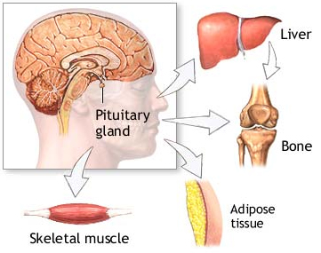
Endocrine System Diseases: Growth Hormone problems
Caused by a pituitary tumor
Too Much Hormone
Gigantism
Small amount of hormone
The child does not grow
Hypoglycemia
Treatment
Remove the tumor

Slide 23
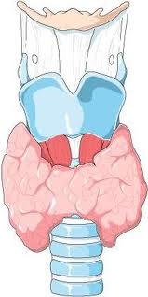
Endocrine System Diseases: Hypertyroidism
Caused by excessive levels of thyroid hormone
Weight loss
Nervousness
Tremors
Increased heart rate and blood pressure
Treatment
Medications
Removal or destruction of the thyroid

Slide 24
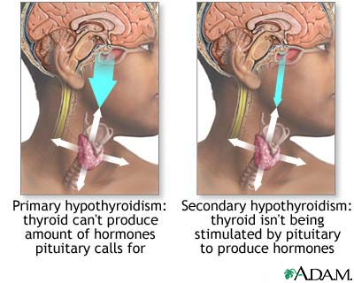
Endocrine System Diseases: Hypotyroidism
Caused by low levels of thyroid hormone
Slow body processes
Produce Fatigue
Slow heart rate
Weight gain
Increased heart rate and blood pressure
Treatment
Thyroid hormone replacement
Hashimoto’s Tyroiditis in children

Slide 25
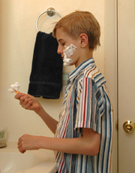
Endocrine System Diseases: Precocious puberty
Pituitary stimulate gonads prematurely
Early growth of gonads and other parts
Treatment
Gonadotropins
Arrest the progression of the development

