Slide 1
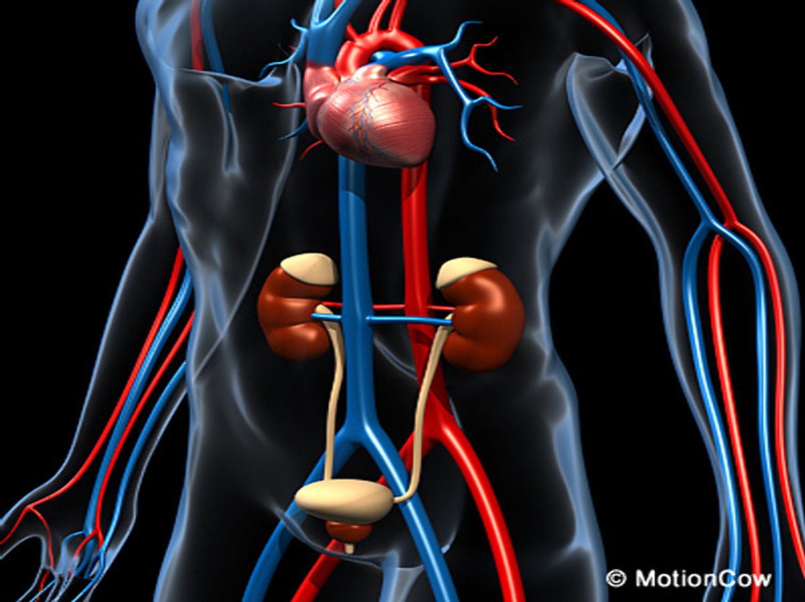
Urinary System
By:
Franco María
Jiménez Iveth
Lamboglia Rosa
Rodríguez Ryan
Rodríguez Yissel
Santamaría Ángel

Slide 2
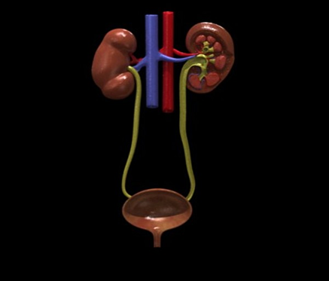
Urinary System
Definition
Organs
Functions
Kidneys
Urinary Bladder
Urethra
Ureters
Basic Unit
Diseases of the Kidney

Slide 3
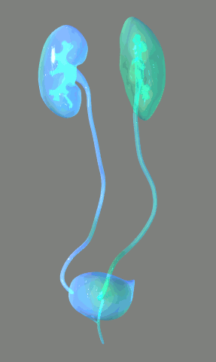
The Urinary System is a group of organs in the body concerned with filtering out excess fluid and other substances from the bloodstream. The substances are filtered out from the body in the form of urine.

Slide 4
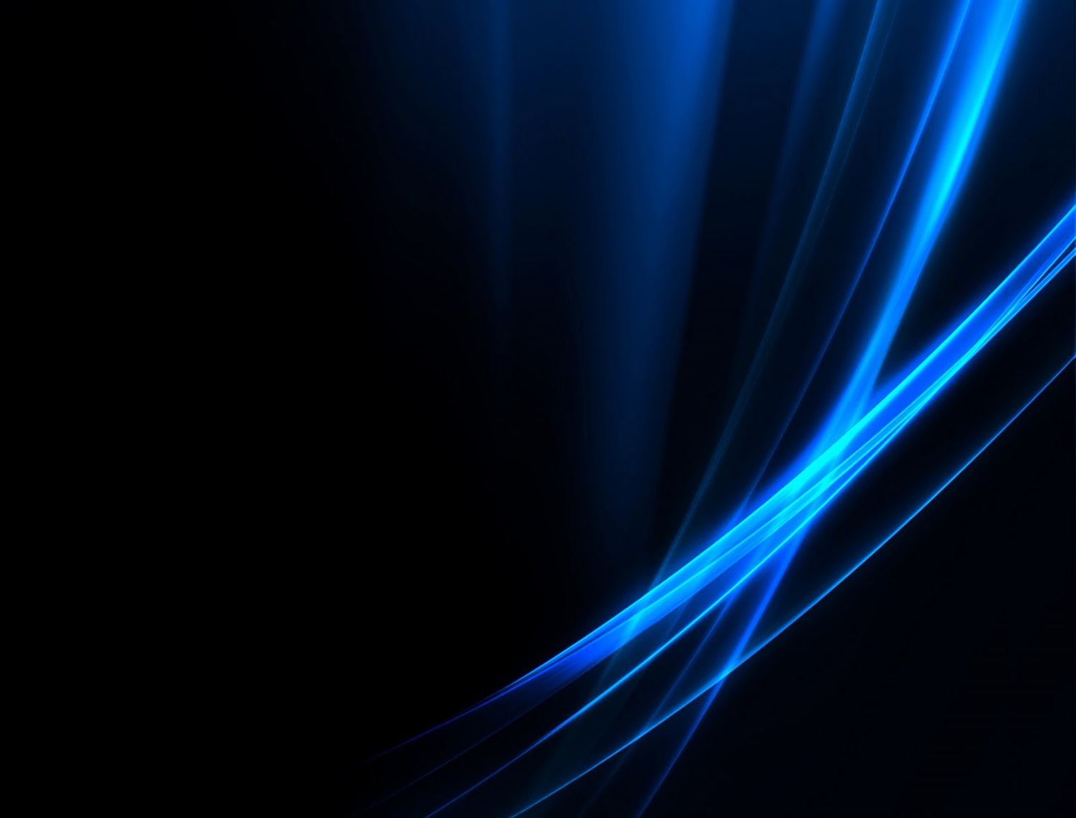
Organs in the Urinary System
Is a hollow, muscular and elastic organ that sits on the pelvic floor
Muscles in the walls of the ureters send the urine in small spurts into the bladder
Is a muscular tube that connects the bladder with the outside of the body
Are located at the rear wall of the abdominal cavity.

Slide 5
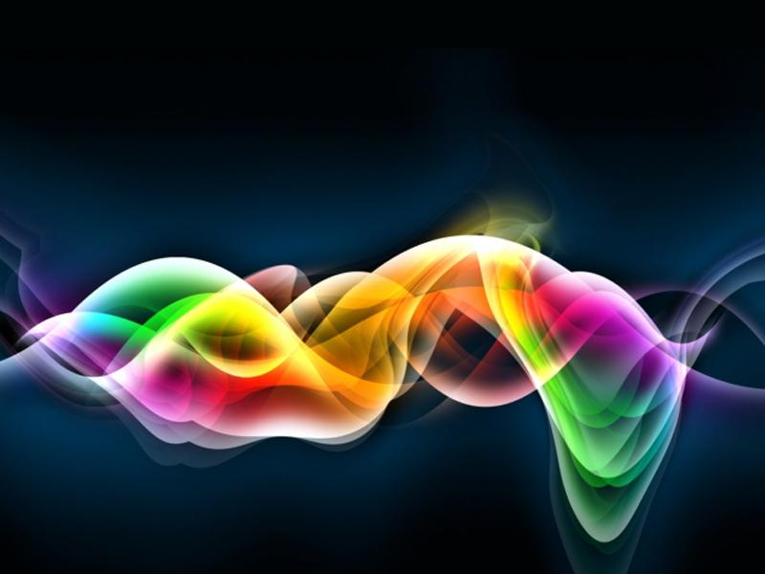
Basic Unit of the Kidneys
Nephrons
Regulate water and soluble substances by filtering the blood
Eliminate wastes from the body
Regulate blood volume and pressure
Control levels of electrolytes and metabolites
Regulate blood pH

Slide 6
Basic Unit of the Kidneys
Its function
Are vital to life and are regulated by hormones such as antidiuretic hormone, aldosterone, and parathyroid hormone
Each nephron
Is composed of an initial filtering component (the renal corpuscle) and a tubule specialized for reabsorption and secretion (the renal tubule).

Slide 7
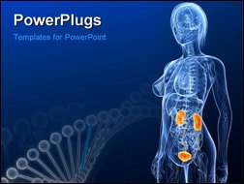
Main functions
process of excretion
water balance
maintain normal ph of the blood
manitain the homeostasis
chemical balance

Slide 8
Formation of Urine
Filtration
Blood enters the afferent arteriole and flows into the glomerulus.
Nonfilterable blood components include blood cells and platelets along with plasma proteins.

Slide 9
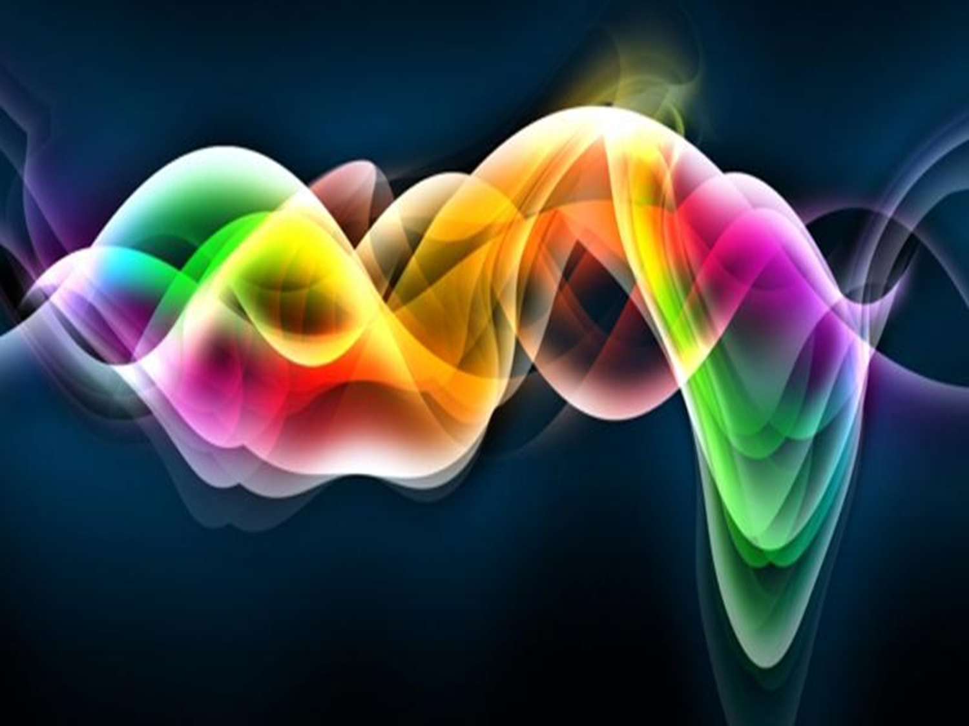
Formation of Urine
Reabsorption
This reabsorption process allows water (H2O) to pass from the glomerular filtrate back into the circulatory system

Slide 10
Formation of Urine
Secretion
Some substances are removed from blood through the peritubular capillary
Urine is a collection of substances that have not been reabsorbed during glomerular filtration or tubular reabsorbtion.

Slide 11
Maintaining Water-Salt Balance
Reabsorption of water
Reabsorption of Salt
Diuretics
Hypernatremia

Slide 12
Reabsorption of water
Exercised by the anti-diuretic hormone (ADH)
Without ADH, little water is reabsorbed
ADH causes the insertion of water channels

Slide 13
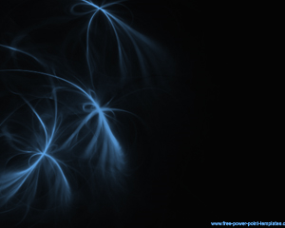
Reabsorption of Salt
1-ADH helping to dilute bodily fluids
2-Aldosterone promotes the excretion of potassium ions
Diuretics
1-Is any drug that elevates the rate of bodily urine excretion
Hypernatremia
1-Increase in plasma sodium levels above normal

Slide 14
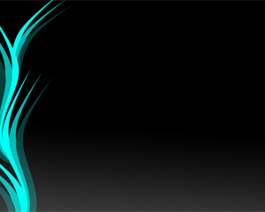
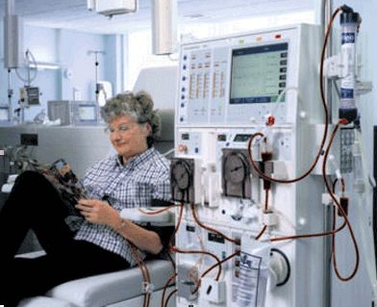
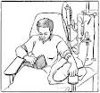
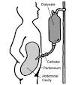
URINARY SYSTEM ‘S PATHOLOGY

Slide 15
Kidney stones is the term commonly used to refer to stones, or calculi, in the urinary system. Stones form in the kidneys and may be found anywhere in the urinary system.
Prostatitis is inflammation of the prostate gland that results in urinary frequency and urgency, burning or painful urination, a condition called dysuria, and pain in the lower back and genital area
Urinary tract infections (UTIs) are caused by bacteria in the urinary tract.

Slide 16
Urinary incontinence, loss of bladder control, is the involuntary passage of urine.
Urinary retention, or bladder-emptying problems, is a common urological problem with many possible causes. Normally, urination can be initiated voluntarily and the bladder empties completely
Proteinuria is the presence of abnormal amounts of protein in the urine.

Slide 17
