Slide 1
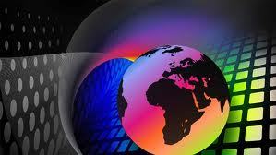
Communications

Slide 2
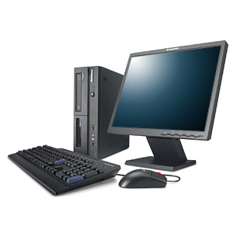
The Computer
A computer is a device that accepts information (in the form of digitalized data) and manipulates it for some result based on a program or sequence of instructions on how the data is to be processed. Complex computers also include the means for storing data (including the program, which is also a form of data) for some necessary duration.

Slide 3
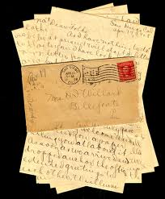
It is written in formal language, usually used when writing from one business organization to another, or for correspondence between such organizations and their customers, clients and other external parties. The overall style of letter will depend on the relationship between the parties concerned. There are many reasons to write a business letter
The Letter

Slide 4
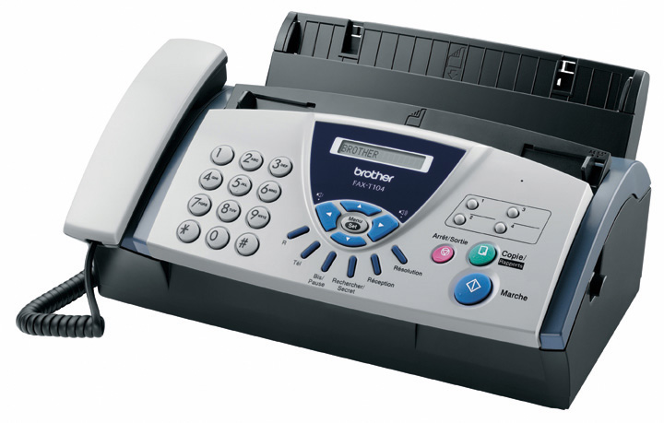
The Fax
A fax (short for facsimile and sometimes called telecopying) is the telephonic transmission of scanned-in printed material (text or images), usually to a telephone number associated with a printer or other output device.

Slide 5
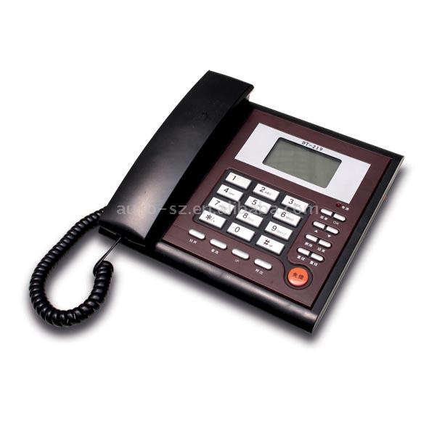
It is a telecommunications device that transmit and receives sound, usually the human voice. Telephones are a point to point communication system whose most basic function is to allow two people separated by large distances to talk to each other.
The fax

Slide 6
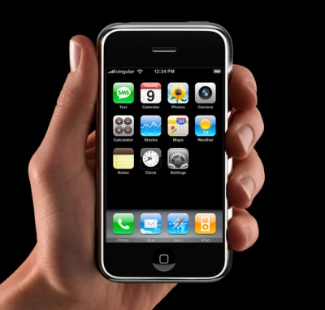
The Cellular Phone
Cellular telephone, sometimes called mobile telephone, is a type of short-wave analog or digital telecommunication in which a subscriber has a wireless connection from a mobile telephone to a relatively nearby transmitter. The transmitter's span of coverage is called a cell. Generally, cellular telephone service is available in urban areas and along major highways.

