Slide 1
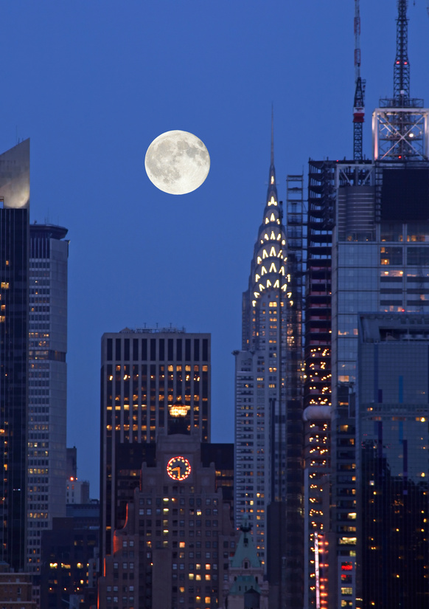
My First Choice
Egypt

