Slide 1
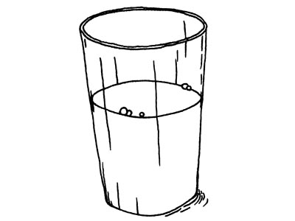
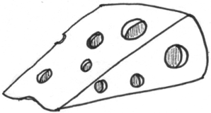
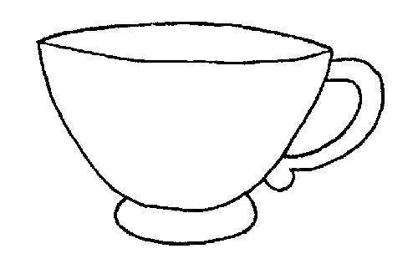
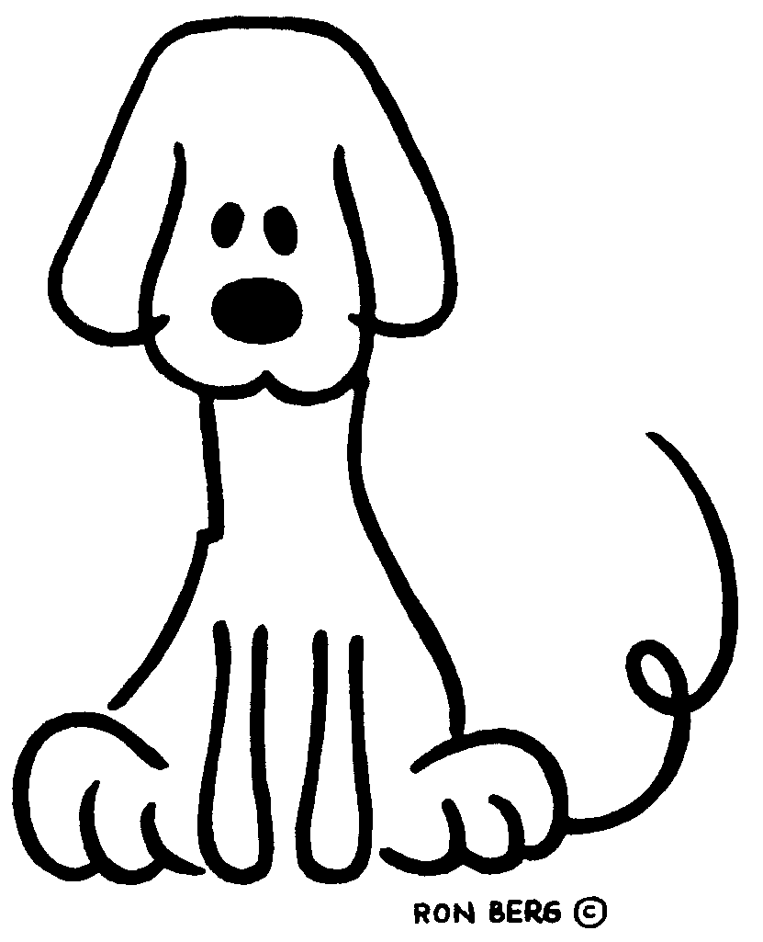
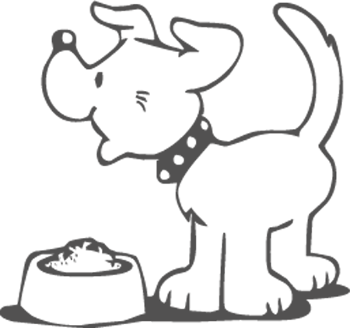
How much ....? =uncountable nouns How many ....? = countable nouns
Milk food cheese apple cup dog
( sustantivos que no puedes contar) (sustantivos que puedes contar)
Examples: Examples:
How much milk does karla drink? How many apples are there in the picture?
Karla drinks milk everyday.
How much food does the dog eat?
there are five(5) apples.
New words- nuevas palabras.
some: algo, un poco.
The dog eats some food. everyday: todos los dias.

