Slide 1
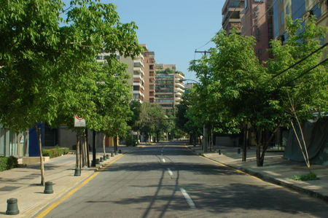
The street

Slide 2
Street

Slide 3
Street name

Slide 4
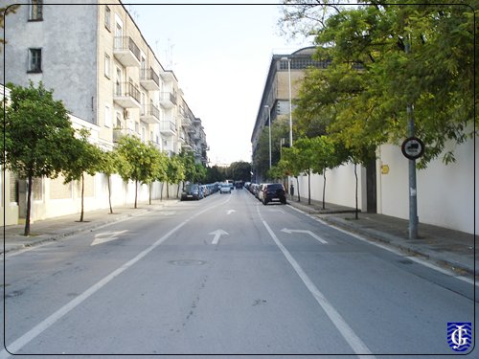
Pavement

Slide 5
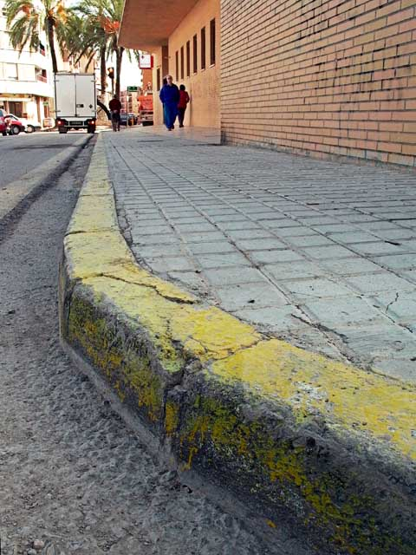
sidewalk

Slide 6
Cross road

Slide 7
roundabout

Slide 8
Buildings

Slide 9
Houses

Slide 10
Telephone box

Slide 11
Bench

Slide 12
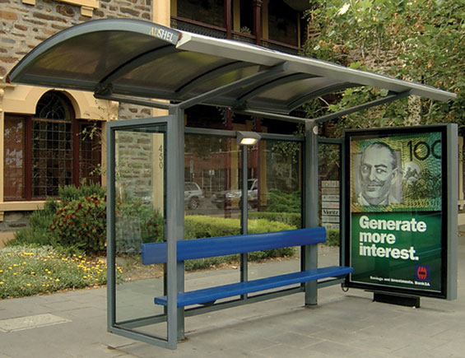
Bus stop

Slide 13
Bus stop signal

Slide 14
underground

Slide 15
Traffic lights

Slide 16
Traffic signs

Slide 17
Traffic signals

Slide 18
cabstand

Slide 19
Park

Slide 20
milestones

Slide 21
playground

Slide 22
Bridge

Slide 23
SHOPS AND BUILDINGS

Slide 24
bakery

Slide 25
butchers

Slide 26
Fish market

Slide 27
Clothes shop

Slide 28
cinema

Slide 29
Hospital

Slide 30
laundry

Slide 31
school

Slide 32
Sports centre

Slide 33
supermarket

Slide 34
Theatre

Slide 35
Transportation

