Slide 1
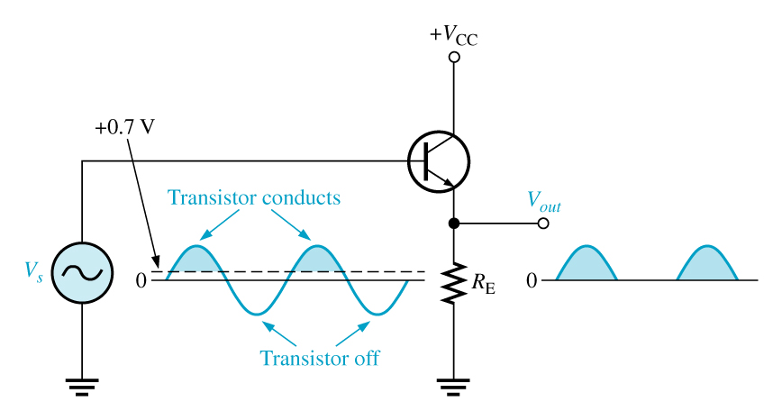
Class b amplifier
An amplifier that has two transistors; each biased to operate in the linear region for 180° of the input cycle and in cutoff for the other 180°.
Since a transistor operating in class B conducts for only 180º of its input cycle, two transistors are required to replicate a complete cycle of the amplifier input; one amplifies the positive cycle and the other amplifies the negative cycle.

