Slide 1
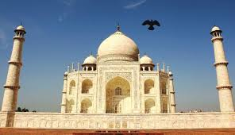
In India you have to:
Say «Namaste» when you meet someone
Take your shoes off
Refuse the first snack or drink
Wear the sari (if you are a women)

