Slide 1
Santa Elena Canyon Stratigraphic Column
By Harriet Furton

Slide 2
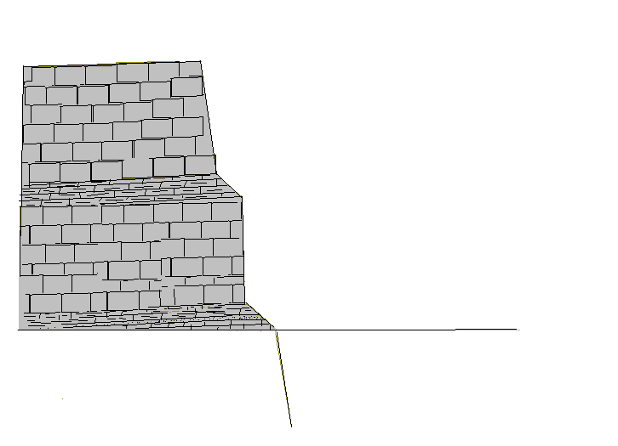
Limestone – resistant rock
Forms ridges
Mid Cretaceous – deep ocean
Mesa de Anguila (US Side)
Shale with limey sediment -easily erodes
Forms slopes more than ridges
Early Cretaceous – intermediate ocean
740 ft
Santa Elena Limestone
Cherty, grey limestone - resistant
Forms ridges
Early Cretaceous – deep ocean
Uplift
Sue Peaks formation
75-250 ft
Drop
Early Cretaceous – deep ocean
350-475 ft
Del Carmen Limestone
Sandstone
Early Cretaceous – shallow ocean
75 ft
Telephone Canyon Formation
Hard limestone
Early Cretaceous (110 mya)– deep ocean
Maxon Formation
Glen Rose Limestone
Rio Grande Level
Terlingua Fault
Glen Rose Limestone
Normal fault due to a NW-SE crustal extension
in the Tertiary Period, around 26 million years ago

Slide 3
Chert- some algae, diatoms, are able to extract silica out of water and incorporate into their exoskeletons. After dying, their exoskeletons accumulates at the bottom of the ocean and with time it lithifies.

Slide 4
Resources
Spearing, Darwin. Roadside Geology of Texas. Missoula:Mountain Press Publishing Company, 1998.
http://geology.com/
http://tin.er.usgs.gov/geology

