Slide 1
ROCKIN’ AROUND BIG BEND!
Sample library from several of Big Bend’s important rock formations

Slide 2
Click to learn more about a formation!
AGUJA FORMATION -
FOSSILIFEROUS LIMESTONE
MARAVILLAS FORMATION -
LIMESTONE AND CHERT
HAYMOND FORMATION -
SHALE & SANDSTONE
CAMEL’S HUMP FORMATION -
VESICULAR IGNEOUS ROCK

Slide 3
Aguja Fm. – south of Terlingua
AGE: Late Cretaceous
ROCK TYPE: “Muddy limestone”
NOTE: A fm. nearby is called Needle Peak
  (Aguja is Spanish for “needle!”)
Reacts with dilute HCl
  Calcareous, fossiliferous
    Macrofossils: shell fragments, worm tubes
    Microfossils: act as cement
From formerly marine environment

Slide 4
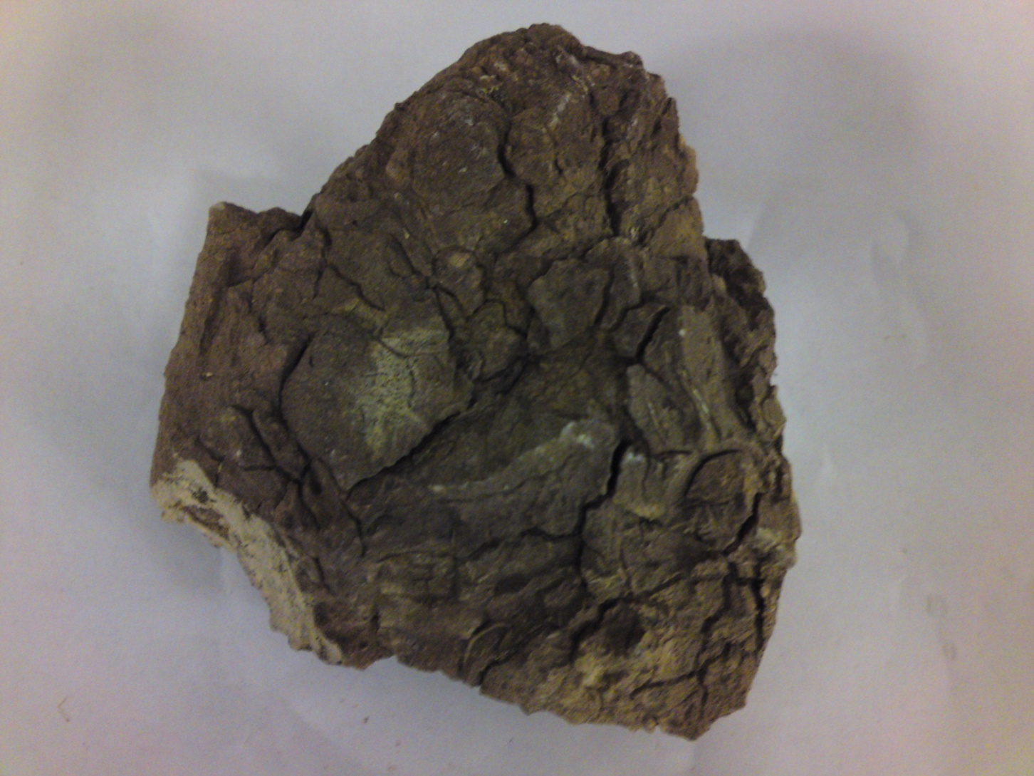
Aguja Fm. – fossiliferous limestone (sedimentary)
NOTE:
WHITE BITS
ARE SHELL MACROFOSSILS, CEMENT IS
MICROFOSSILS

Slide 5
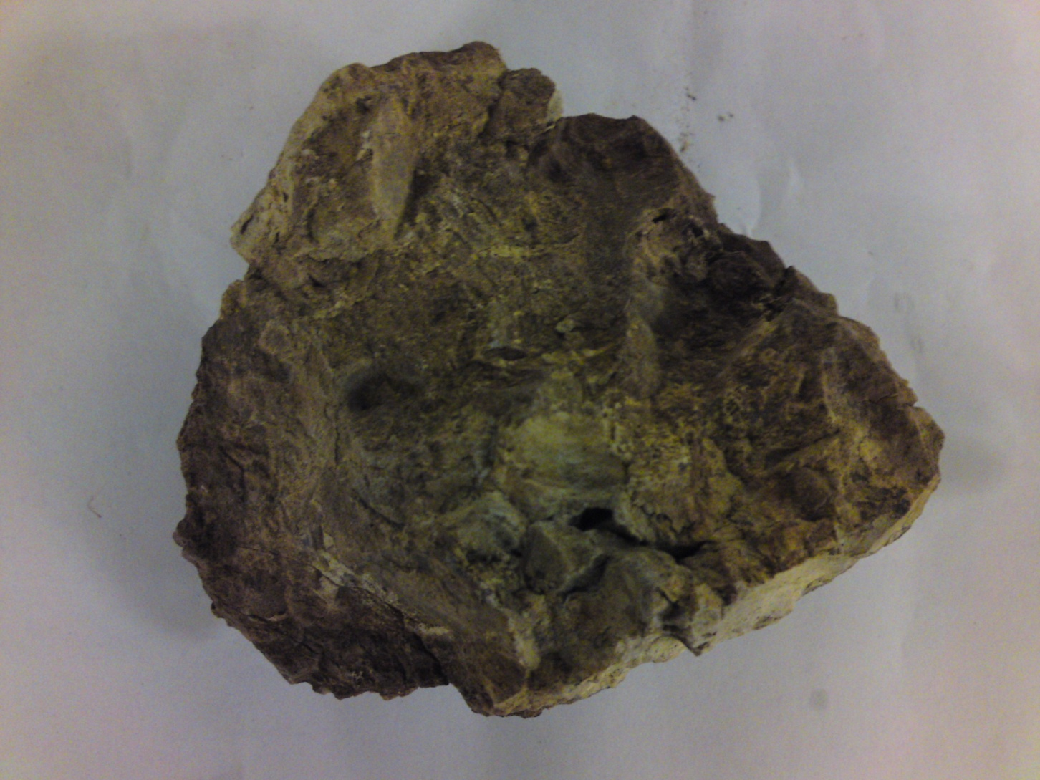
Aguja Fm. – fossiliferous limestone (sedimentary)
NOTE:
FOSSILIZED
WORM TUBES
BACK TO FORMATION LIST

Slide 6
Haymond Fm. – Just E of Marathon
AGE: Pennsylvanian, ~300 mya
ROCK TYPES:
  SAMPLE 1 – shale
  SAMPLES 2 & 3 – sandstone and shale
  SAMPLE 4 – sandstone
From formerly shallow water environment
  “ripples” on top of sample 4 indicate this
  Deposited by turbidity currents
Fine-grained olive brown sandstone alternates with black-banded shale in near-vertical beds
BACK TO FORMATION LIST

Slide 7
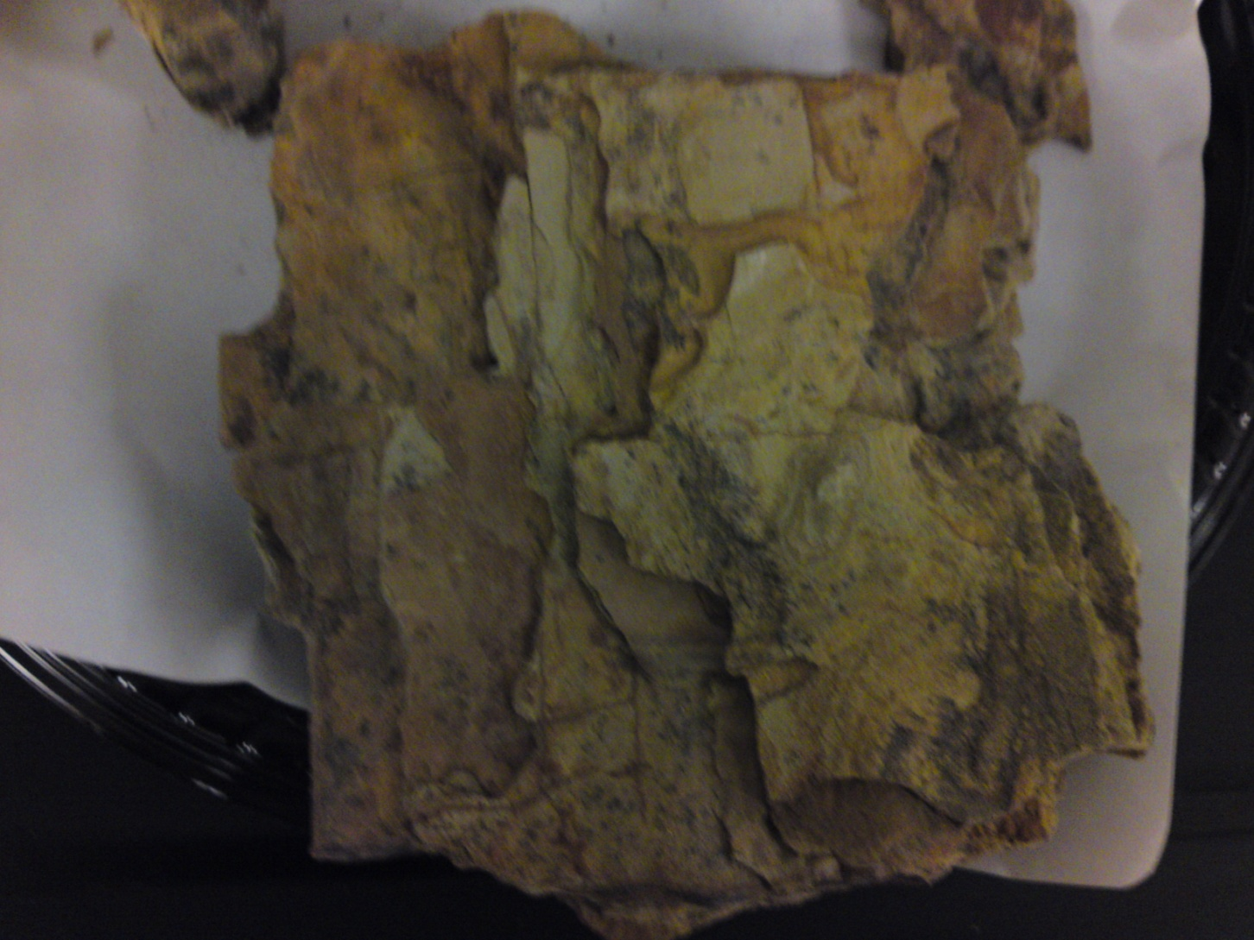
Haymond Fm. – sample 1; shale (sedimentary)

Slide 8
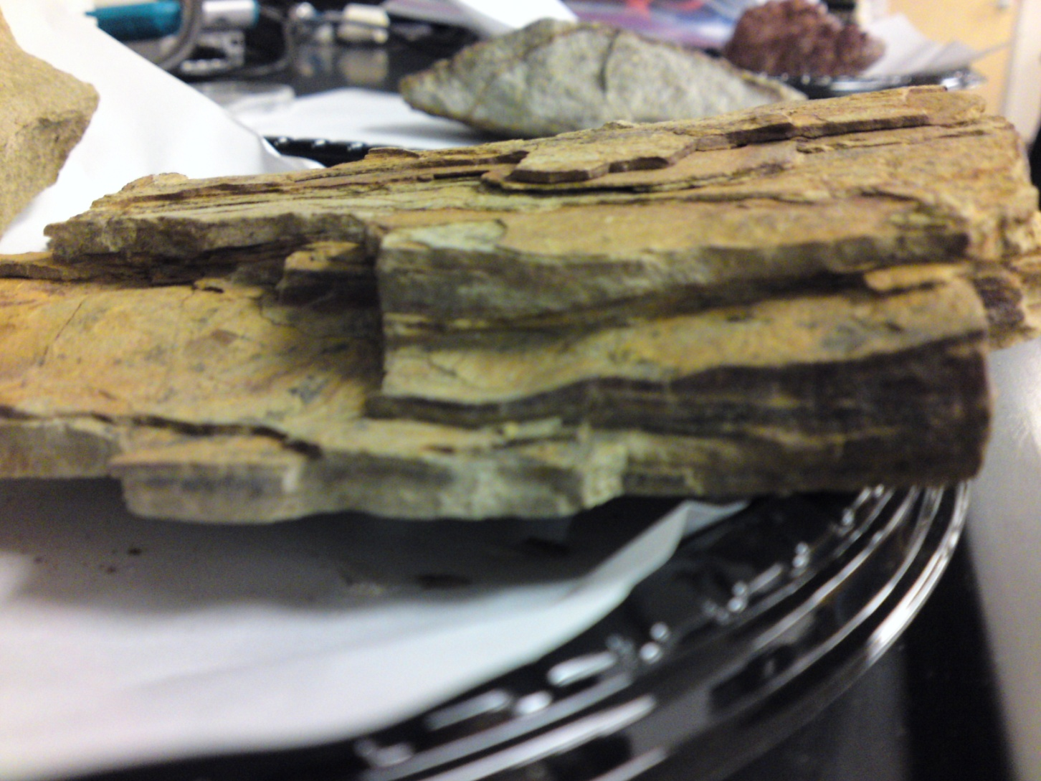
Haymond Fm. – sample 1; shale (sedimentary)
NOTE:
THE PLATY, LAYERED NATURE OF THIS SHALE COMES FROM DEPOSITION BY TURBIDITY CURRENTS OVER TIME
BACK TO HAYMOND FM. INFO

Slide 9
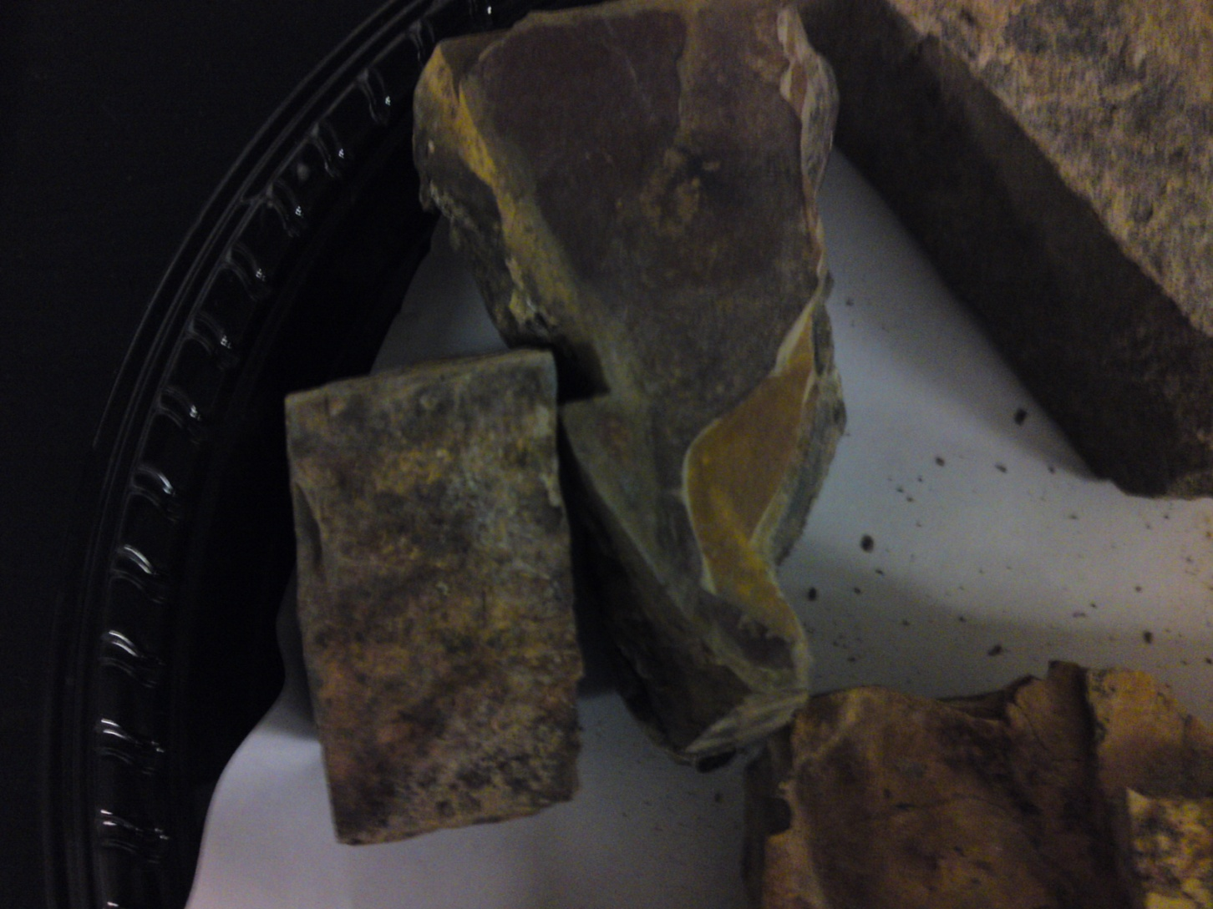
Haymond Fm. – samples 2 & 3; sandstone AND shale (sedimentary)

Slide 10
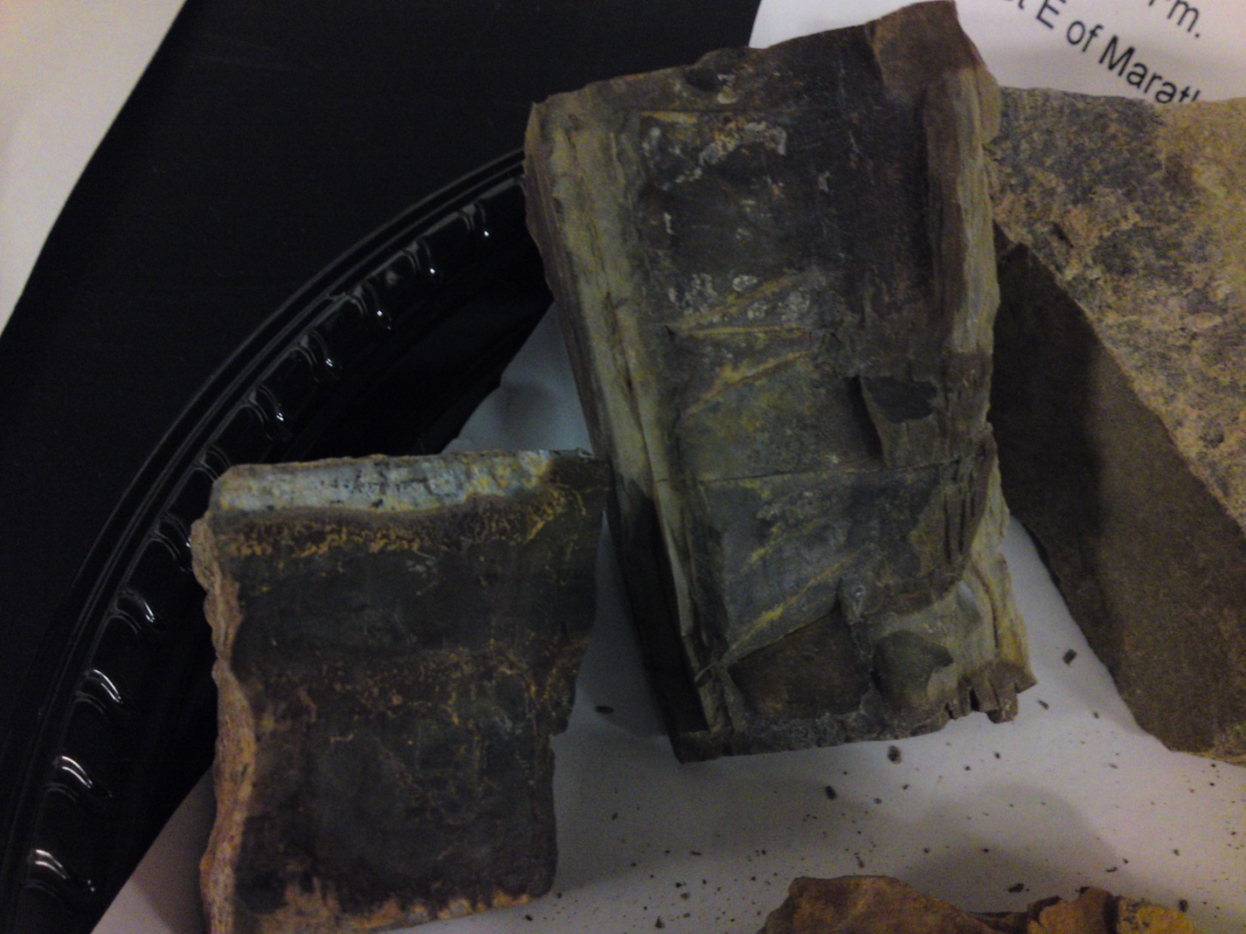
Haymond Fm. – samples 2 & 3; sandstone AND shale (sedimentary)
NOTE:
THIS ROCK HAS MORE BLOCKY FRACTURING THAN THE SHALE SAMPLE BECAUSE IT HAS SANDSTONE IN IT
BACK TO HAYMOND FM. INFO

Slide 11
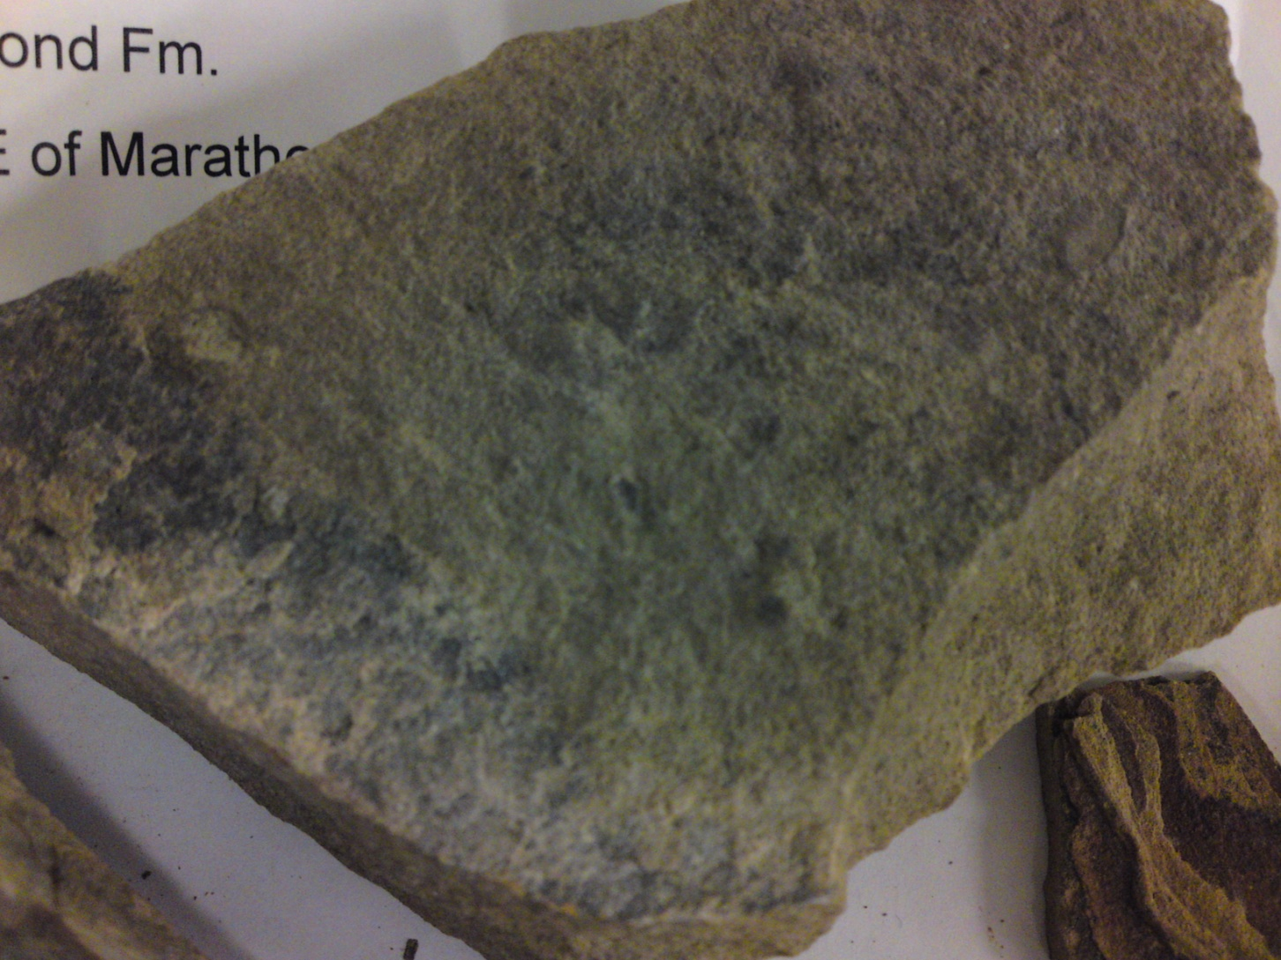
Haymond Fm. – sample 4; sandstone (sedimentary)
NOTE:
RIPPLES ACROSS SURFACE INDICATE THIS ROCK WAS DEPOSITED IN A SHALLOW-WATER ENVIRONMENT

Slide 12
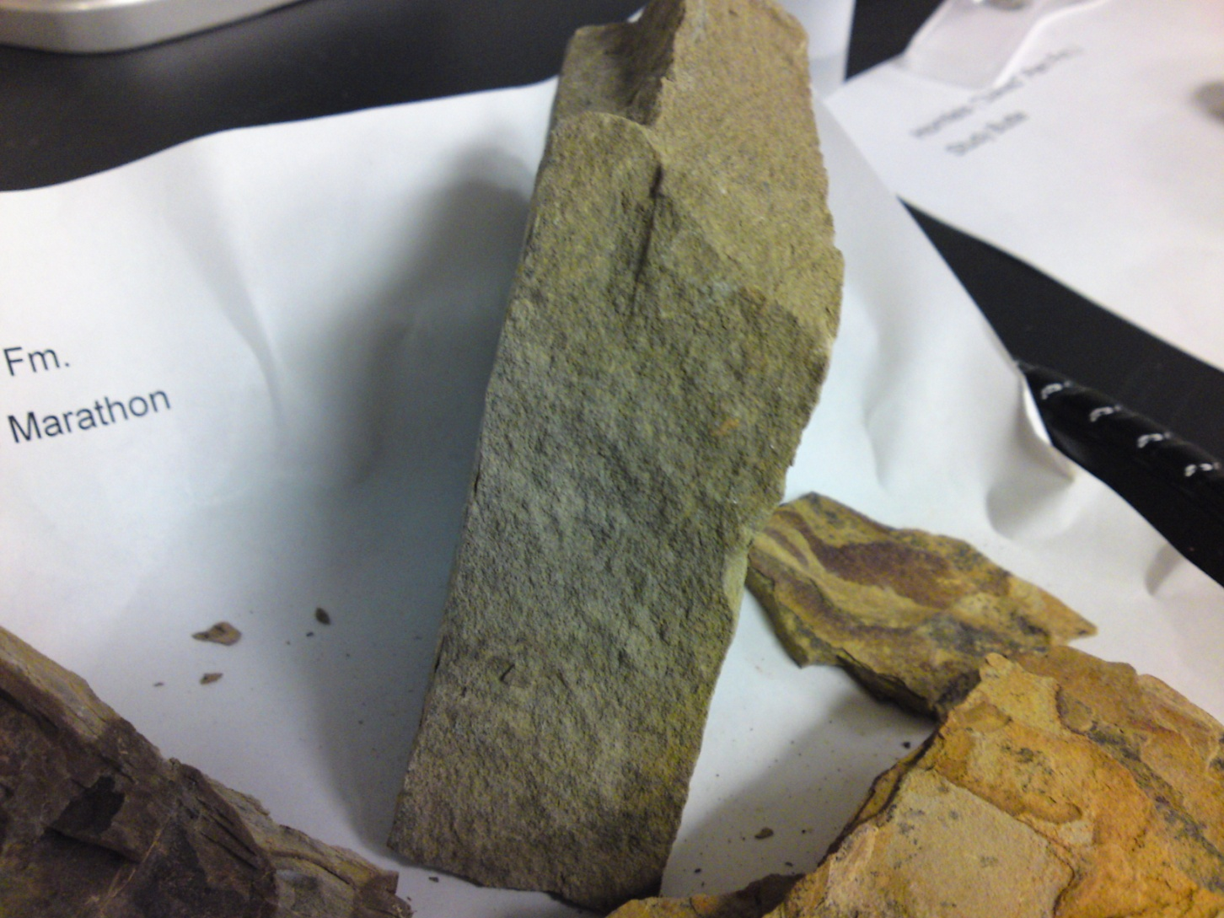
Haymond Fm. – sample 4; sandstone (sedimentary)
BACK TO HAYMOND FM. INFO
BACK TO FORMATION LIST

Slide 13
Maravillas Fm. – Just NE of Marathon
AGE: Late to middle Ordovician
ROCK TYPES:
  Limestone – fizzes with HCl in white and reddish layers
    Calcareous – made of calcium carbonate microfossils
  Chert - no fizzing in gray/black layers
    Siliceous – made of interlocking quartz crystals
From marine environment because contains radiolarians
  Can tell depth of rock in former environment by ratios of chert and limestone: diagram here

Slide 14
Ratios of chert and limestone to determine depth of formation
DEPTH
PRESSURE
CHERT
LIMESTONE
NOTE: CACO3 IS MORE SOLUBLE AT HIGHER PRESSURES AND LOWER TEMPS!

Slide 15
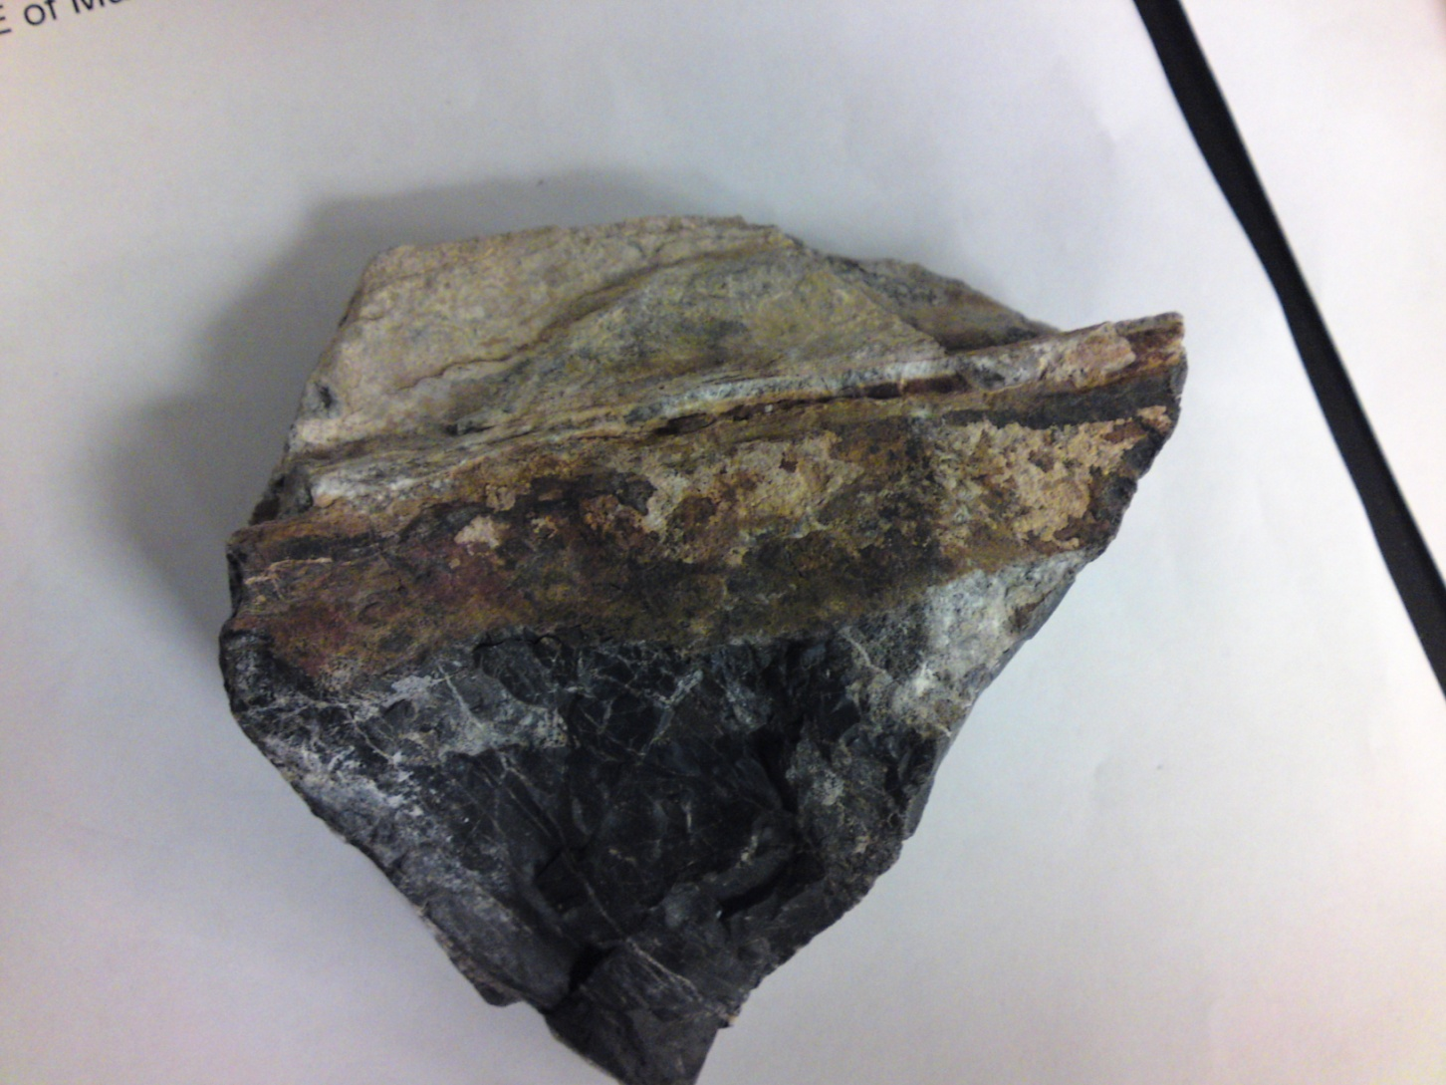
Maravillas Fm. – limestone and chert (sedimentary)
NOTE:
WHITISH AND RED ROCK IS LIMESTONE (REACTS WITH DILUTE HCL/CALCAREOUS)
NOTE:
DARK GRAY/BLACK ROCK IS CHERT (DOES NOT REACT WITH DILUTE HCL/SILICEOUS)
BACK TO FORMATION LIST

Slide 16
Camel’s Hump Fm. -
AGE: Pennsylvanian, ~300 mya
ROCK TYPE: Reddish, lightweight rock full of holes is an intrusive igneous rock that cooled very slowly underground with gas pockets trapped inside.
The green spots are opal trapped within.
Result of uplift event that eroded down over the years to create the “Two Camel’s Humps” shape.

Slide 17
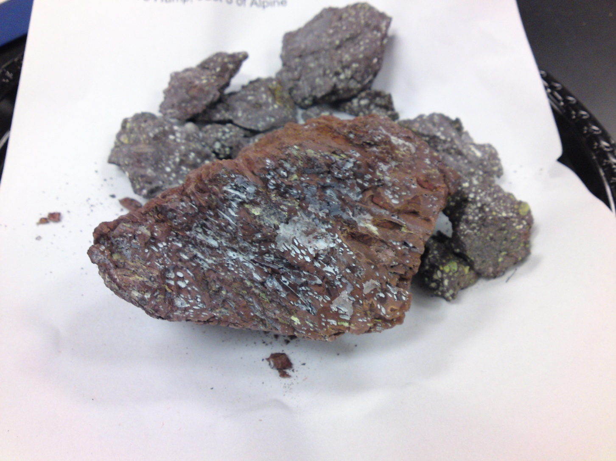
Camel’s Hump Fm. – vesicular igneous
NOTE:
GREEN BITS ARE TRAPPED OPAL CRYSTALS

Slide 18
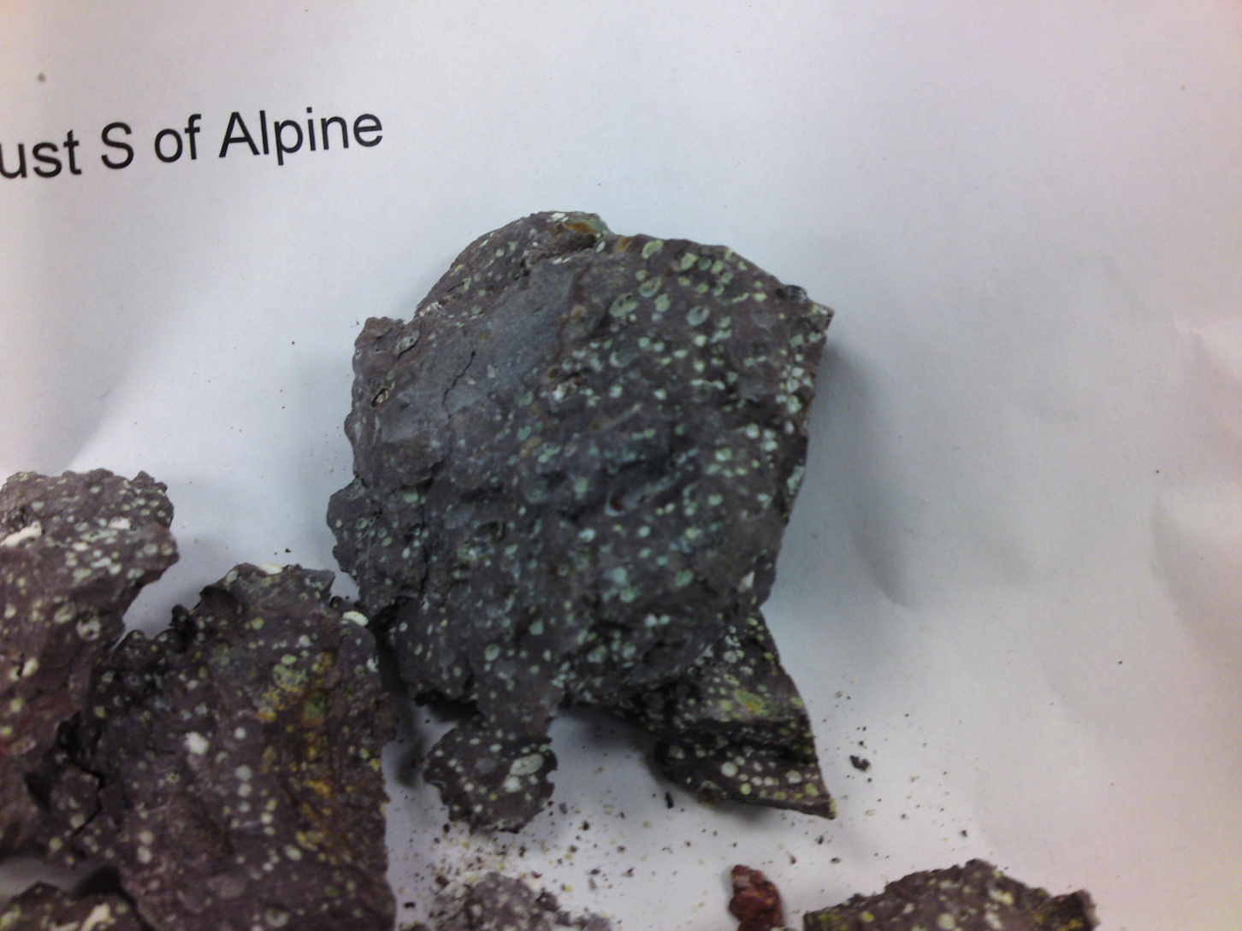
Camel’s Hump Fm. – vesicular igneous
TO BONUS FORMATION!

Slide 19
BONUS! One rock type creates another in the Baked Pen Fm.!
STUDY BUTTE: BAKED PEN FM. – BASALTIC INTRUSION
STUDY BUTTE: BAKED PEN FM.
- HORNFELS

Slide 20
“Baked” Pen Fm., basaltic intrusion
– Study Butte
AGE: Late Cretaceous (earlier than Aguja Fm.)
ROCK TYPE: Basalt (this is the igneous rock that “baked” the hornfels).
The intrusive igneous “plug” that created this basalt consisted of magma that never quite rose to the surface.
  Its intense heat metamorphosed the surrounding rock.
Whitish rock that reacts with dilute HCl is limestone that is stuck on from surrounding rocks.

Slide 21
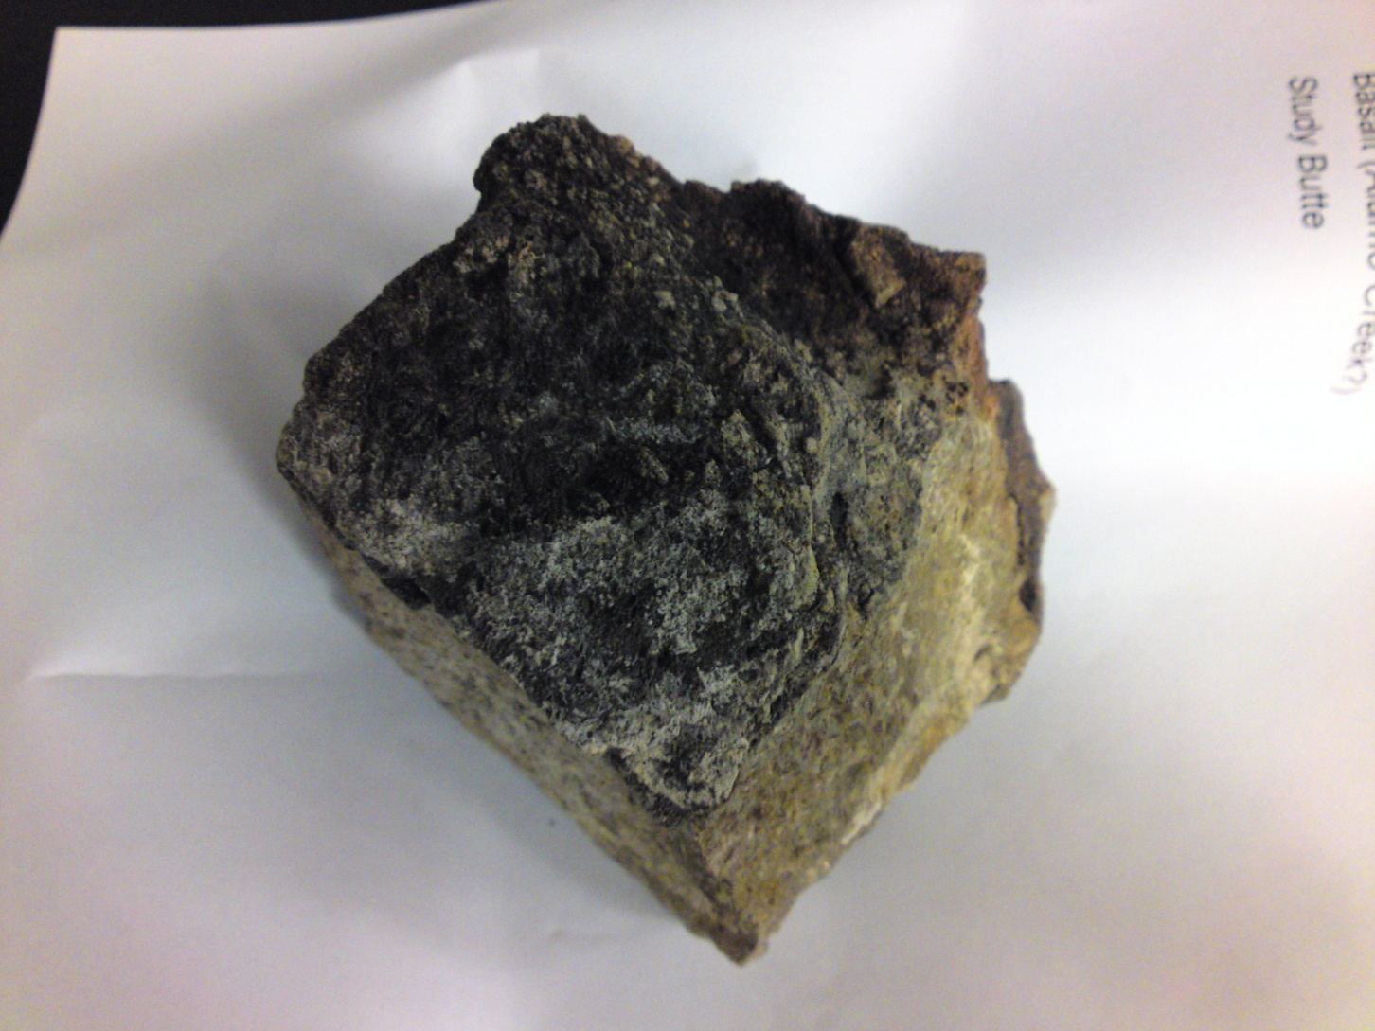
Study Butte, Baked Pen Fm. – basalt (igneous)
NOTE:
THIS IS THE IGNEOUS ROCK THAT CREATED THE HORNFELS; WHITISH ROCK IS LIMESTONE

Slide 22
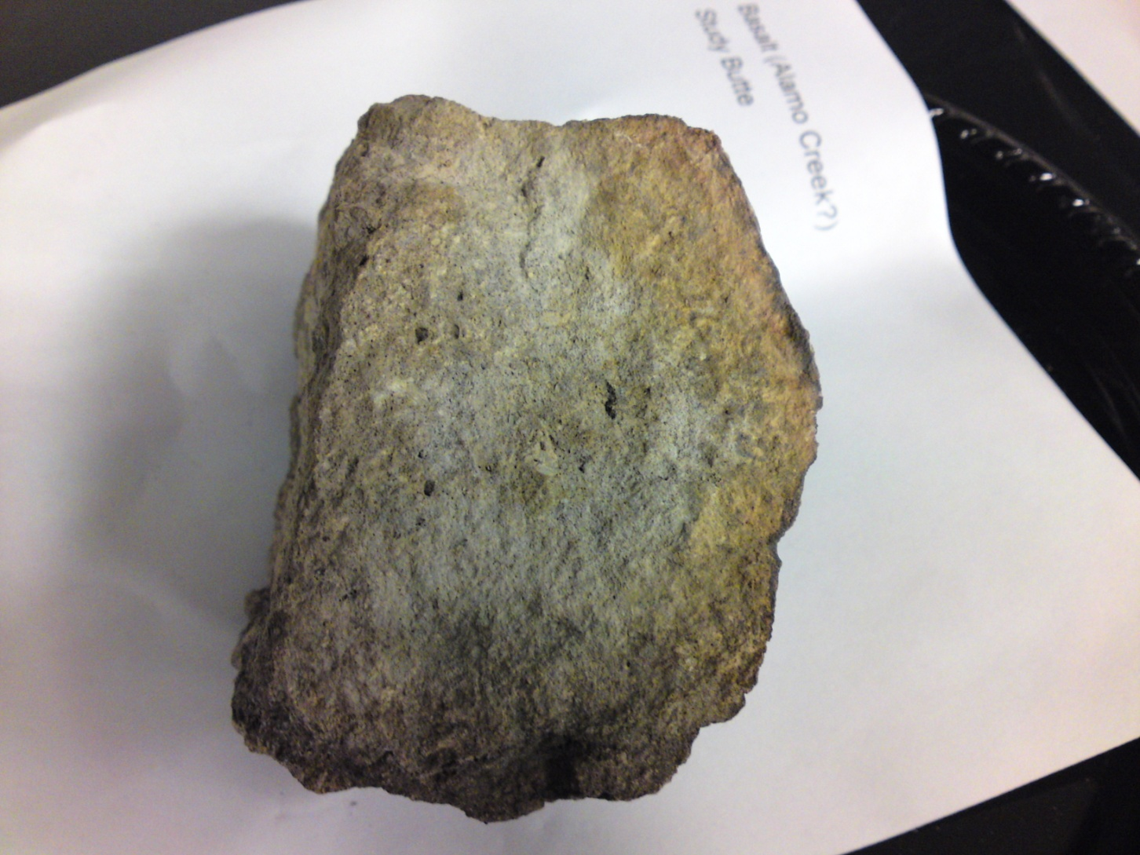
Study Butte, Baked Pen Fm. – basalt (igneous)

Slide 23
“Baked” Pen Fm., hornfels
– Study Butte
AGE: Late Cretaceous (earlier than Aguja Fm.)
ROCK TYPE: Hornfels (composed of quartz, feldspar and mica that has been metamorphosed). Before becoming hornfels, this rock was probably shale!
Basically, this hornfels is a rock created by contact metamorphism, which is when an igneous intrusion creates enough heat to literally “bake” an adjacent rock formation.
  The basalt in this fm. is the rock that was responsible for “baking” this hornfels.

Slide 24
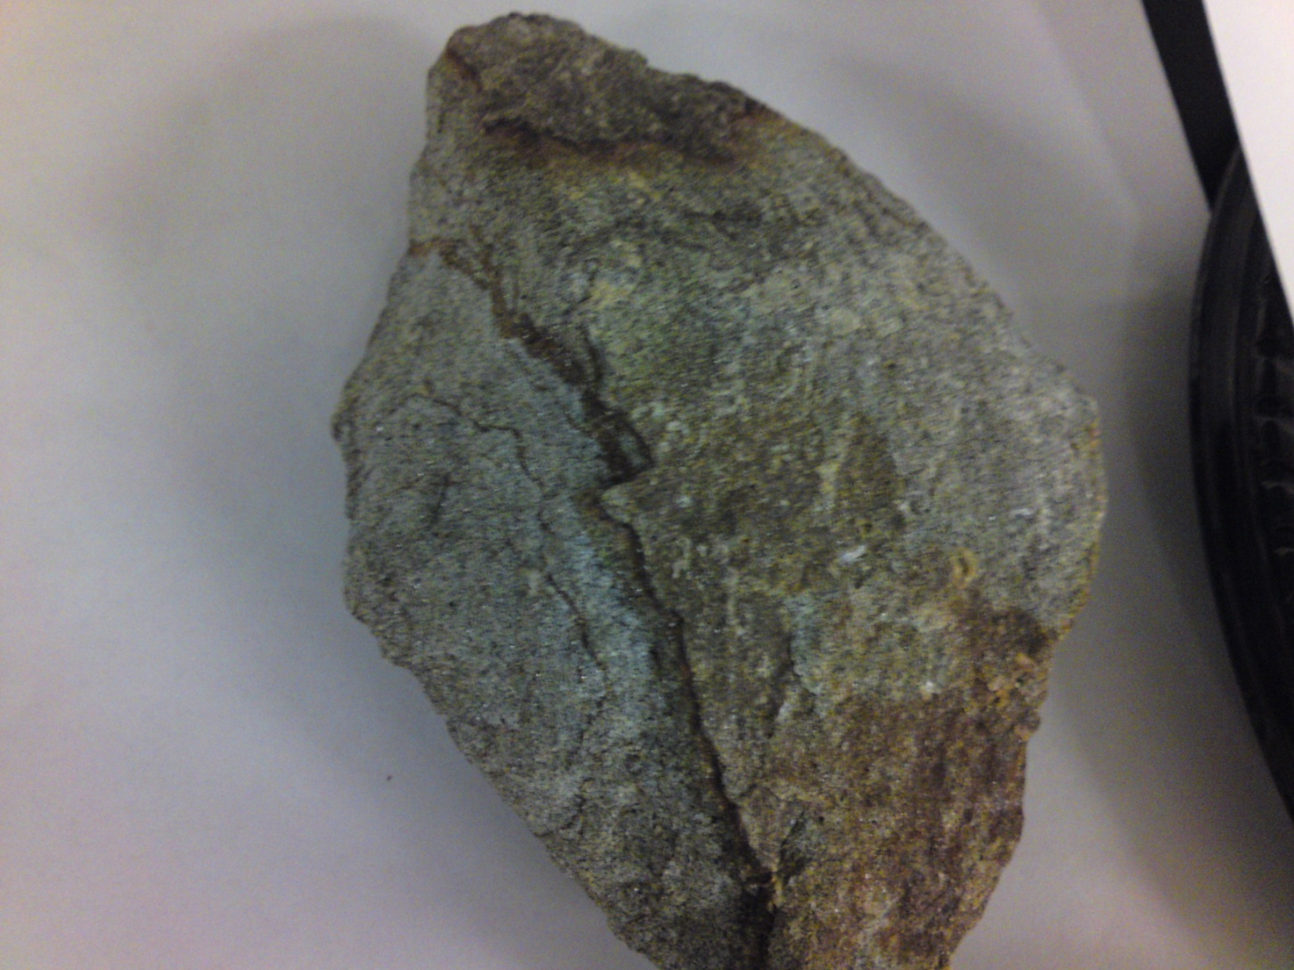
Study Butte, Baked Pen Fm. – hornfels (metamorphic)
NOTE:
THIS ROCK EVEN LOOKS LIKE IT WAS BAKED!

Slide 25
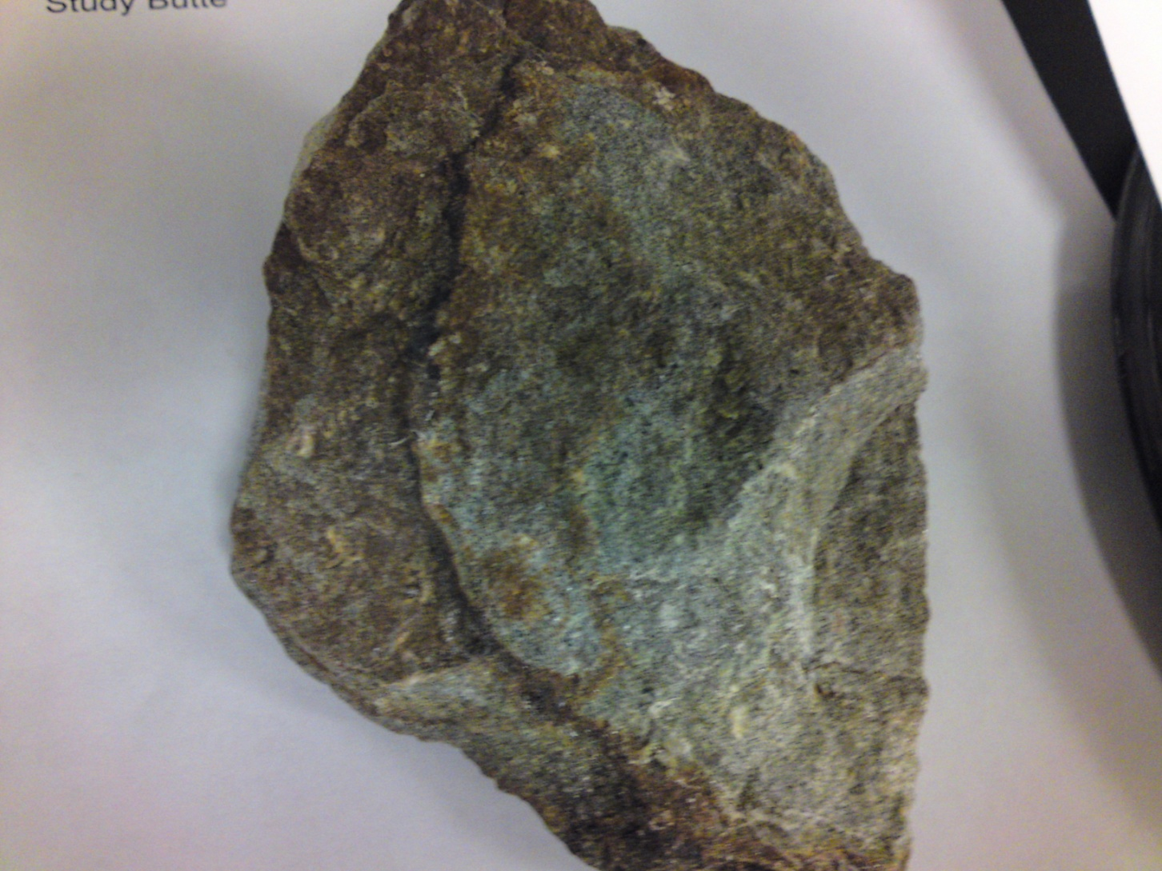
Study Butte, Baked Pen Fm. – hornfels (metamorphic)
TO SUMMARY

Slide 26
KEEP ON ROCKIN’ !
As you analyze new samples, keep in mind their age, origin, location, composition and position relative to other rocks in the formation.
Now go unlock some of Earth’s most fascinating mysteries!!!

