Slide 1


The Northern Corridor Partnership
Geoff Timm & Tom McCue
Partnership Brokers
Queensland Youth Industry Links
Notes:
1

Slide 2


Slide 3
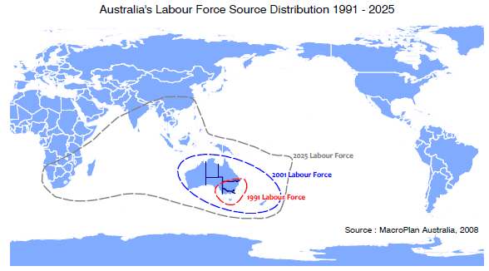

Global Drivers
Changing nature of labour markets

Slide 4
LOCAL DRIVERS
More people 65+ are working
Notes:
yes

Slide 5
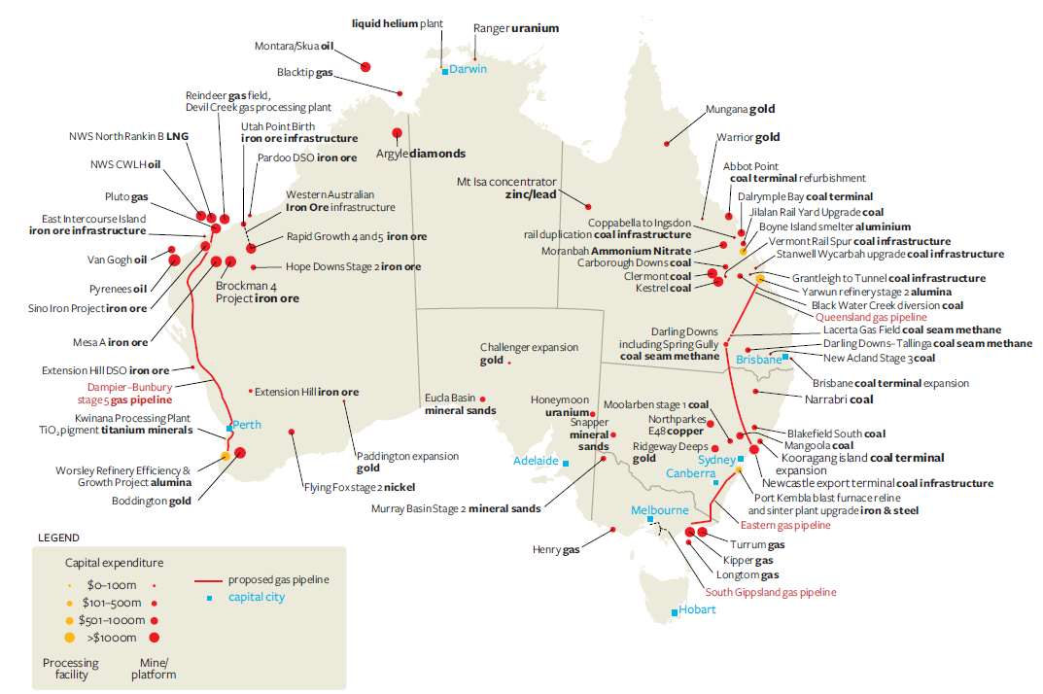
NATIONAL DRIVERS
Advanced resource projects
Source: ABARE (2009)
Notes:
yes

Slide 6
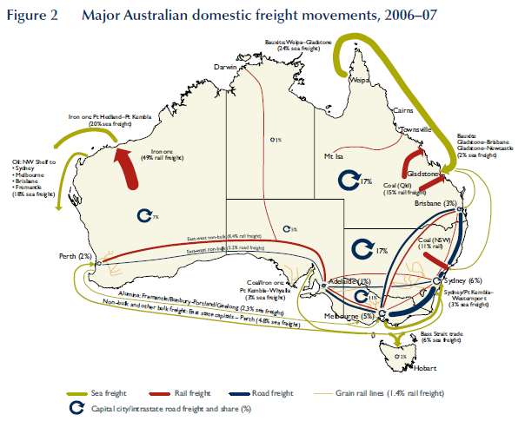
NATIONAL DRIVERS
Catalysts: Freight & Logistics
Source: BITRE (2008)
Notes:
yes

Slide 7
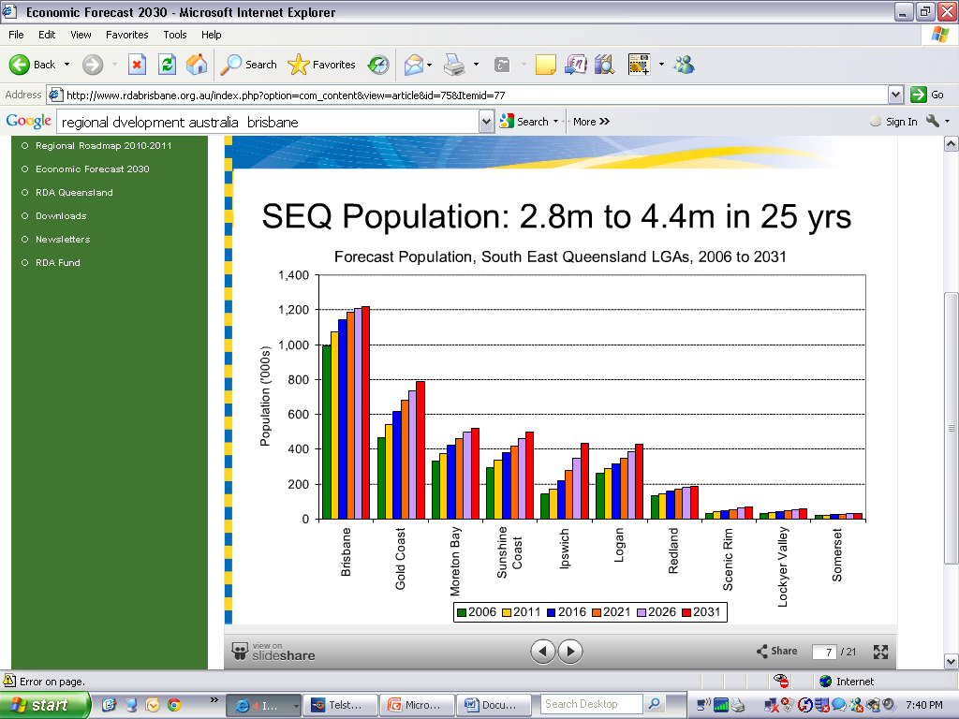
Notes:
yes

Slide 8
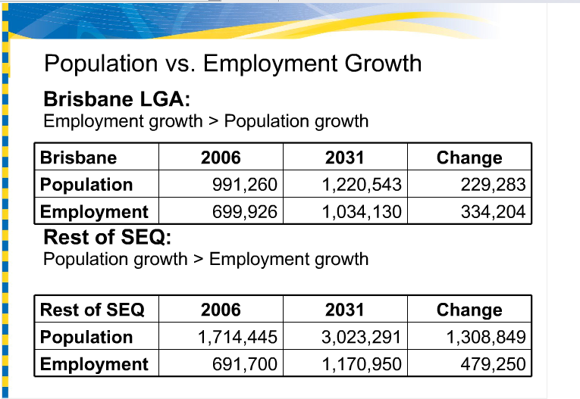
Notes:
yes

Slide 9
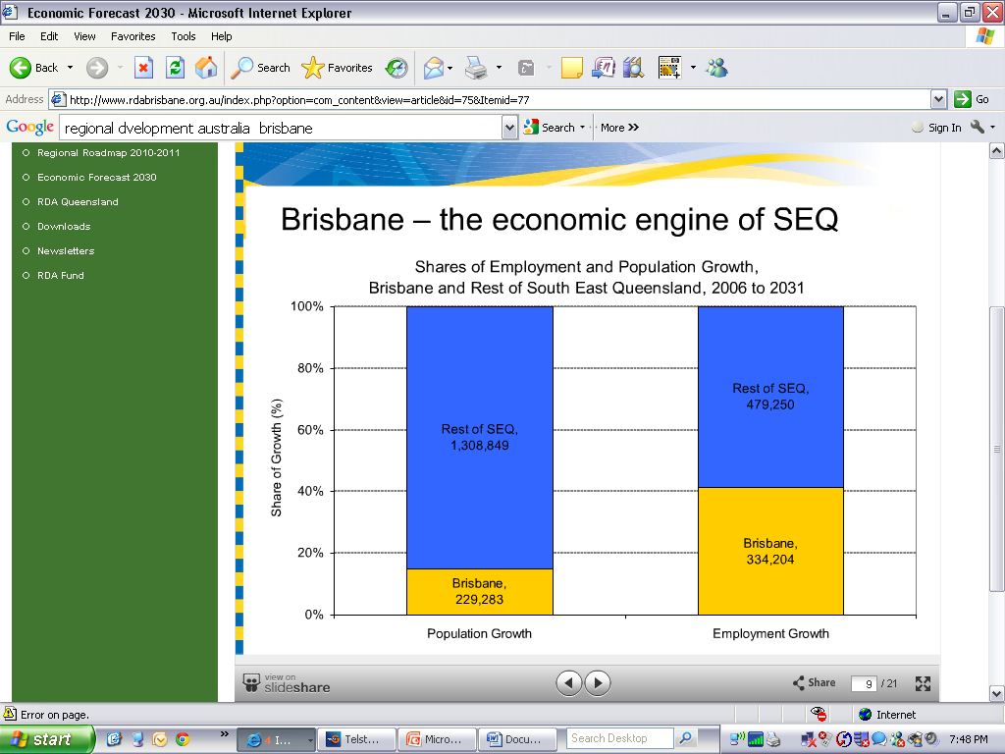
Notes:
Yes. Disproportionate number of jobs in Brisbane

Slide 10
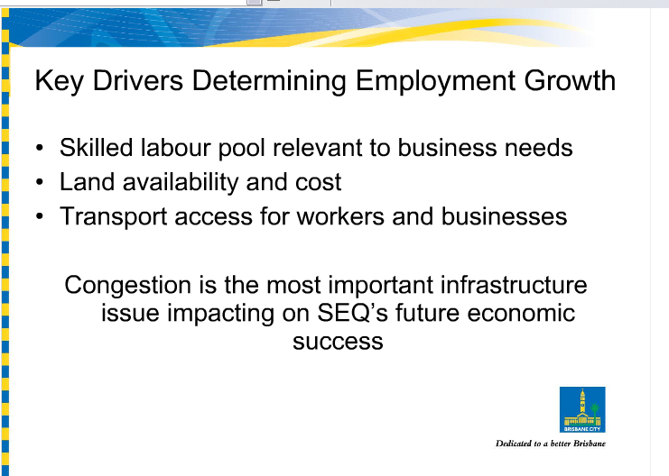

Slide 11
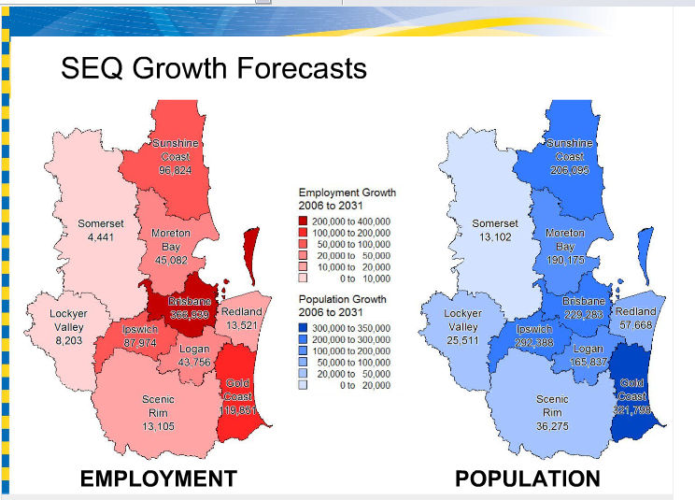
Notes:
Think about this one

Slide 12
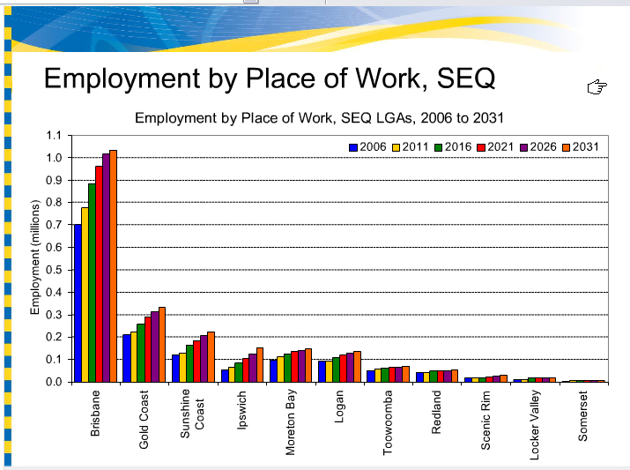
Notes:
Disproportionate jobs focus on Brisbane

Slide 13
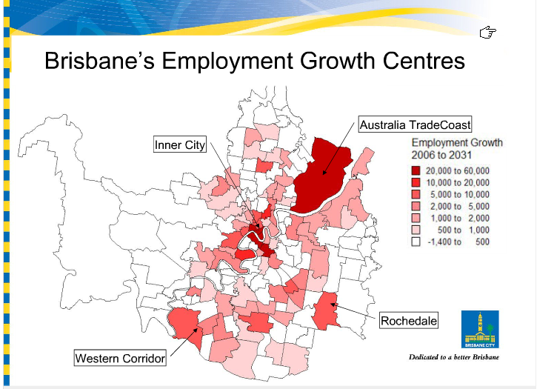

Slide 14
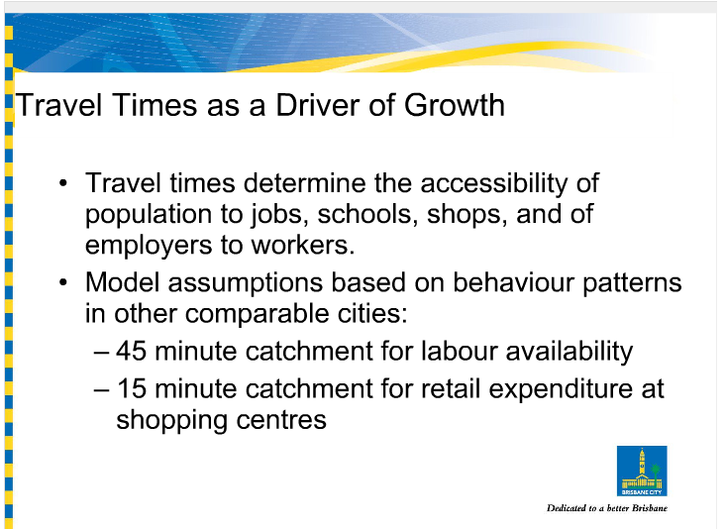
Notes:
Think about this one what do the figures mean?

Slide 15
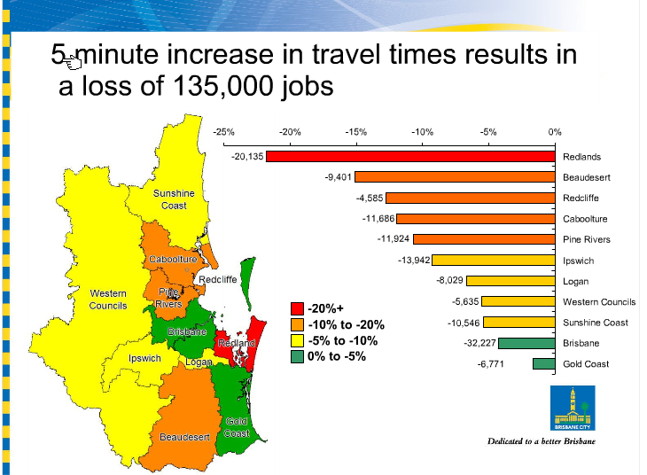
Notes:
What does this stat mean?

Slide 16
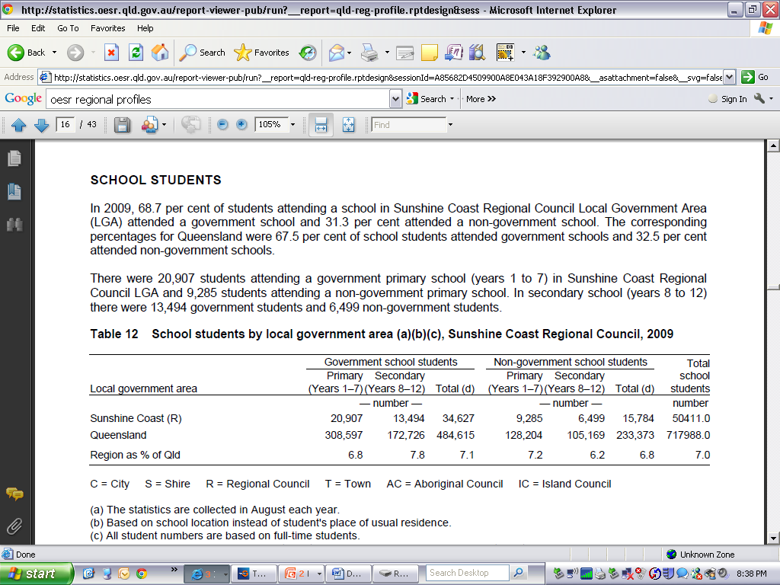
Notes:
To provide context

Slide 17
30,192 Primary
29.6 %
19,993
Secondary

Slide 18
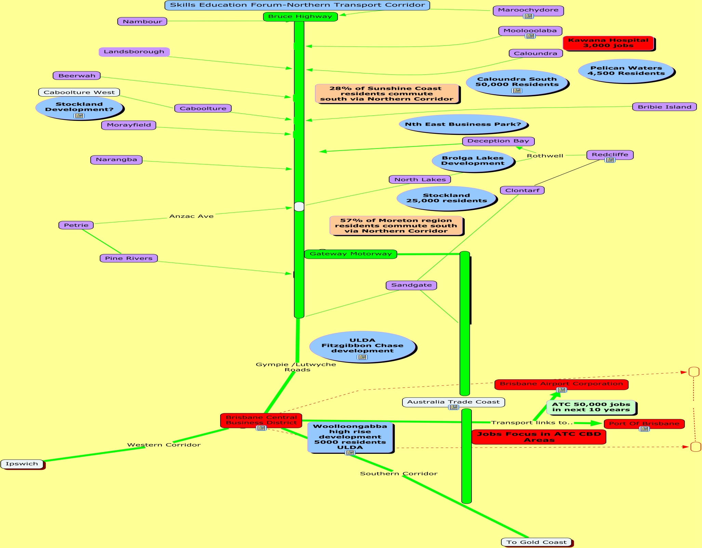

Slide 19
To summarise..
Residential development
Sunshine Coast
Pelican Waters 4,500 new residents
Caloundra South 50,000 new residents
27% of Sunshine Coast residents commute to the South each day

Slide 20
Residential development
Moreton Region.
Caboolture West
Caboolture Central
Further development planned for the Morayfield/Burpengary area
Brolga Lakes
Northlakes 25,000 new residents

Slide 21
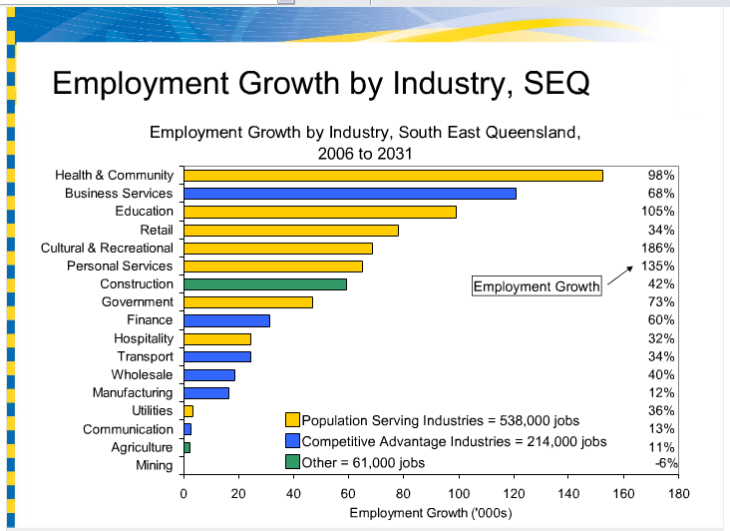

Slide 22
