Slide 1
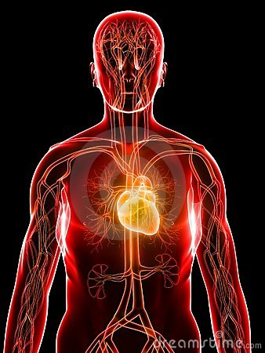
CARDIOVASCULAR SYSTEM
By :
Arauz Leticia
Ávila María Teresa
Morales Lidenis
Santiago Mónica
Santamaría Angelis

Slide 2
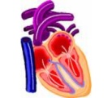
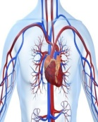
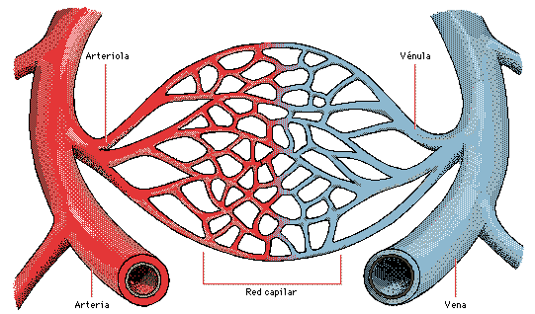
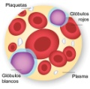
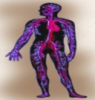
DEFINITION OF CARDIOVASCULAR SYSTEM
COMPONENTS OF CARDIOVASCULAR SYSTEM
PHYSIOLOGY OF THIS SYSTEM
HEART
Blood Vessels
IMPORTANCE OF THE CARDIOVASCULAR SYSTEM
Blood
TABLE OF CONTENTS

Slide 3
CARDIOVASCULAR SYSTEM
Index
The term “vascular” means blood vessels.
The term “cardiovascular” is a combination of two word; “Cardio” and “vascular”.
The term “cardio” is derived from “cardiac” meaning Heart
Cardiovascular system means the system of heart and blood vessels of human body.
So the name itself indicates that

Slide 4
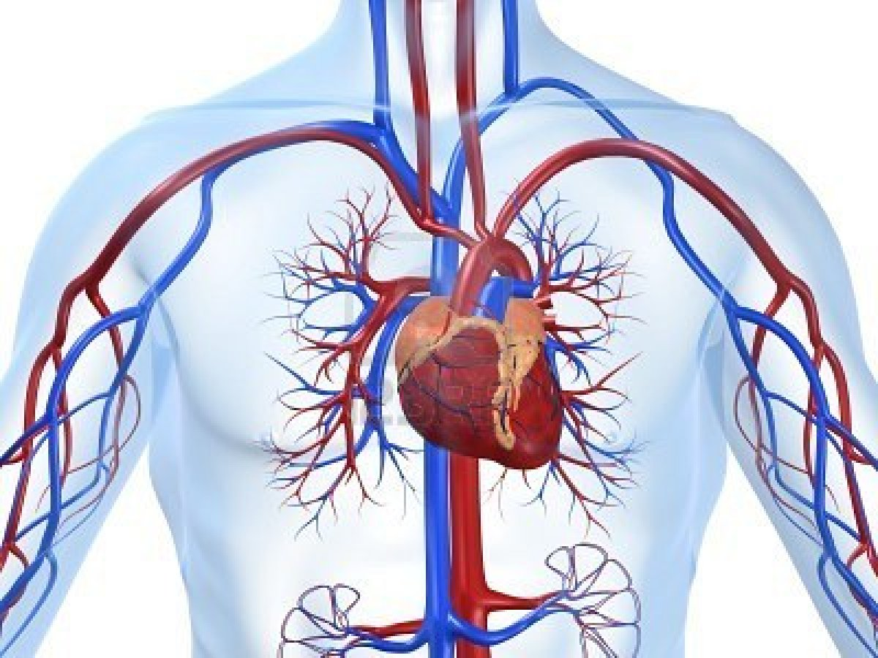
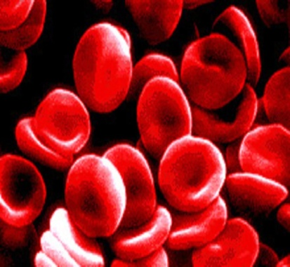
COMPONENTS OF CARDIOVASCULAR SYSTEM
Index
Heart
Blood Vessels
Blood

Slide 5
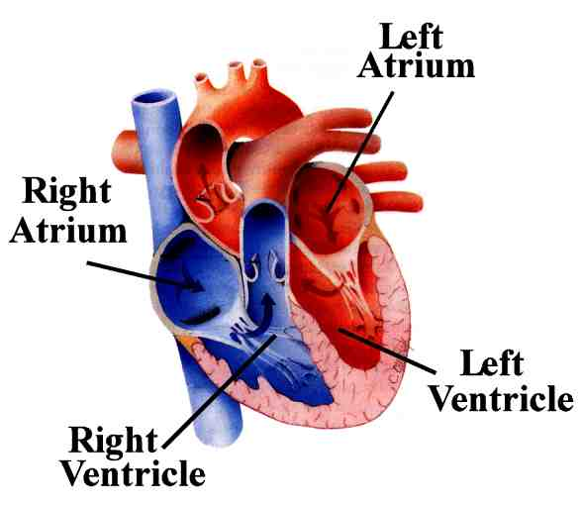
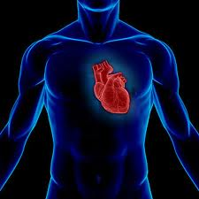
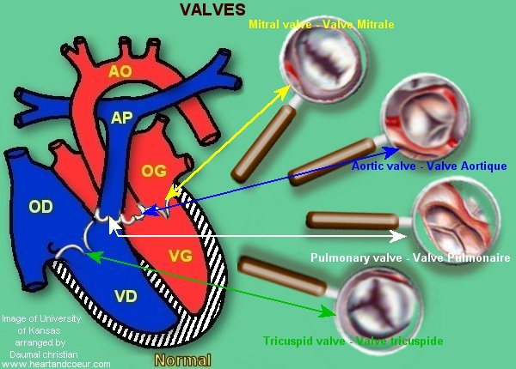
THE HEART
Index
HAVE:
2 atriums
2 ventricles
HAVE
4 valves:
Aortic valve
Pulmonary valve
Mitral valve
Tricuspid valve
It`s located in the middle of the chest , called the mediastinum

Slide 6
Index
PARTS OF THE HEART

Slide 7
Index
LOCALITATION OF THE HEART

Slide 8
Index
VALVES OF THE HEART

Slide 9
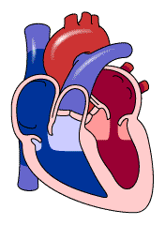
THE HEART
Index
Index
IT´S
A muscular organ and its size is like a closed hand
its function is
Blood pumping to all parts of the body.
AND
Heart have three layers:
Pericardium
Myocardium
Endocardium.

Slide 10
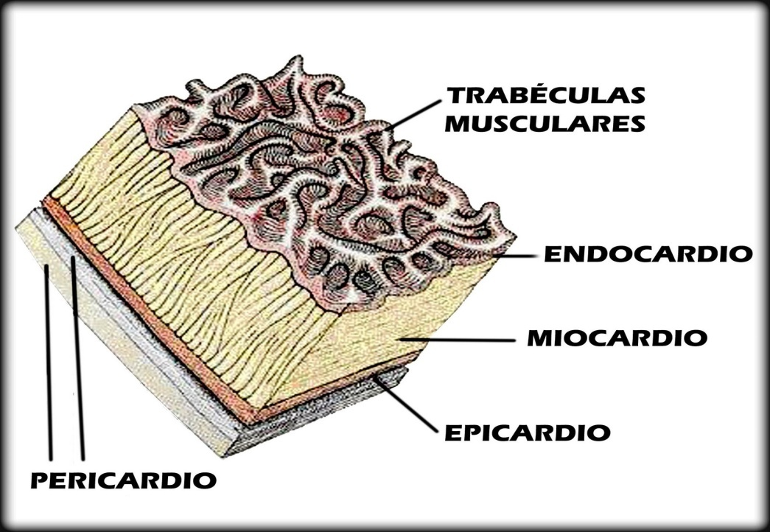
LAYERS OF THE HEART
Index
Endocardium
Myocardium
Pericardium

Slide 11
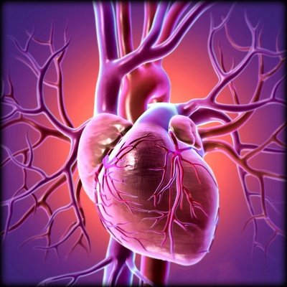
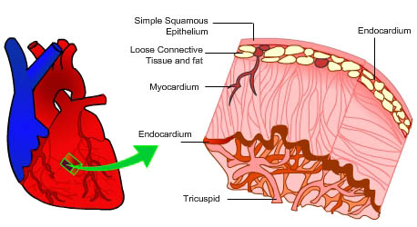
THE ENDOCARDIUM
Index
The endocardium is the innermost layer of tissue that lines the chambers of the heart.

Slide 12
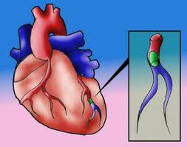
THE MYOCARDIUM
Index
It`s the middle layer of the hearth , made of cardiac muscle, contracts to push out blood.

Slide 13
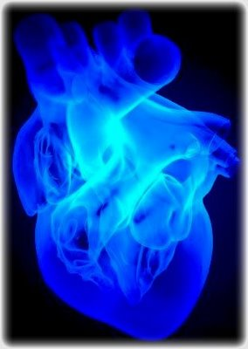
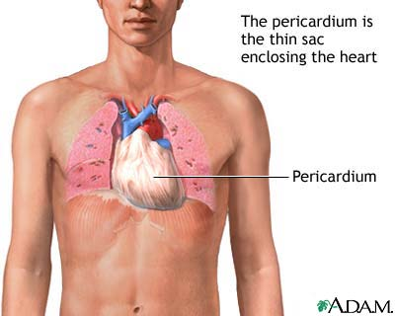
THE PERICARDIUM
Index
It`s a double walled sac that contains the heart and the roots of the great vessels.

Slide 14
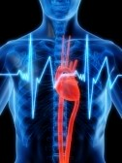
PHYSIOLOGY OF THE CARDIOVASCULAR SYSTEM
Index
HEART CONDUCTION SYSTEM
CARDIAC CYCLE
HEART SOUNDS

Slide 15
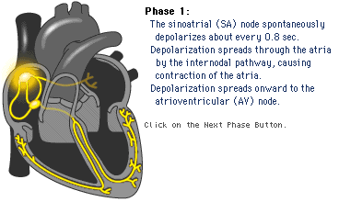
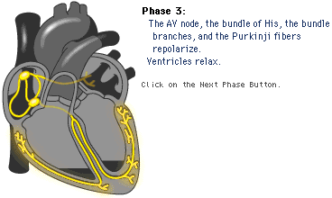
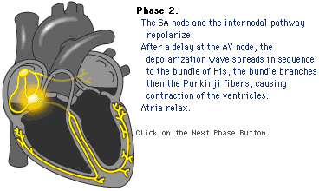
Index
The sinusal node its be inside to right atrium stimulates bouth atriums
Conduction System of Heart
HEART CONDUCTION SYSTEM
The purkinges fibres stimulate the ventricle wall muscle.
The atrium ventricular node originates the “haz of his” is divided in two branches (right and left) this branches stimulates the ventricles.

Slide 16
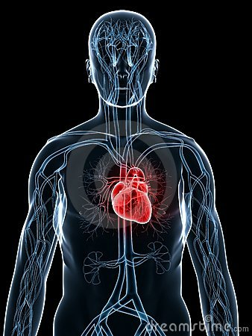
Index
CARDIAC CYCLE

Slide 17
Index
THE CARDIAC CYCLE
Is divided in to
Minor Circulation
Major Circulation

Slide 18
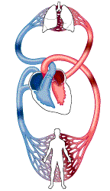
Minor Circulation
Index
The right ventricle send blood to the pulmonary artery.
The pulmonary artery send the blood to the lungs where blood is oxygenated.
The pulmonary veins send the oxygenated blood to the left atrium.

Slide 19
Major Circulation
Index
The left ventricle contracts and send oxygenated blood to the aorta.
The aorta pass the blood oxygenated to the arterioles and the capillaries.
The superior and inferior cava veins returns the blood to the right atrium.

Slide 20
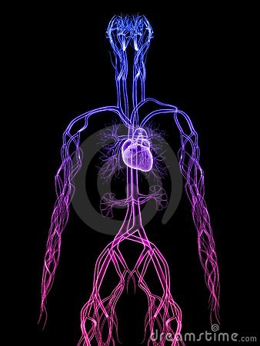
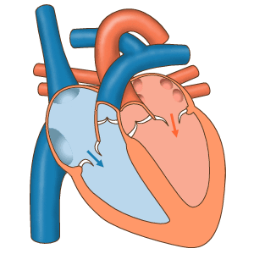
CARDIAC SOUNDS
Index
THE HEART HAVE TWO SOUNDS
SYSTOLE
DIASTOLE
It`s the first sound because indicate the entry of blood in the ventricles.
It`s the secound sound when the outflow of the blood to every parts of the body.

Slide 21
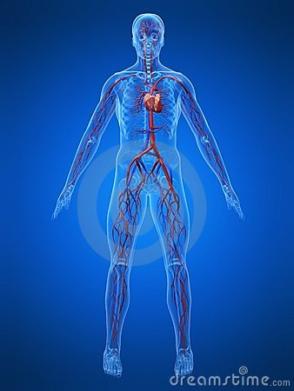
Index
THEY ARE THE ROUTES OF THE BLOOD CONDUCTION
Arteries
Capillaries
Veins
Blood Vessels
Arteries
CALLED
Capillaries
Veins

Slide 22
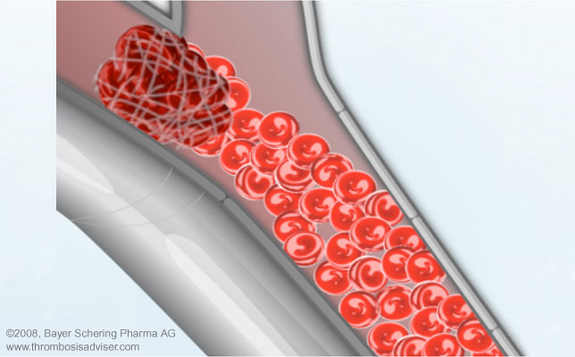
ARTERIES
Index
The principal function is transport the oxigenated blood to all the body
An artery is a elastic blood vessels that transport blood aways of the heart.

Slide 23
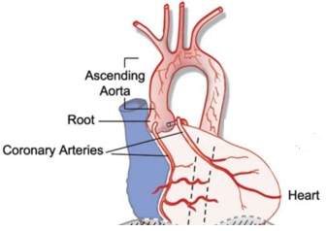
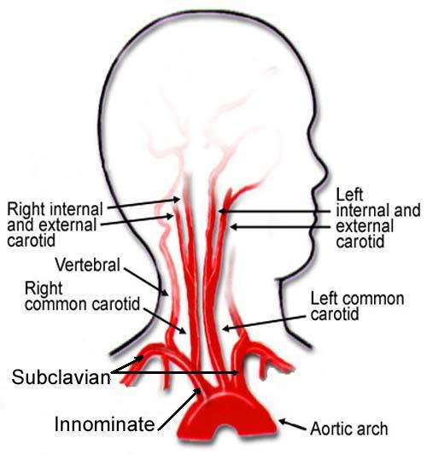
Index
PRINCIPAL ARTERIES
Ascending Aorta
Aortic Arch

Slide 24
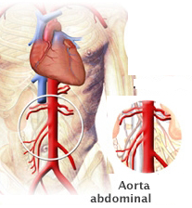
DESCENDANT AORTA
Index
thoracic aorta
Abdominal aorta

Slide 25
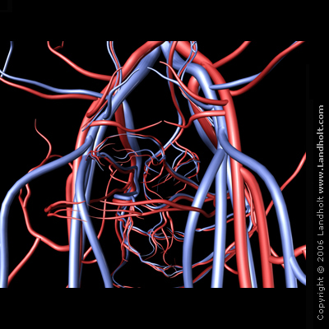
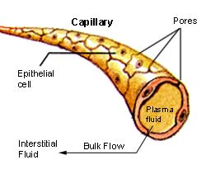
CAPILLARIES
Index
Microscopic blood vessels where exchange of nutrients with tissues.

Slide 26
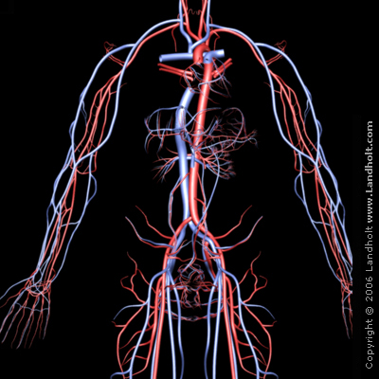
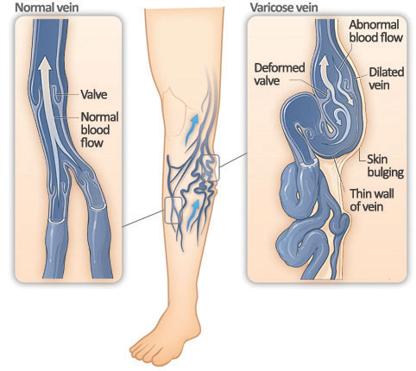
VEINS
Index
A vein is a vessel that carries blood low in oxigen content from the body back to the heart

Slide 27
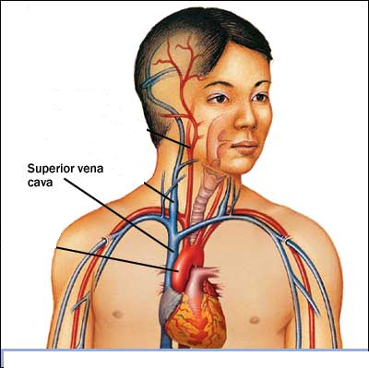
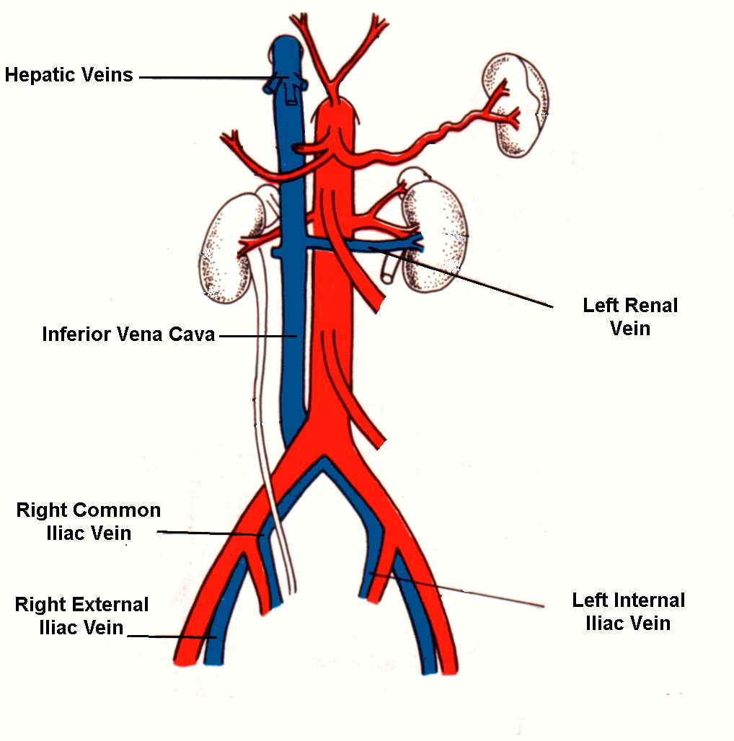
Index
PRINCIPAL VEINS
SUPERIOR CAVA VEIN
INFERIOR CAVA
VEIN

Slide 28
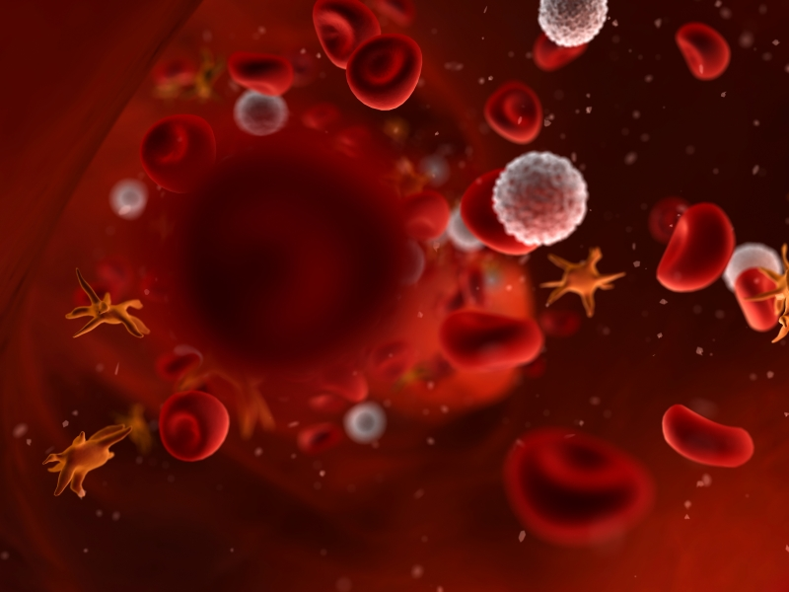
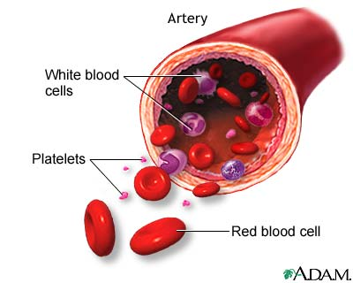
THE BLOOD
BLOOD CELLS
Red Blood Cells (RBCs)
White Blood Cells (WBCs)
PLASMA
It`s the watery portion of blood that makes it a fluid.
Index
It`s a specialized tissue of body that exists in fluid form.
Platelets

Slide 29
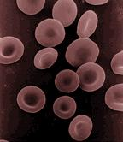
RED BLOOD CELLS (RBCs)
Index
They are the most common type of blood cell
They transport the oxygen and the nutrients to all the tissues of the body

Slide 30
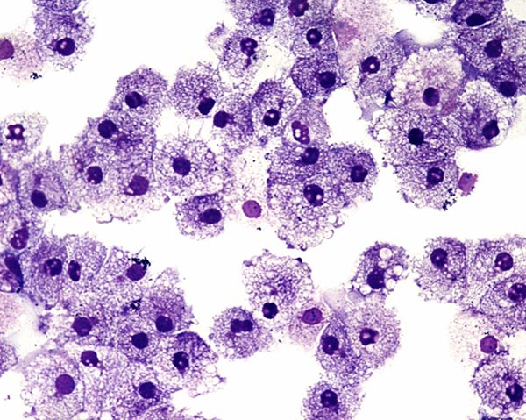
White Blood Cells (WBCs)
They are cells of the immune system involved in defendin the body against both infectious disease and foreign materials.

Slide 31
Index
White Blood Cells (WBCs)
Is divided in
THE GRANULOCYTES
THE AGRANULOCYTES
Neutrophil
Lymphocyte
Eosinophil
Monocyte
Basophil

Slide 32
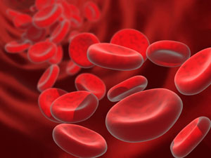
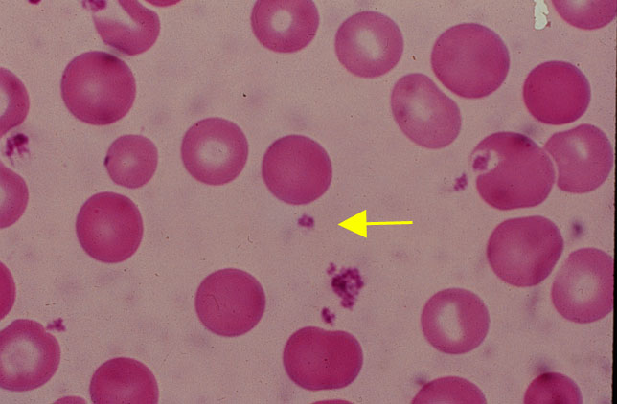
THE PLATELETS
Index
Platelets, or thrombocyte are small irregular fragments of cell .
They are important to the coagulation of the blood

Slide 33
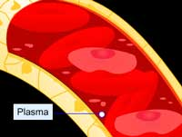
CHARACTERISTICS OF BLOOD PLASMA
Index
Contains water proteins, glucose, clotting factors, mineral ions, hormones and carbon dioxide.
It makes up about 55% of the total blood volume.
Blood plasma is the straw-colored liquid

Slide 34
IMPORTANCE OF THE CARDIOVASCULAR SYSTEM
Index
Transporting blood, nutrients and oxygen (O2) to all parts of the body.
Collect the waste products and carbon dioxide (CO2).

Slide 35
GOD BLESS YOU

