Slide 1
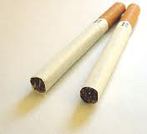
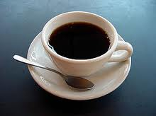
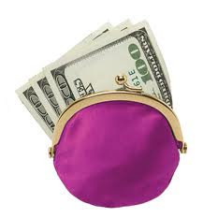
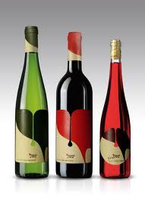
How much- How many?
How much
How many
How much
coffee do you need to drink?
I need some money.
do I need?
cigarettes do you smoke a day?
bottles of
wine do you drink?
How many
How many
How much
Vocabulary
Wine ( noun)
Coffee (noncount noun, noun)
Cigarettes (noncount noun, noun)
Bottles (noun)

