Slide 1
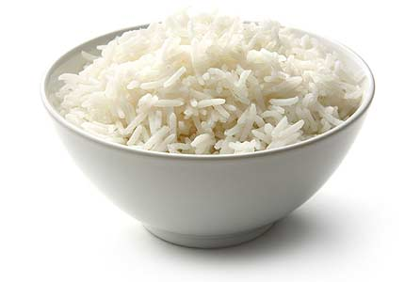
April 27,2012 Using How many and How much with countable and uncountable nouns
"How many“
for questions using countable or plural objects.
Examples: How many books do you have?
How many apples are there in the basket?
"How much"
for questions using a non-countable or singular object.
Examples: How much juice is left?
How much rice is there?

