Slide 1
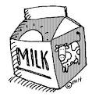

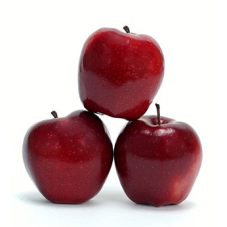



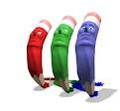

How much How many
Used with non-count nouns.
Used with count nouns
1- How much milk do you want?
2- How much sugar is left in the bowl?
3- How much time do you need?
1- How many apples do you see?
2- How many birds can you feed?
3-How many books do you use?
More Non-count nouns:
Air Water Soup
Love Salt Food
More count nouns:
Chairs Rulers Fans
Pages Erasers Computers

