Slide 1
Emergency Phone Numbers

Slide 2
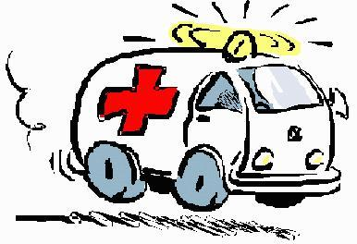
For the ambulance
131

Slide 3
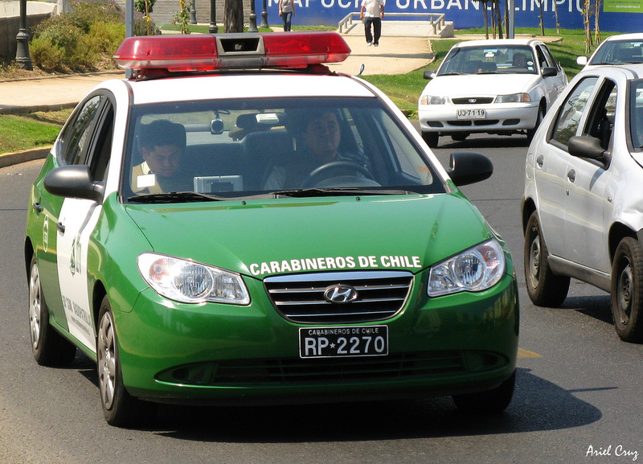
For policemen
133

Slide 4
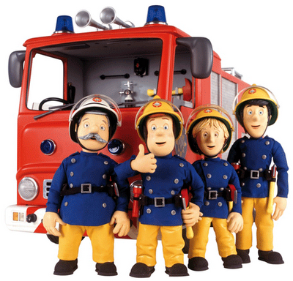
For fire fighters
132

Slide 5
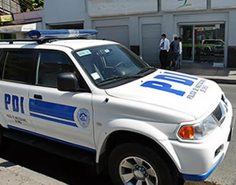
For Investigation Police
134

