Slide 1
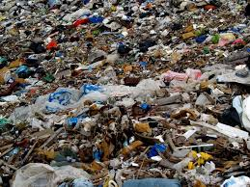
Waste

Slide 2
Waste
Write down on a piece of paper what comes to your mind when somebody mentions the word waste?

Slide 3
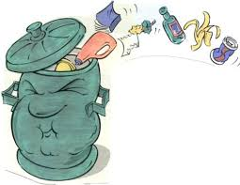
What is Waste?
Is the unwanted material that individuals and industries throw away.
EU legal definition of waste is:
“An object the holder discards, intends to discard or is required to be discard”
The UN Environment Programme defines waste as:
“Wastes are substances or objects, which are disposed of or are intended to be disposed of or are required to be disposed of by the provision of national law”

Slide 4
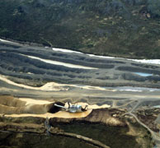
Creation of waste
Waste is created at any point of the life cycle of a product.
During the extraction of raw materials,
During the processing of the raw materials,
During the production of goods,
During the consumption of goods.

Slide 5
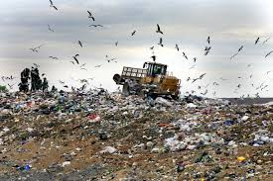
Different types of waste
Municipal waste
Hazardous waste
Bio-medical waste
Special Hazardous waste

Slide 6
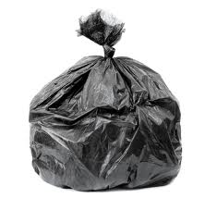
Municipal waste
Is everyday refuse/rubbish disposed by :
Households
Industries
Construction

Slide 7
Municipal Waste

Slide 8
Hazardous waste
Is waste that poses substantial or potential threats to public health or the environment. Hazardous waste is known to be made up of one or more of the characteristics below:
ignitability (i.e., flammable)
reactivity
corrosively
toxicity

Slide 9
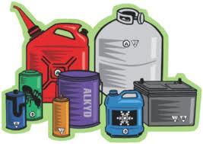
Hazards Waste
Hazards waste can be created by individuals and industries.
Example dry cleaning material, photo processing material, automobile servicing or repairs, hospital waste, detergents, pest control products etc.

Slide 10
Bio-medical Waste

Slide 11
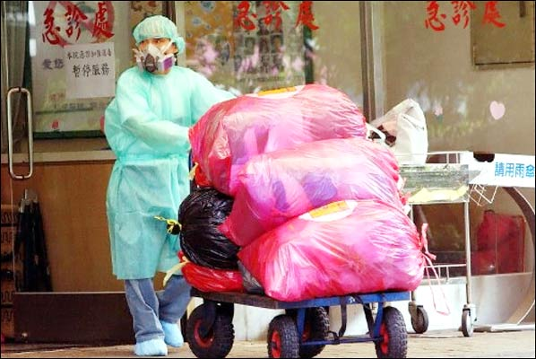
Bio-Medical Waste
Bio-medical waste consists of solids, liquids, sharps, and laboratory waste that are potentially infectious or dangerous.
Bio-waste is normally produced in hospital and clinics.
The best way to dispose of bio-medical waste is by using inclinators.

Slide 12
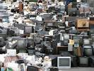
Special Hazardous Waste
Includes:
Radioactive waste
Explosive Waste
Electronic Waste /e-waste

Slide 13
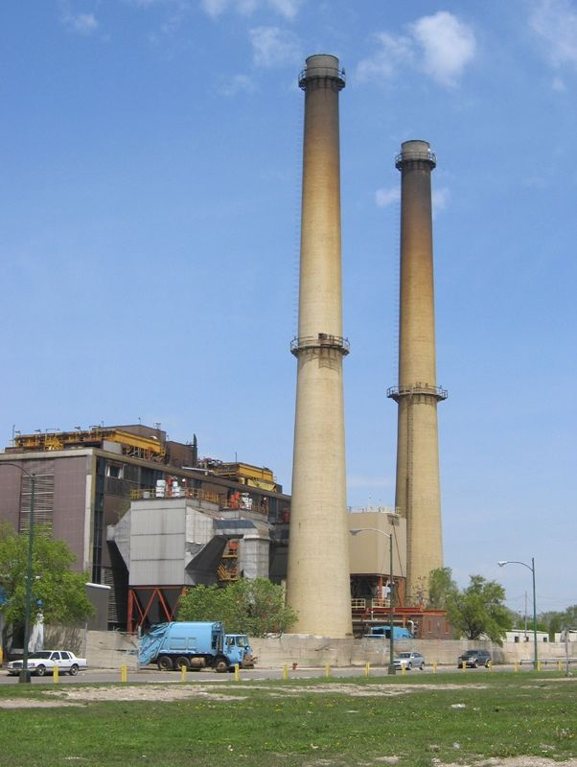
Waste Disposal
Landfills
Incinerator
Recycling

Slide 14
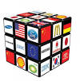
Waste is costly on the
Environment
Society
Economy

