Slide 1
Nicolás

Slide 2
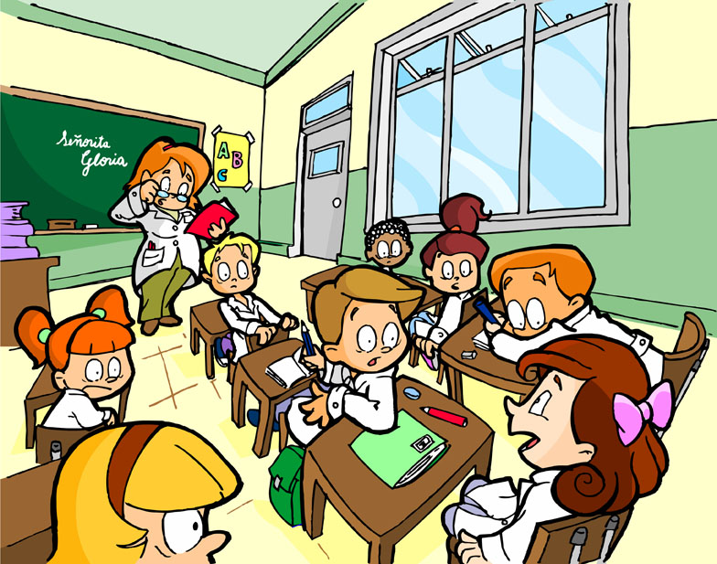
Andoni
Xabier
Joaquin
Miguel
Manu
Luis
Javier
Gabriel
Adrian
Eduardo

