Slide 1


Slide 2

cancion
Highway to hell
(1979)

Slide 3

Living easy, living free
season ticket on a one-way ride
asking nothing, leave me be
taking everything in my stride
don't need reason, don't need rhyme
ain't nothing i would rather do
going down, party time
my friends are gonna be there too

Slide 4
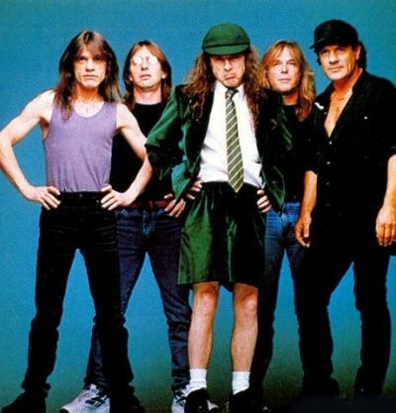
I'm on the highway to hell
No stop signs, speed limit
nobody's gonna slow me down
like a wheel, gonna spin it
nobody's gonna mess me round
hey satan, paid my dues
playing in a rocking band

Slide 5
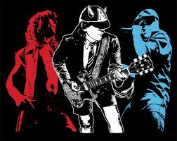
hey momma, look at me
i'm on my way to the promised land
I'm on the highway to hell
(don't stop me)
And i'm going down, all the way down
i'm on the highway to hell

Slide 6

https://www.youtube.com/watch?v=TIAOnuYv-VQ&list=PL35BF506CC5CBE669

Slide 7


