Slide 1
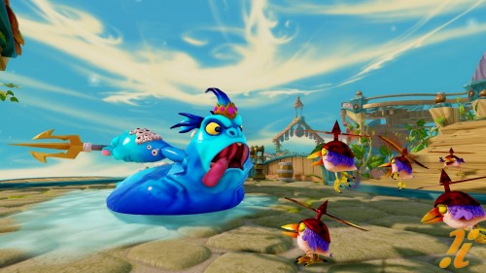
Rubén

Slide 2
OTTO
TELMO
LUCAS
HUGO
PELAYO
ALEX
RUBEN M
DANIEL
GILLERMO
RUBEN O

