Slide 1
Self-Portraits

Slide 2
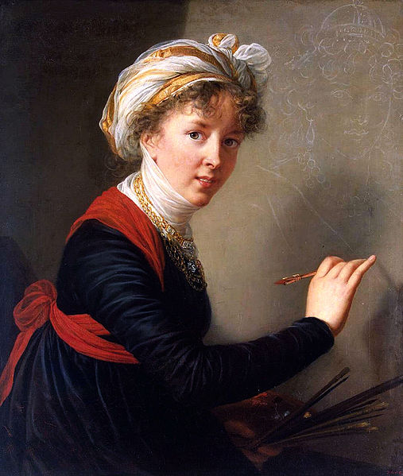
Louise-Élisabeth Vigée-Le Brun, 1800
Hermitage Museum, Saint Petersburg, Russia

Slide 3
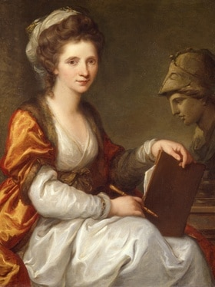
Angelica Kauffmann, 1780-1781
Bündner Kunstmuseum, Chur, Switzerland

Slide 4
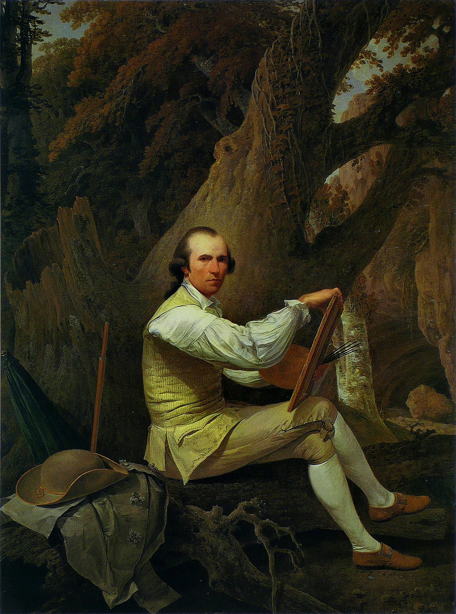
Jacob More, 1783
Uffizi Gallery, Florence, Italy

Slide 5
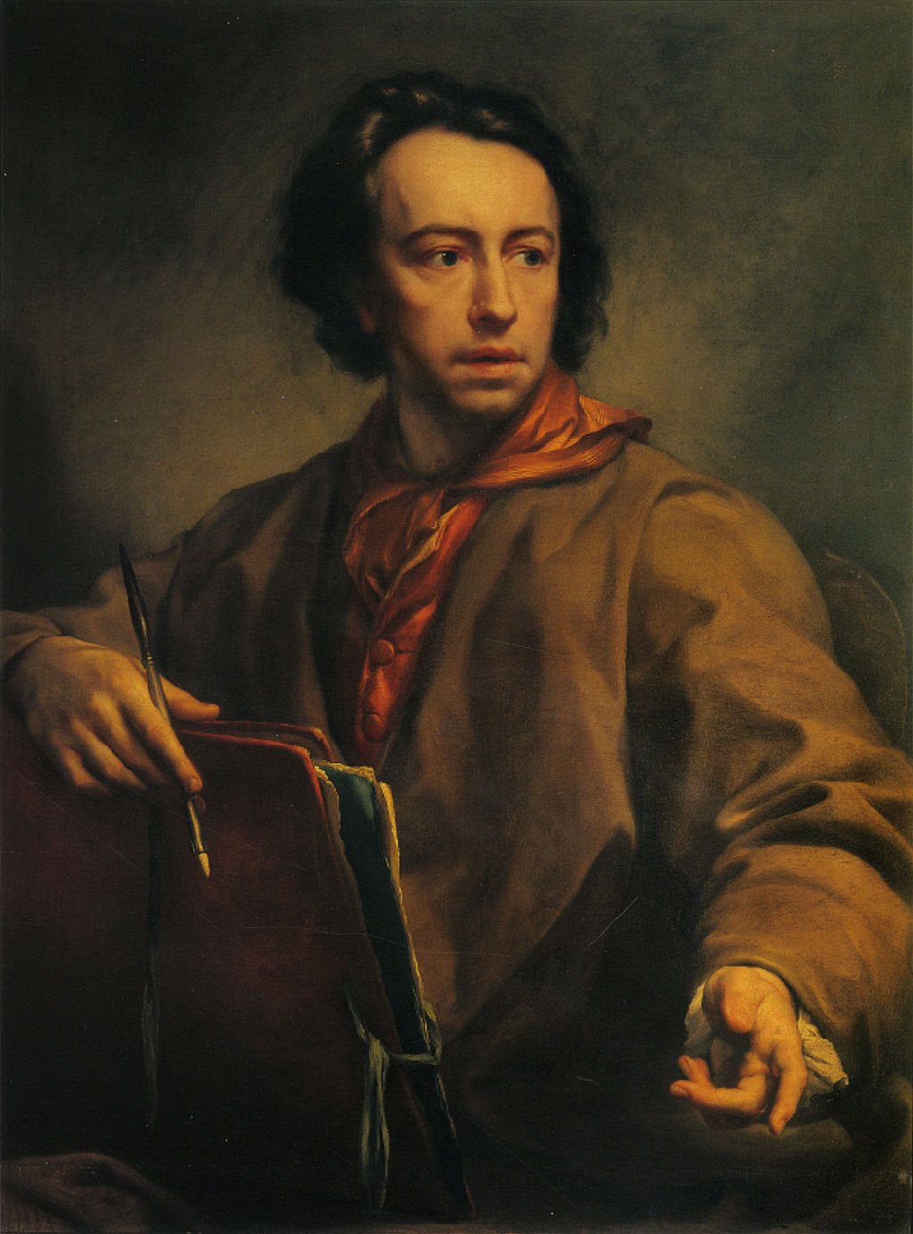
Anton Raphael Mengs, 1775
Uffizi Gallery, Florence, Italy

Slide 6
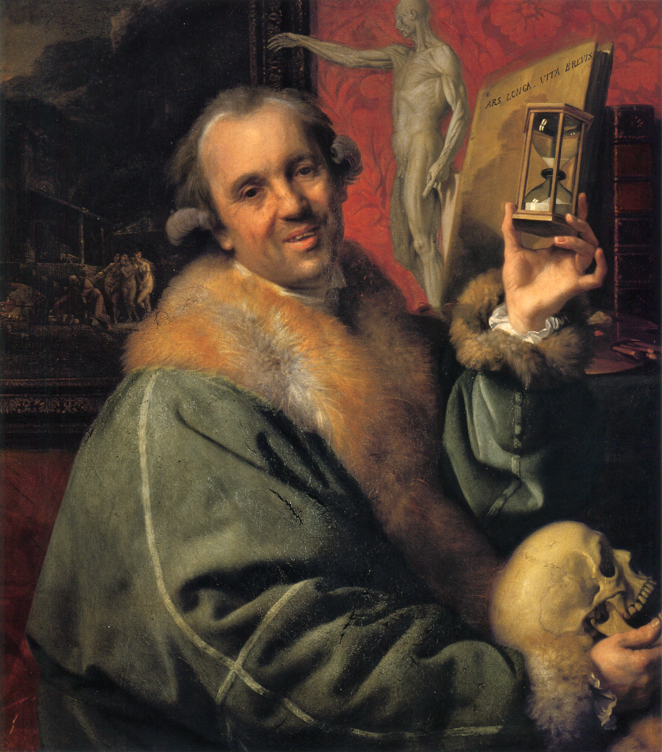
Johann Zoffany, 1776
Uffizi Gallery, Florence, Italy

